Slide 1
iTEAMS Mission and Goals
iTEAMS is designed to provide teachers with the tools to develop inquiry-based lessons, and the opportunity to develop a deep understanding of implementation of NGSS and Common Core through support from a team of faculty led by both San Francisco State and the Exploratorium.
.

Slide 2
Next Generation Science Standards

Slide 3
Some questions about NGSS that came up yesterday…
When do we transition to it?
When is curriculum coming?
Will MS science be taught by discipline or be integrated?
What can we do now?

Slide 4
CALIFORNIA NGSS IMPLEMENTATION TIMELINE
Year | Implementation Plan | Framework & Instructional Materials | Implementation Activities | Assessment
2014- 2015 |  | (Sept ‘14- Feb ‘15) Framework development meetings (Apr-Nov ‘15) Draft reviewed by public
2016- 2017 |  | Jan ’16- SBE action on IQC’s recommended Science Framework | 2017 Anticipated implementation of NGSS in CA schools | Anticipated Recommendation to the SBE on Science Assessment
2017- 2018 |  | Anticipated Instructional Materials Adoption
Notes:
NGSS adopted by SBE on September 4, 2013
July/Aug 2014 Presentation of final draft of CA NGSS Implementation Plan to State Board of Education (SBE)
SSPI recommends CA NGSS Implementation Plan to SBE

Slide 5
Will MS science be taught by discipline or be integrated?
SBE was expected to vote on integrated science back in November, but instead introduced an alternative plan in response to teacher feedback in opposition to the integrated framework
School districts can either teach integrated science or continue to separate the disciplines
Notes:
Teachers were very concerned about the lack of curriculum materials and the amount of professional development required to make the new method work.
Too much while they’re already implementing new Common Core State Standards and the overall Next Generation Science Standards.
----- Meeting Notes (6/19/14 08:54) -----
→ What will happen to AP courses??
Interdisciplinary in one but not in other state or school district- kids moving b/w and w/in states affected?
Text books? Will publishers make the appropriate materials?

Slide 6
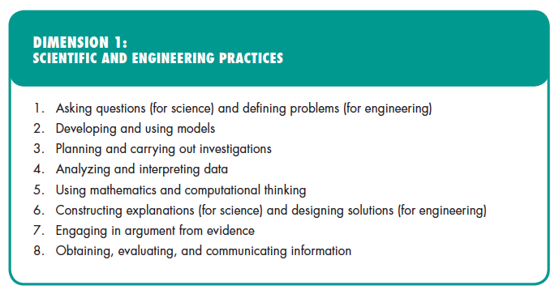

Slide 7
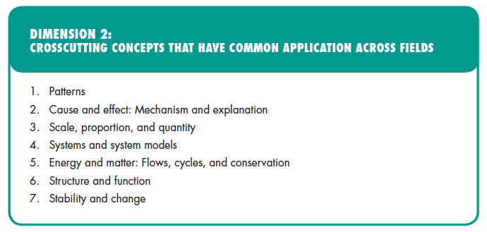

Slide 8
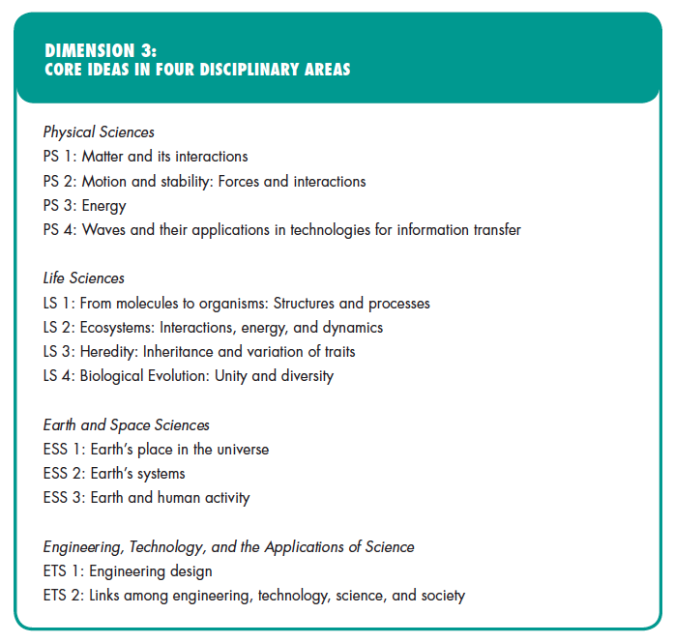
Notes:
DCI From molecule to organisms: structures and processes=> Topic: Structure, Function, and Information Processing
DCI Ecosystems: interactions, energy and dyanmics => Under Topic: Interdependent Relationships in Ecosystems: Animals, Plants, and Their Environment

Slide 9
Topic vs. DCI Arrangement?
“At the beginning of the Framework design process, the writers arranged disciplinary core ideas into topics around which to develop the standards eliminate potential redundancy, seek an appropriate grain size, and seek natural connections
In response to previous public feedback, the coding structure of individual performance expectations has changed to be based on the same DCI arrangement as the Framework.
Topic name retained to allow easy comparisons and many states prefer the topical arrangement”
Notes:
go back to the last slide and give a couple of examples

Slide 10
Designing and Using Models
Notes:
For end of day debrief

Slide 11
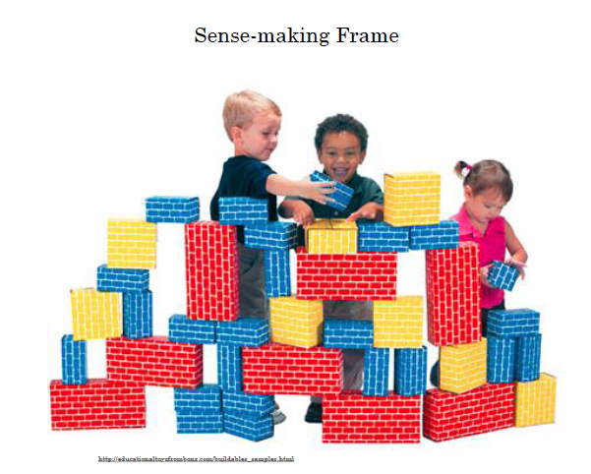
Implementation of the practices requires a fundamental shift
From an “information” frame for instruction
“Knowing About”
To a “sense making” frame for instruction
“Figuring Out”
Cindy Passmore, Associate Professor, UC Davis
Notes:
This addresses the “student centered” question

Slide 12
Scientific and Engineering Practices
Asking Questions (in science)/Defining problems (in engineering)
Planning and carrying out Investigations
Constructing Explanations (in science) &
Designing Solutions (in engineering)
Analyzing and Interpreting Data
Obtaining, Evaluating & Communicating Information
Using Mathematics and Computational Reasoning
Developing and using models
Engaging in Argument from Evidence
Framework:
“ Engaging in the full range of scientific practices helps students understand how scientific knowledge develops
and gives them an appreciation of the wide range of approaches that are used to investigate, model,
and explain the world.
Similarly, engaging in the practices of engineering helps students understand the
work of engineers and the links between engineering and science.”
Notes:
Practices are highly interconnected and that the practices are at the core of “figuring out.”
Students need to be engaged in the practices to make sense of the core ideas
(Modeling makes a pretty good anchor for all of the other practices).

Slide 13
Developing and Using Models in Science
Models are representations of sets of ideas that can be used to explain, predict, and make sense of phenomena
Modeling is when students are actively engaged in grappling with ideas which can explain a given phenomena. In this process, learners engage in:
Developing a model that explains or answers a question
Evaluating that model against empirical evidence
Using the model to illustrate, predict and explain
Revising that model as new evidence is gathered
Cindy Passmore, Associate Professor, UC Davis
Notes:
Important to make explicit to students:
Why are we doing this? To construct an explanation to answer a question we have about natural phenomena
Why in groups? Collaborative efforts needed throughout the process in science and engineering

Slide 14
Why engage students in modeling?
Framework: this practices helps learners to “establish, extend, and refine knowledge”
Modeling helps students build
subject matter understanding- models make invisible processes, mechanisms and components visible and testable
understanding of the way science works- testing and revising models of systems and processes used in science and engineering
practices and skills- systems thinking; collaboration, sharing and evaluating ideas; thinking about evidence and mechanisms
Cindy Passmore, Associate Professor, UC Davis
Notes:
Often not explicit in a text book, which makes science seem like a collection of facts (and that these facts are never changing).

Slide 15
Asking Questions (in science)/ Defining problems (in engineering)
Planning and carrying Out Investigations
Constructing Explanations (in science) & Designing Solutions (in engineering)
Analyzing and Interpreting Data
Obtaining, Evaluating & Communicating Information
Using Mathematics and Computational Reasoning
Developing and using models
Engaging in Argument from Evidence
Notes:
Think back to the black box activity: in what other practices did you engage?
Focus on the interactions between the three main practices:
Models/Constructing explanations/engaging in argument from data

Slide 16
Asking Questions (in science)/ Defining problems (in engineering)
Planning and carrying Out Investigations
Constructing Explanations (in science) & Designing Solutions (in engineering)
Analyzing and Interpreting Data
Obtaining, Evaluating & Communicating Information
Using Mathematics and Computational Reasoning
Developing and using models
Engaging in Argument from Evidence
Notes:
But really, you engaged in all of the practices… Developing models could be used as an “anchor” practice

Slide 17
Math
Science
M4. Models with mathematics
S2: Develop & use models
S5: Use mathematics & computational thinking
M1: Make sense of problems and persevere in solving them
M2: Reason abstractly & quantitatively
M6: Attend to precision
M7: Look for & make use of structure
M8: Look for & make use of regularity in repeated reasoning
S1: Ask questions and define problems
S3: Plan & carry out investigations
S4: Analyze & interpret data
S6: Construct explanations & design solutions
E2: Build a strong base of knowledge through content rich texts
E5: Read, write, and speak grounded in evidence
M3 & E4: Construct viable arguments and critique reasoning of others
S7: Engage in argument from evidence
E6: Use technology & digital media strategically & capably
M5: Use appropriate tools strategically
S8: Obtain, evaluate, & communicate information
E3: Obtain, synthesize, and report findings clearly and effectively in response to task and purpose
E1: Demonstrate independence in reading complex texts, and writing and speaking about them
E7: Come to understand other perspectives and cultures through reading, listening, and collaborations
Commonalities
Among the Practices in Science, Mathematics and English Language Arts
Based on work
by Tina Chuek
ell.stanford.edu
ELA
Notes:
iTEAMS curriculum is designed to support teachers in Math, Science and ELA – Common Core and NGSS standards.

Slide 18
Year 1: Bridges and Structures
Intensive Hours: 60 hours per year
SUMMER 2014 |  | 2014-15
June 18 – June 19 Marin County Office of Education 8:30 – 3:30 | August 12 – August 14 Exploratorium 9:00 – 3:00 (Bus- San Rafael High – Leaves 8:00 am) | 3 RELEASE DAYS: 8:30 -3:00 Marin Location Dates TBD
Continue to explore scientific and engineering practices and other NGSS related topics
Be introduced to content related to bridge building, structures, earthquakes etc.
Notes:
The CaMSP Grants are very strict that each teacher MUST participate in 84 hours per year. This includes this meeting (1 hour) plus the 5 days of summer PD and the 3 Release Days.
Teachers also must participate in 24 follow up hours per year. More guidance will be given about this after each session. This includes 3 coaching/observation sessions with our faculty per year plus paid collaborative time and paid online support time. Notes there will be coffee in the morning June 17 and June 18 and snack but please bring your lunch. You do NOT need to bring food to the Exploratorium.

