Slide 1
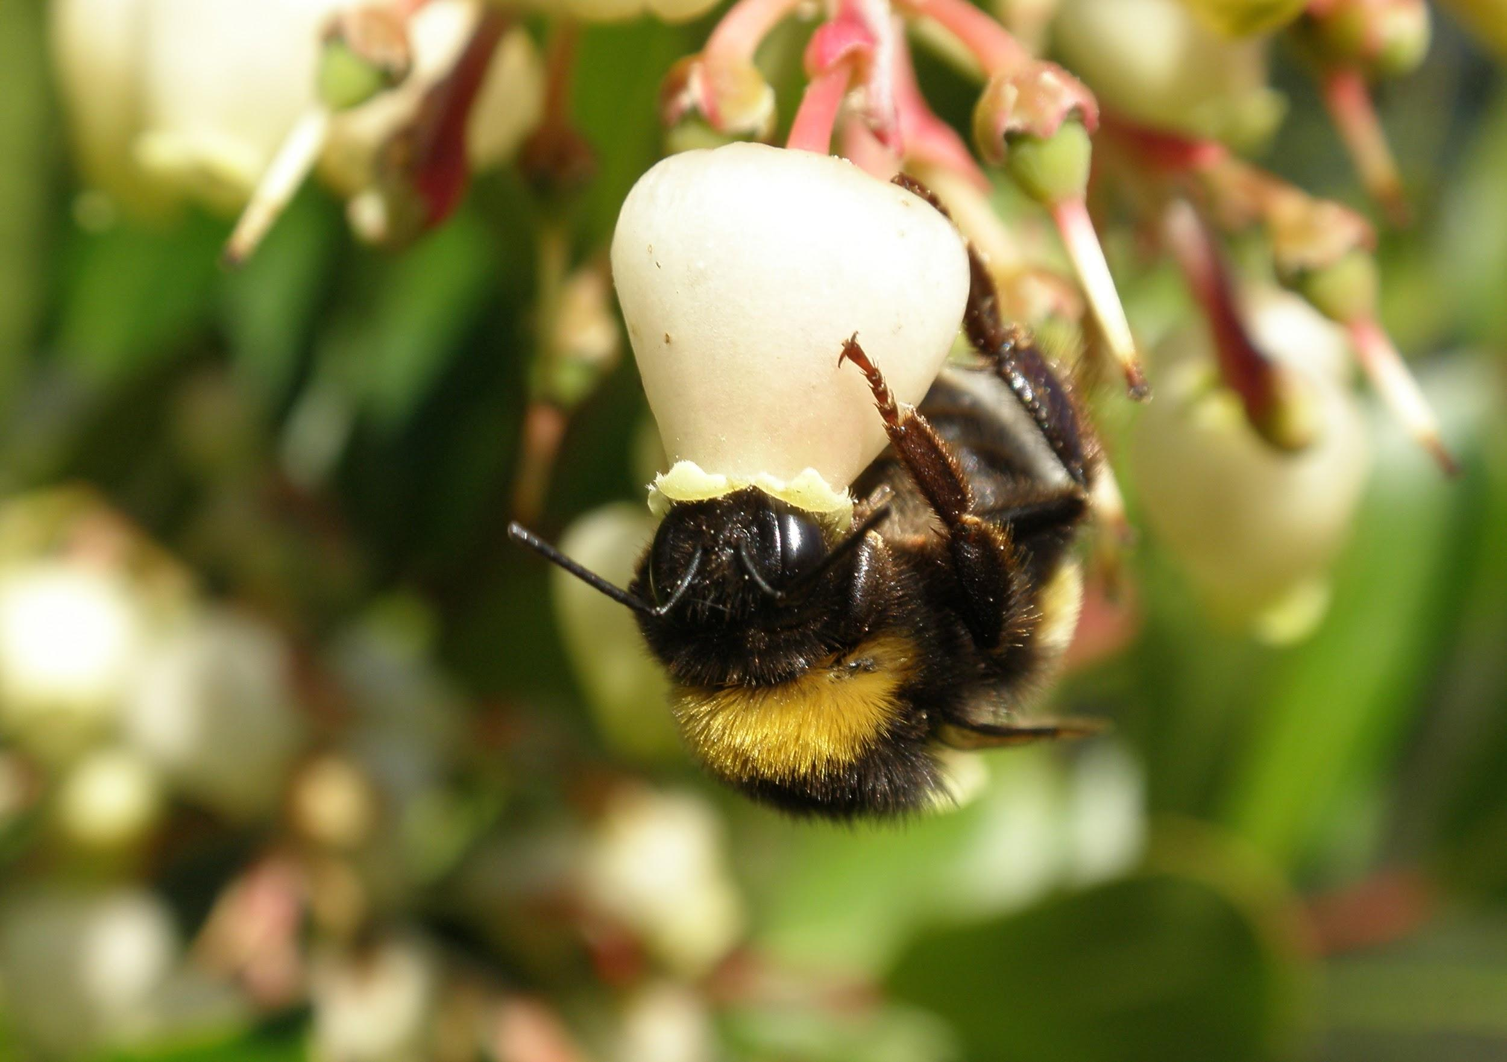
Pollinator Palooza

Slide 2
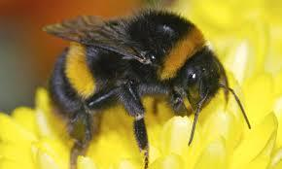
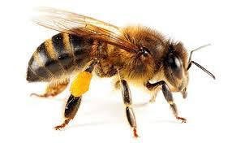
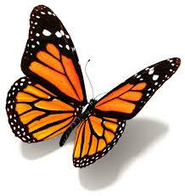
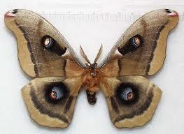
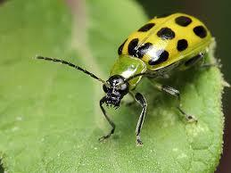
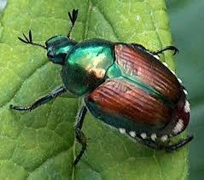
Types Of Pollinators
Bees
Butterflies/Moths
Beetles

Slide 3
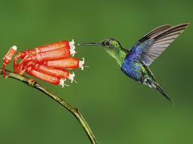
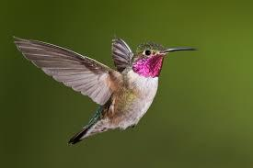
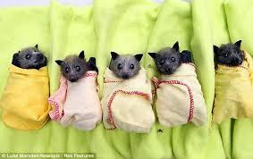
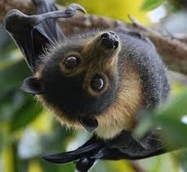
Types of Pollinators
Hummingbirds
Bats

Slide 4
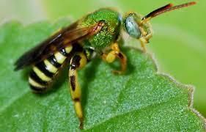
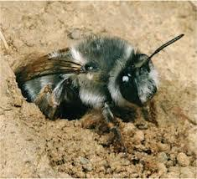
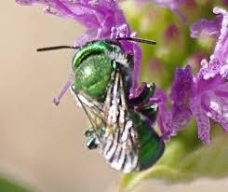
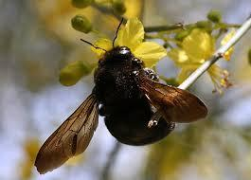
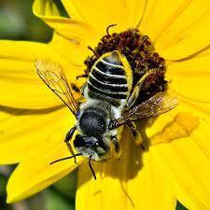
Have You Seen a Native Bee?

Slide 5
Flower Mechanisms for Pollination
http://www.saburchill.com/chapters/chap0042.html

Slide 6
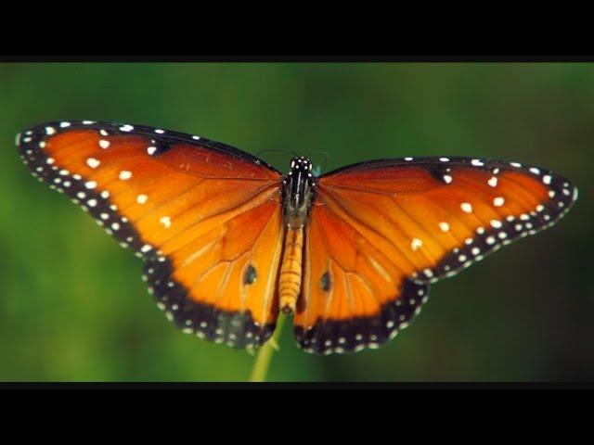
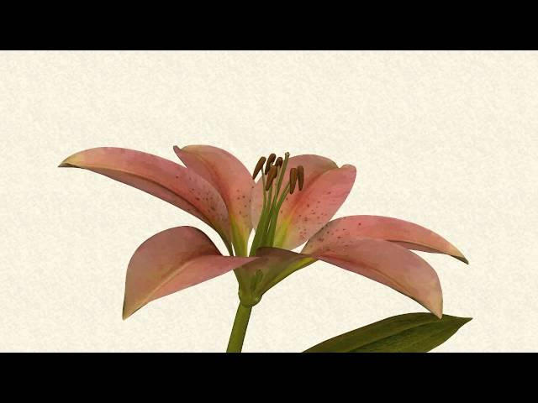
The Process of Pollination
Pollination: Moving Art
https://www.youtube.com/watch?v=MQiszdkOwuU#
Simple pollination
https://www.youtube.com/watch?v=26oq5tWrb2Q

Slide 7
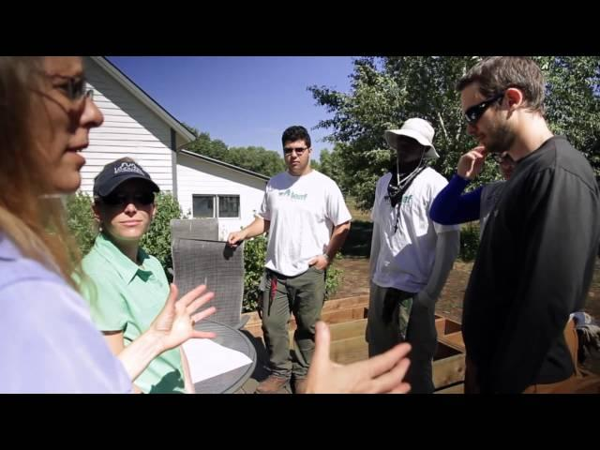
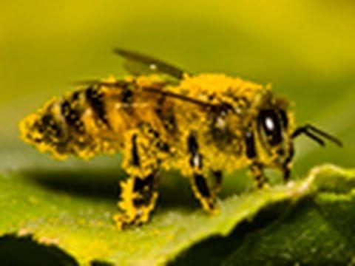
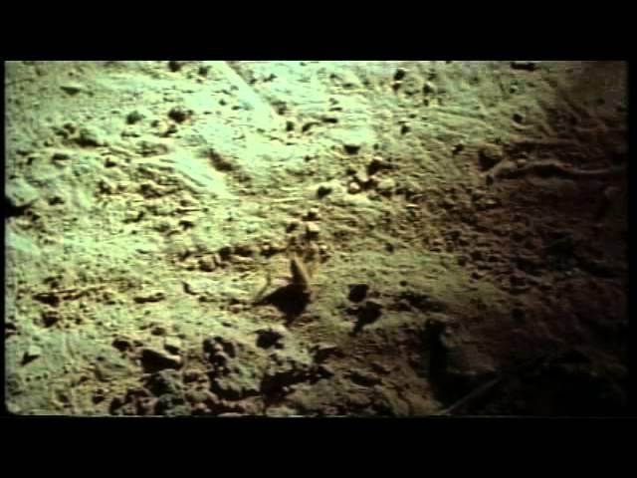
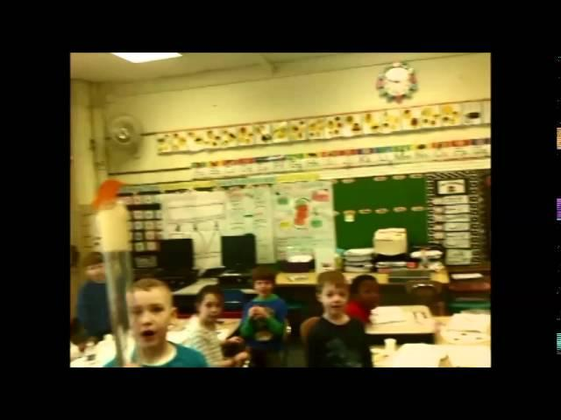
Importance of Pollinators
Food - https://www.youtube.com/watch?v=0hAR18ubIGs
https://www.youtube.com/watch?v=rmL_XTrPOMw
Bats - https://www.youtube.com/watch?v=hHqjJMJHeqA
Hand pollinator designs - https://www.youtube.com/watch?v=0IJqpJubXh8

Slide 8
Your Engineering Challenge
Design a hand pollinator that can successfully pollinate at least 2 different types of flowers.
Super Challenge: Pollinate 3-4 flower types.
Super Duper Challenge: Design/Build a 5th type of flower you can pollinate.

