Slide 1
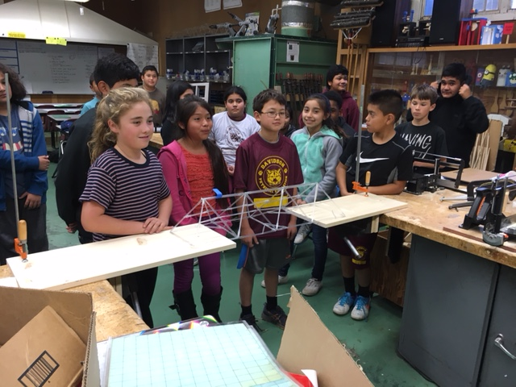
iTEAMS CELEBRATION 2017
EVALUATION REPORT
An Exploration of 3 Years of
iTEAMS & STEM Education in
Marin County & Beyond

Slide 2
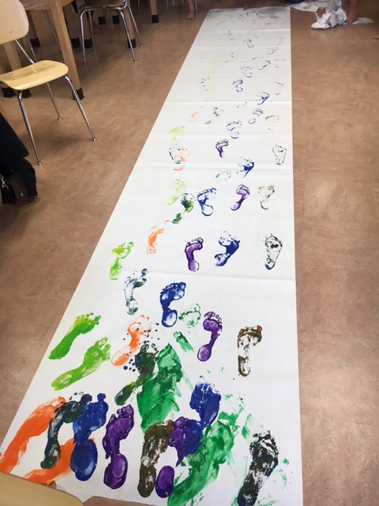
iTEAMS CELEBRATION

Slide 3
iTEAMS TEACHER REFLECTION

Slide 4
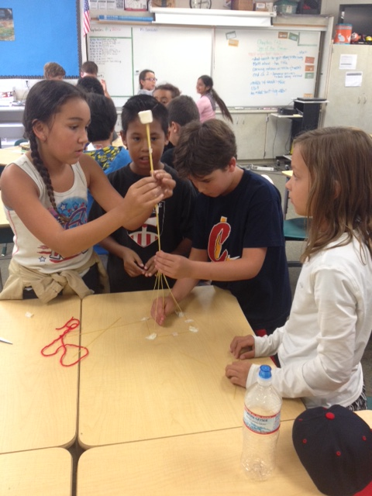
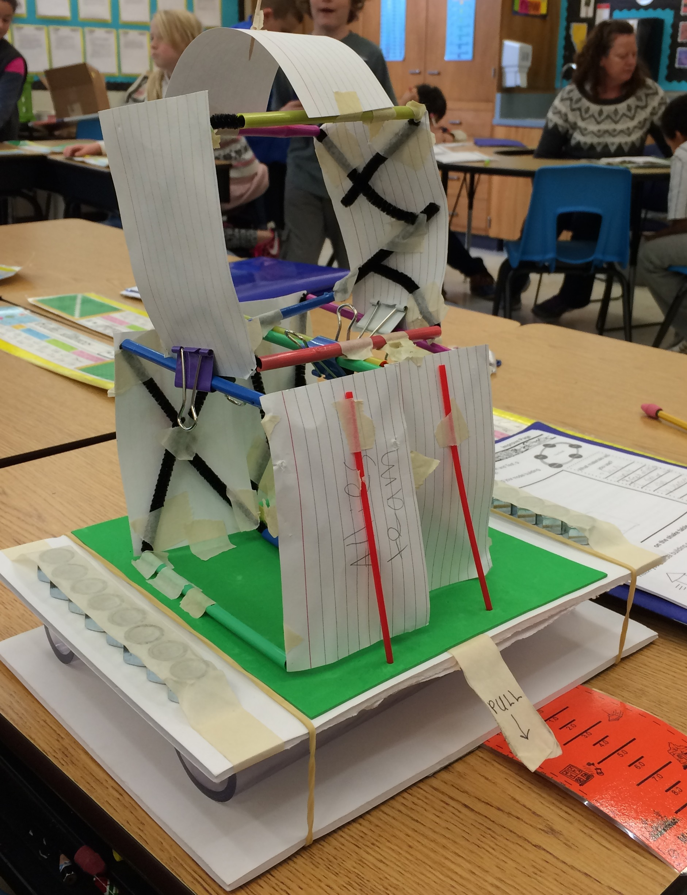
iTEAMS CELEBRATION

Slide 5
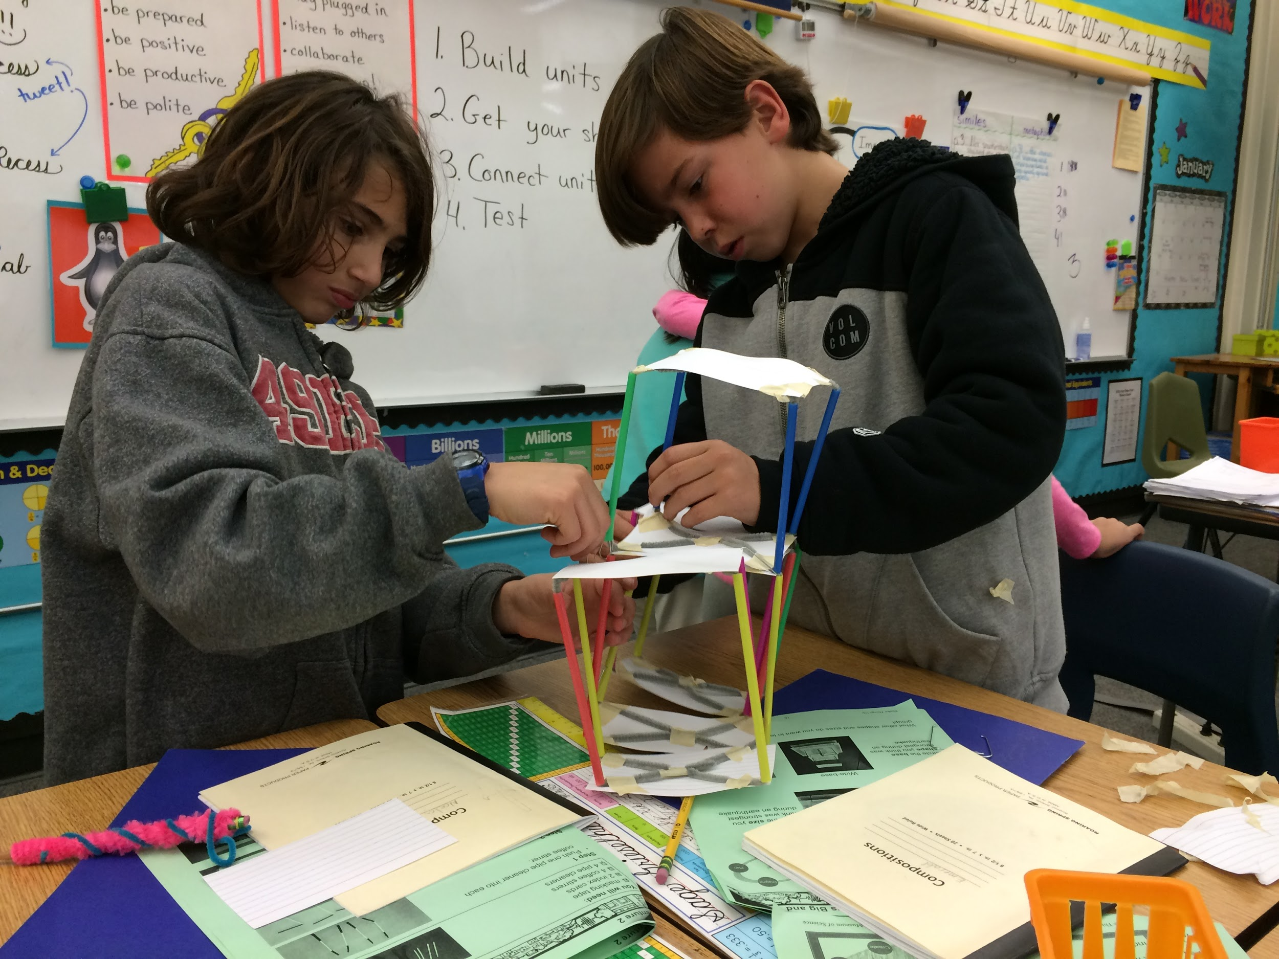
iTEAMS CELEBRATION

Slide 6
iTEAMS TEACHER REFLECTION

Slide 7
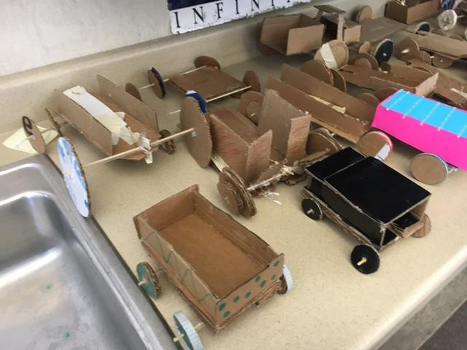
iTEAMS CELEBRATION

Slide 8
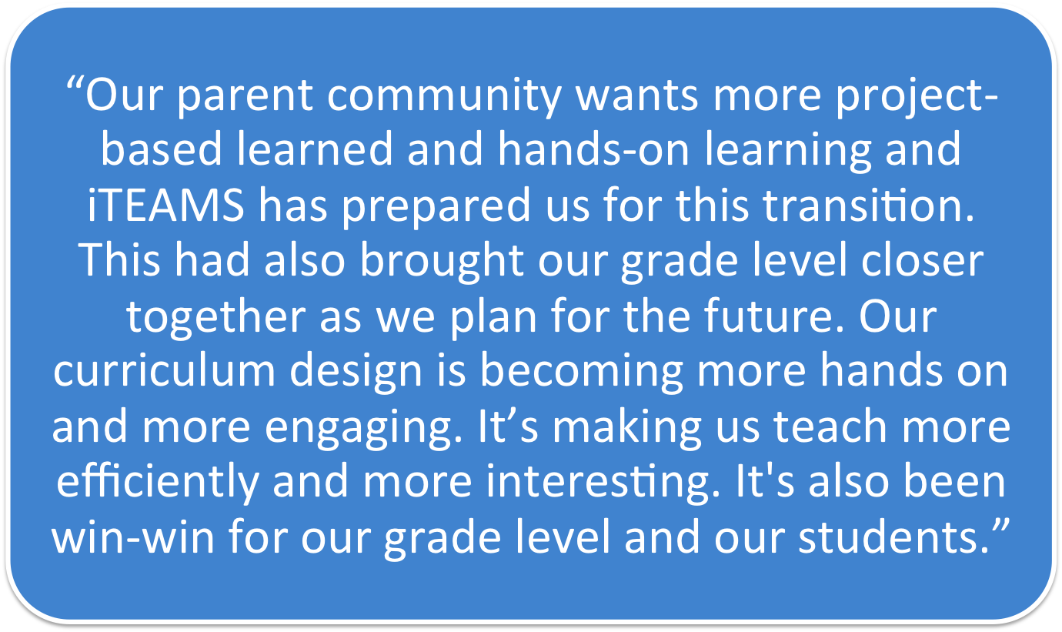
iTEAMS TEACHER REFLECTION

Slide 9
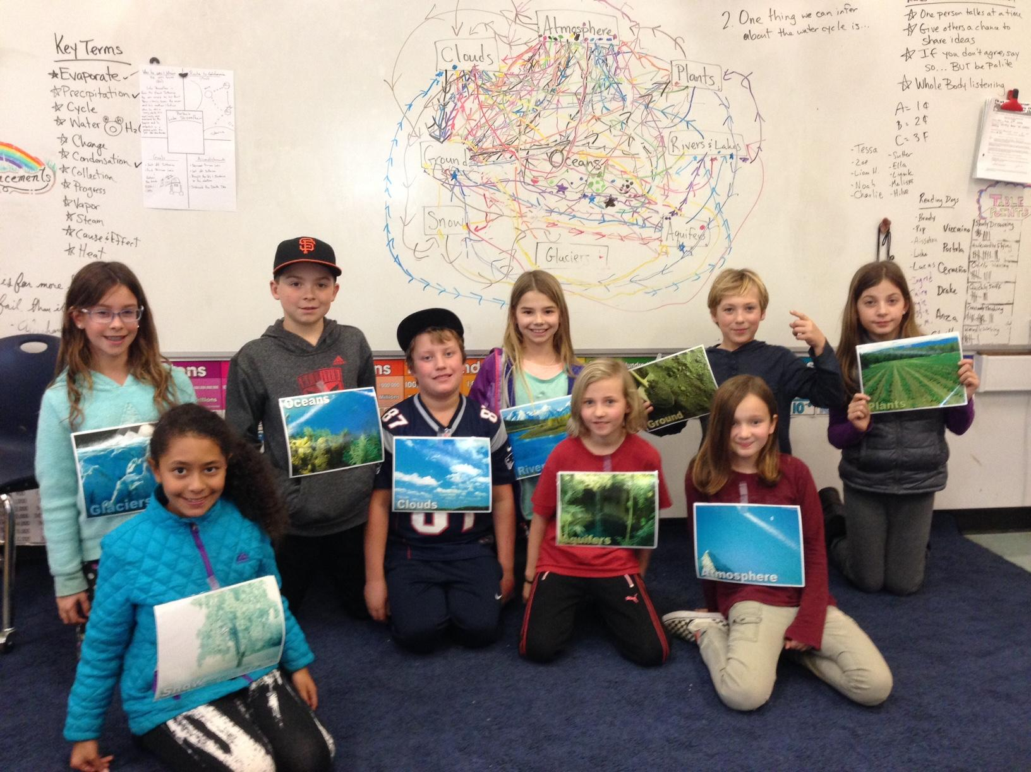
iTEAMS CELEBRATION

Slide 10
iTEAMS TEACHER REFLECTION

Slide 11
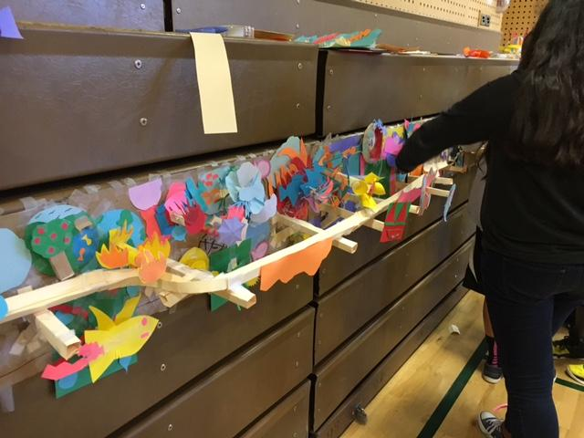
iTEAMS CELEBRATION

Slide 12
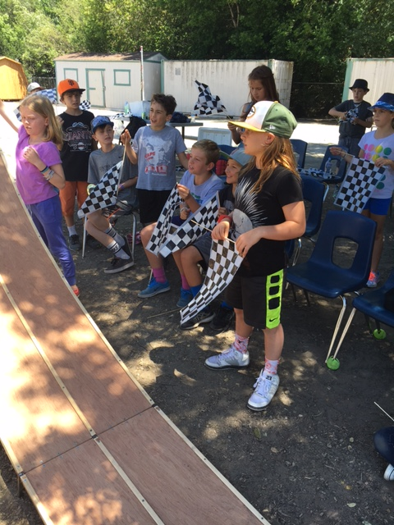
iTEAMS CELEBRATION

Slide 13
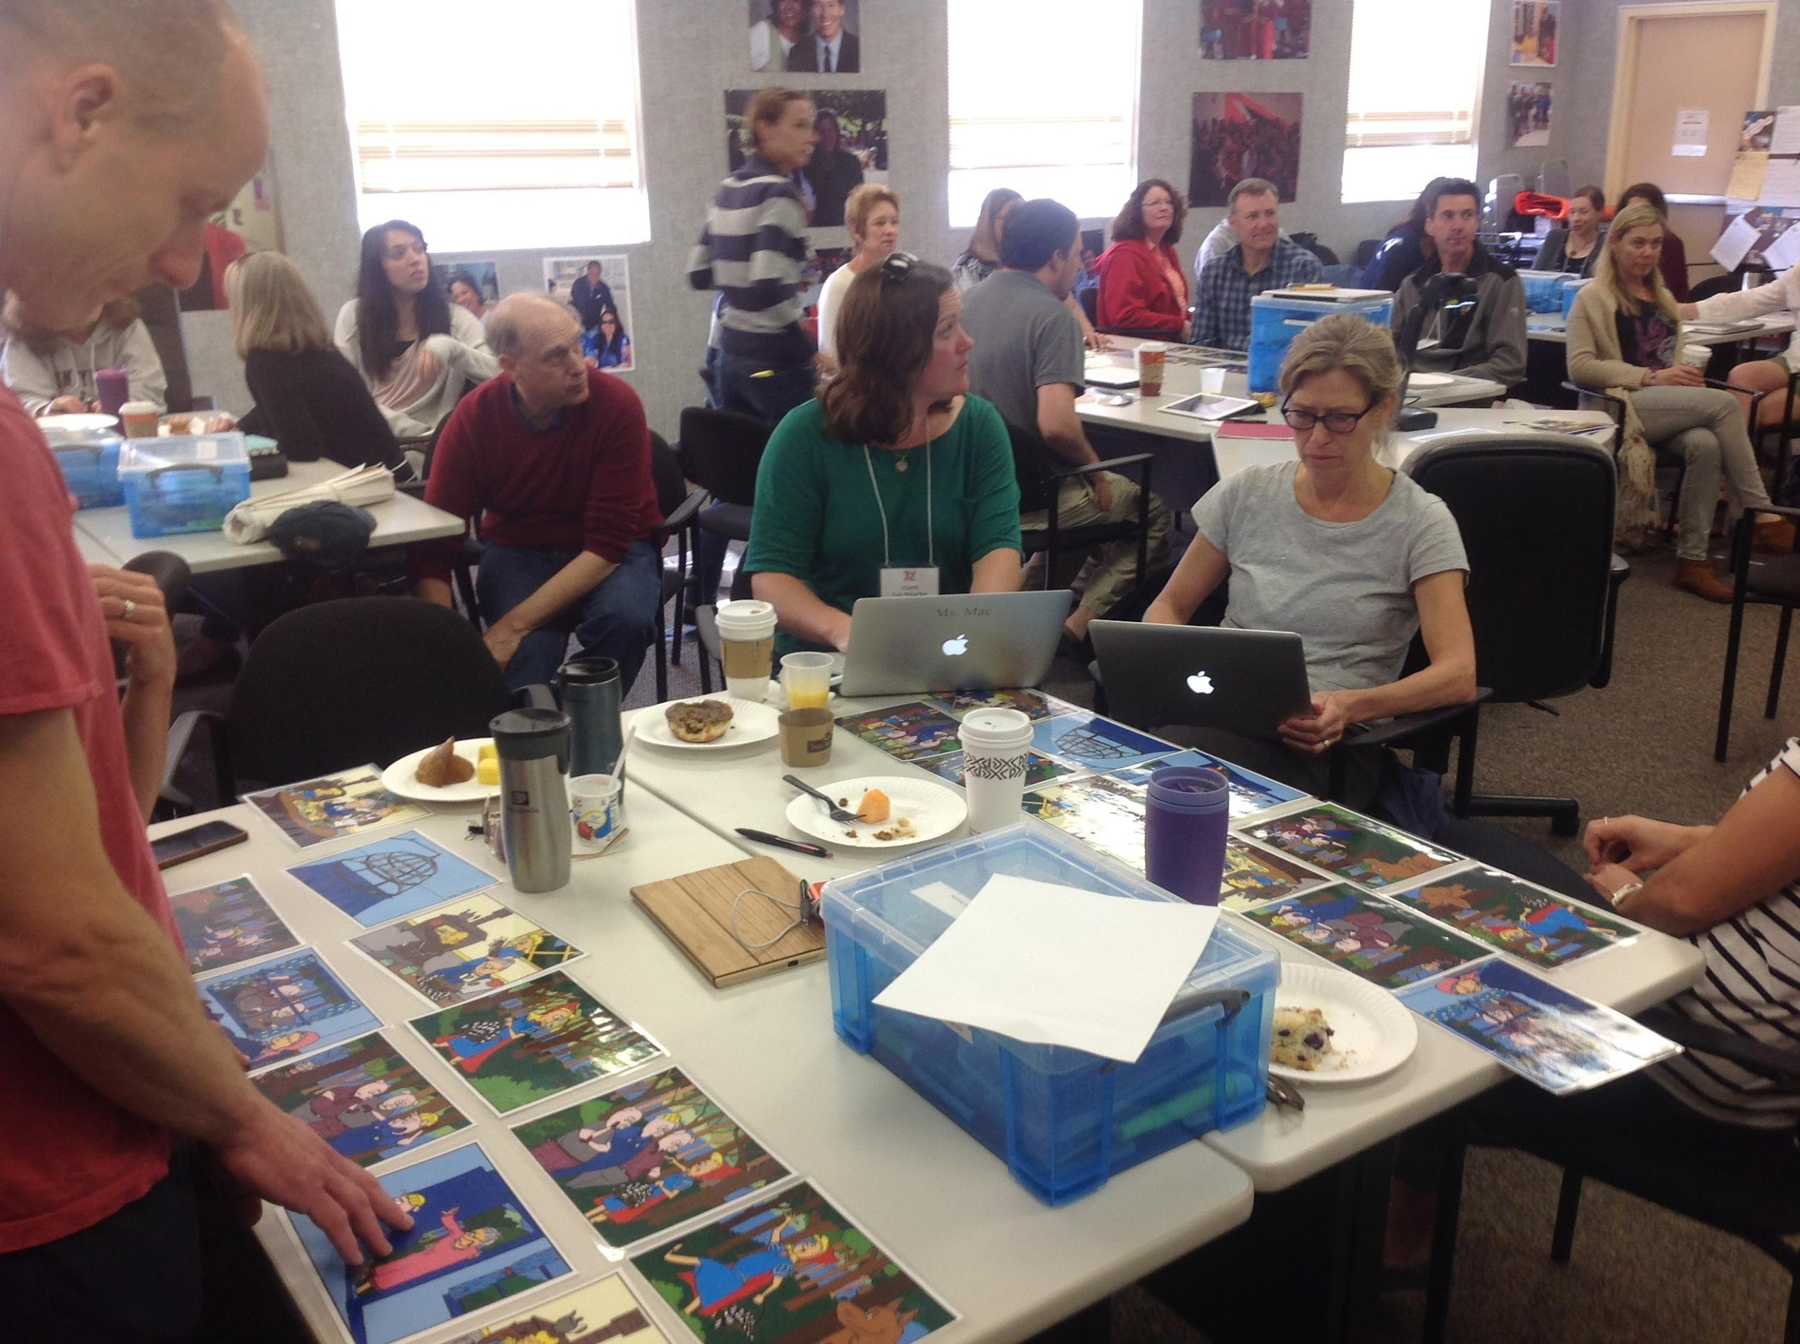
iTEAMS CELEBRATION

Slide 14
iTEAMS TEACHER REFLECTION

Slide 15
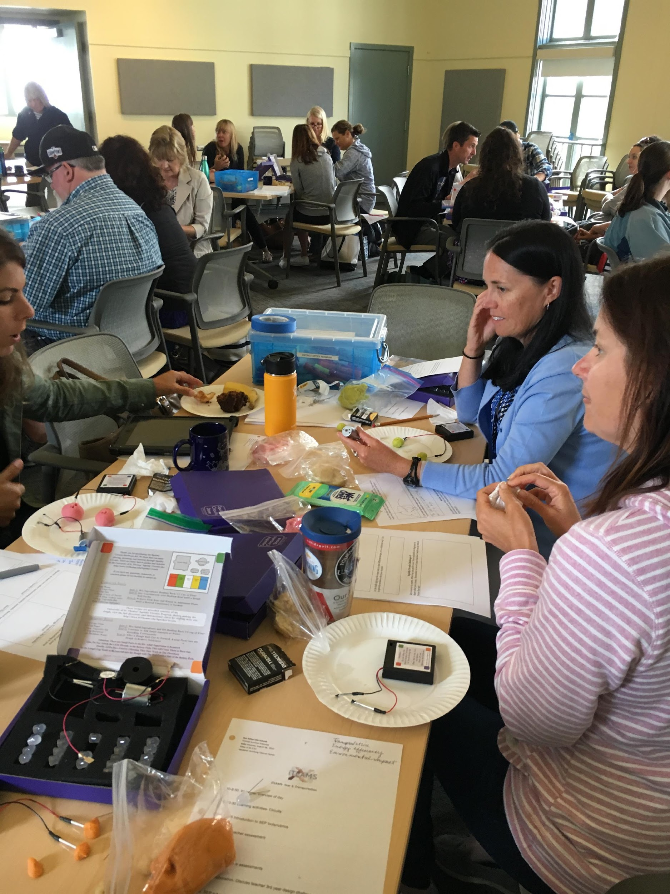
iTEAMS CELEBRATION
Notes:
Welcome.
15

Slide 16
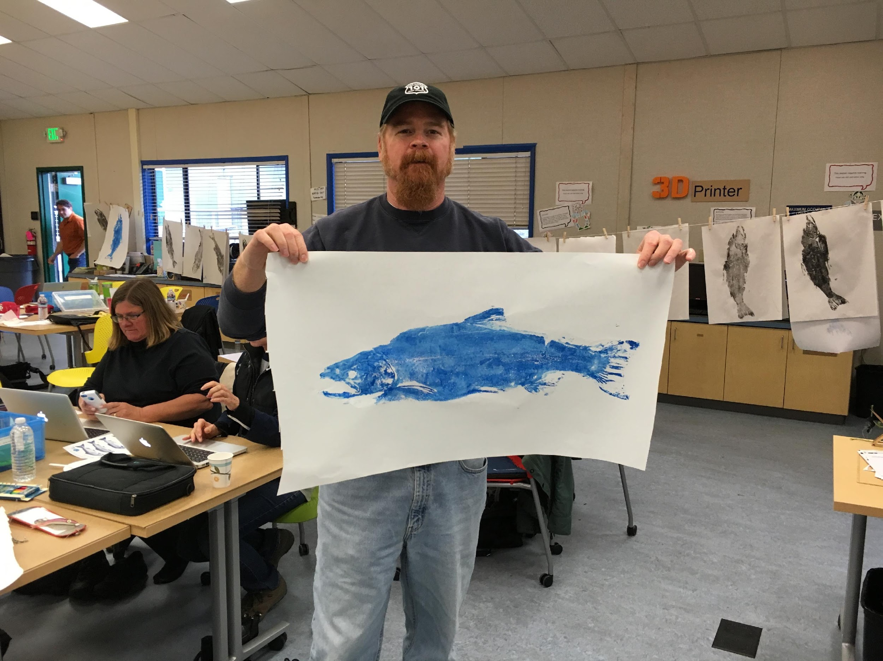
iTEAMS CELEBRATION

Slide 17
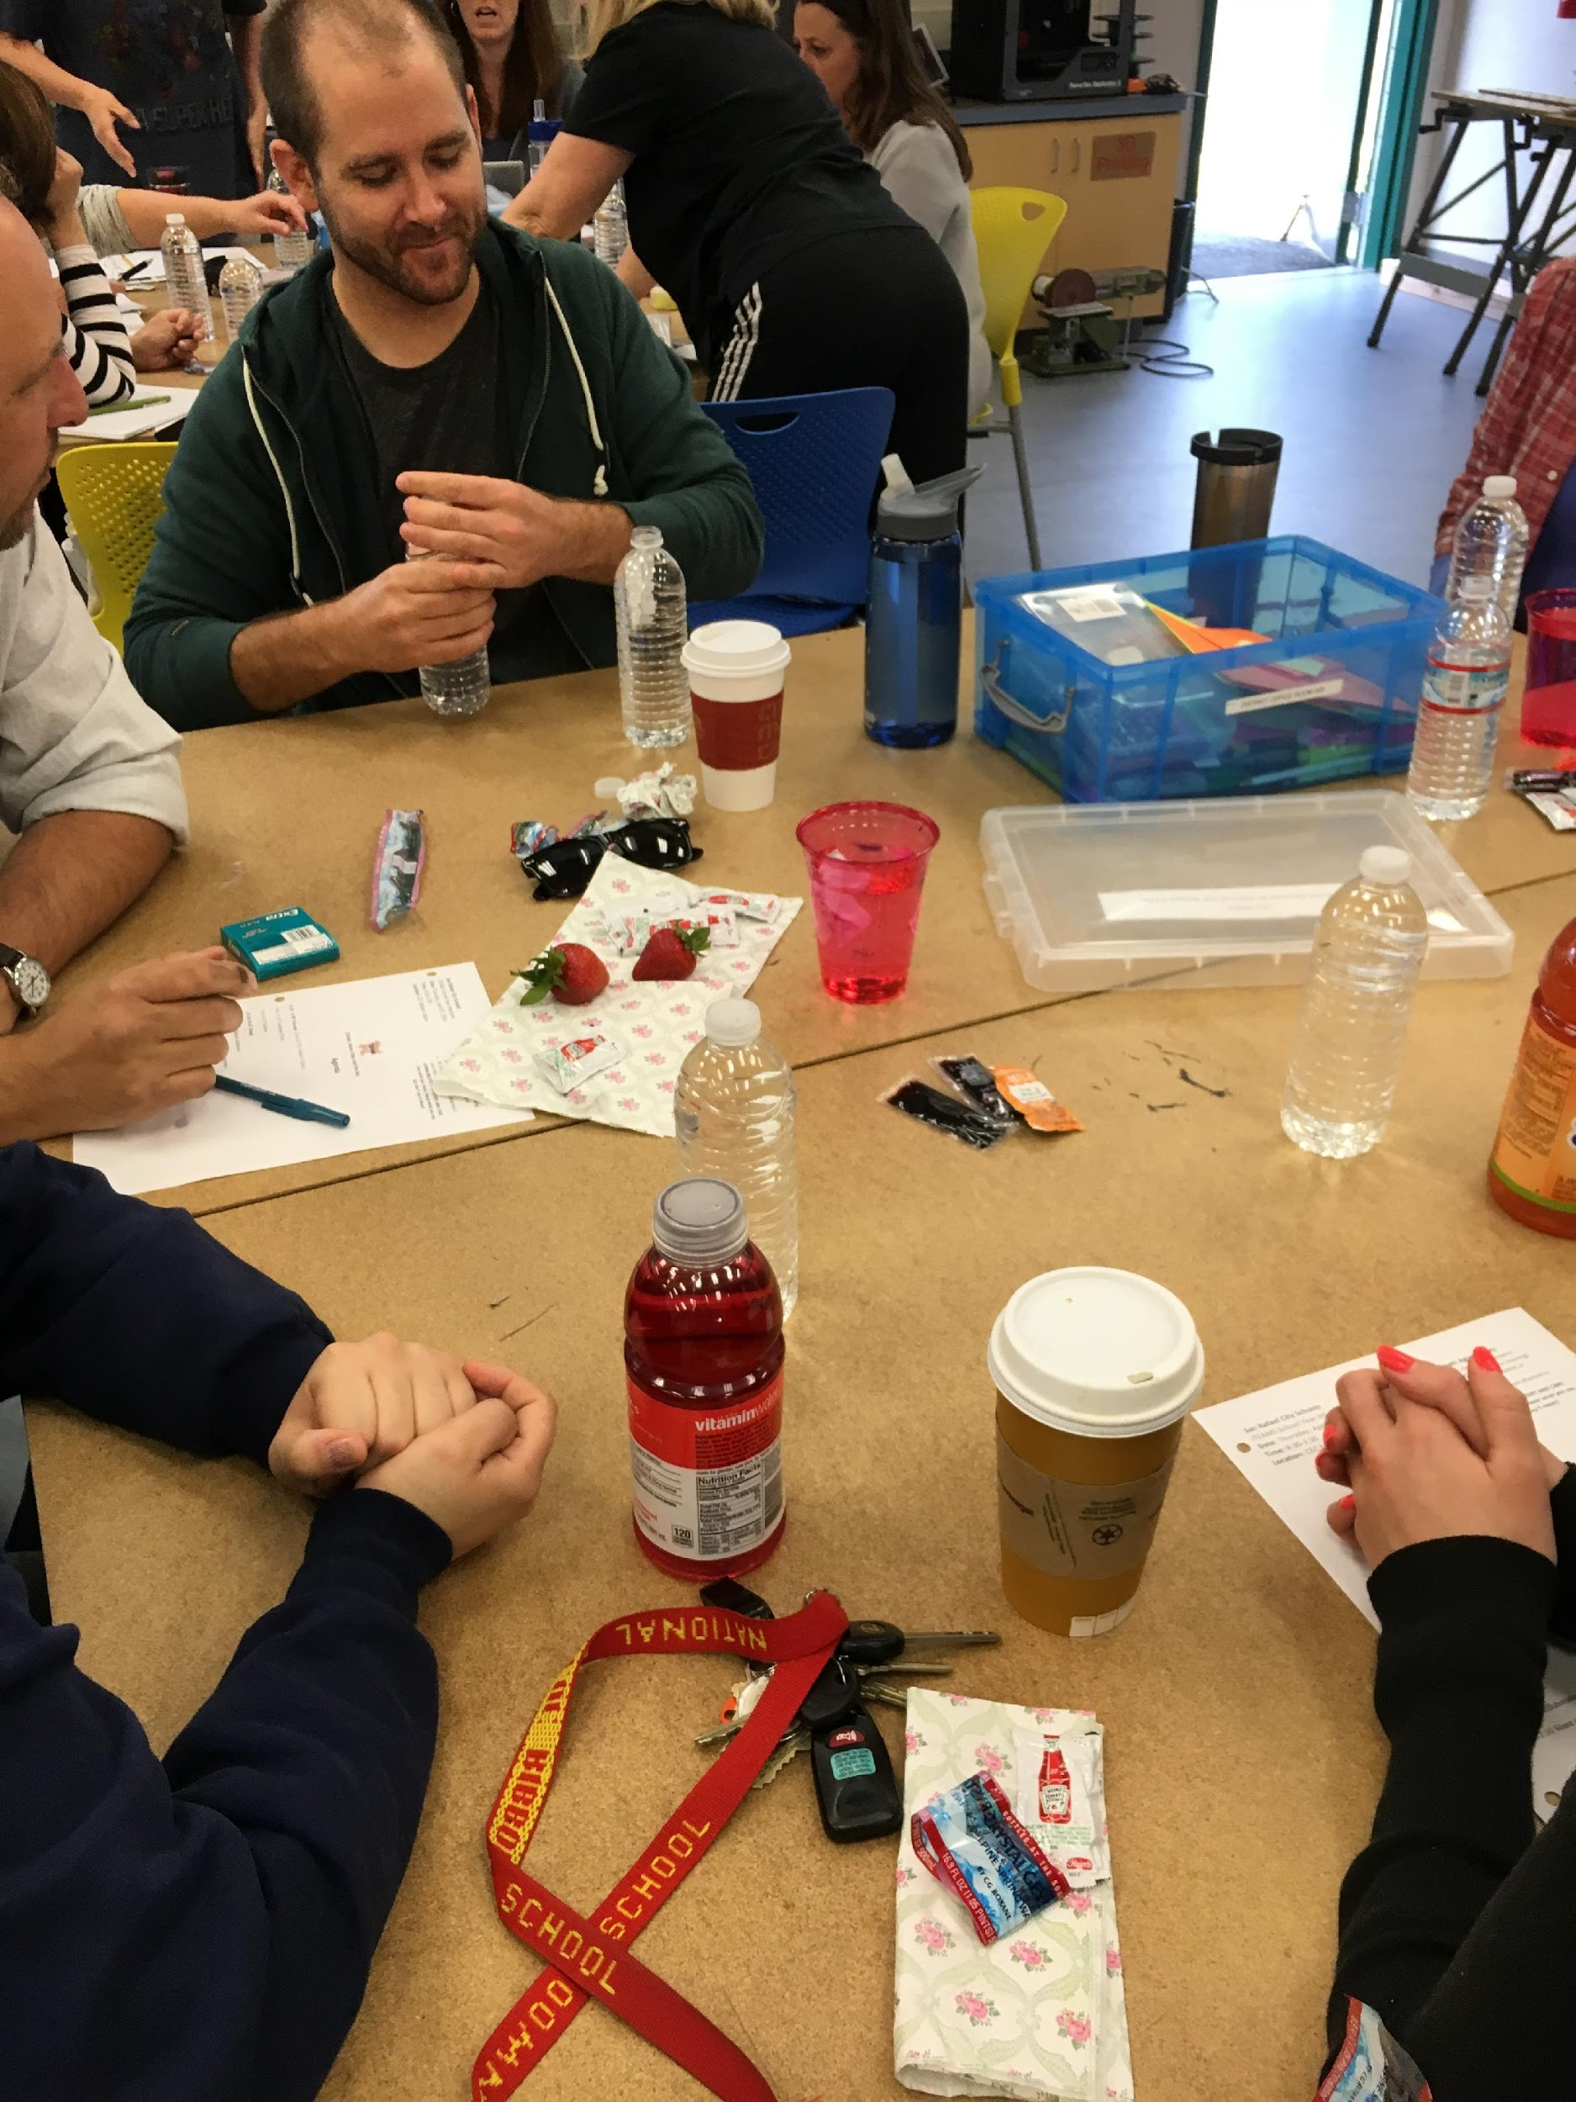
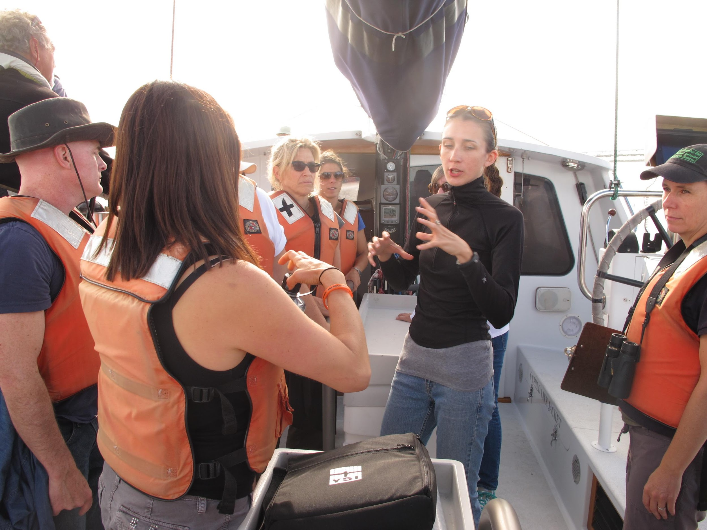
iTEAMS CELEBRATION

Slide 18
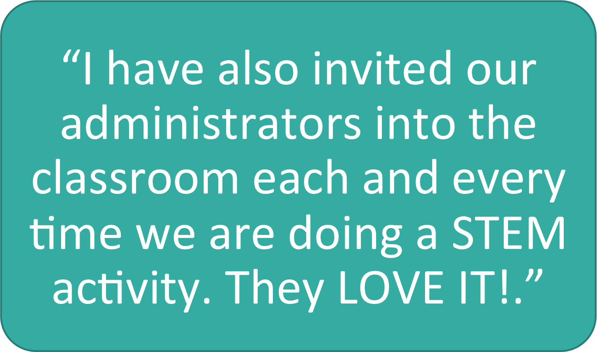
iTEAMS TEACHER REFLECTION

Slide 19
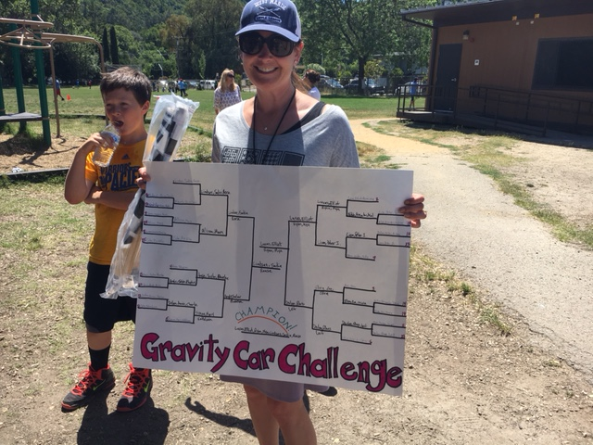
iTEAMS CELEBRATION

Slide 20
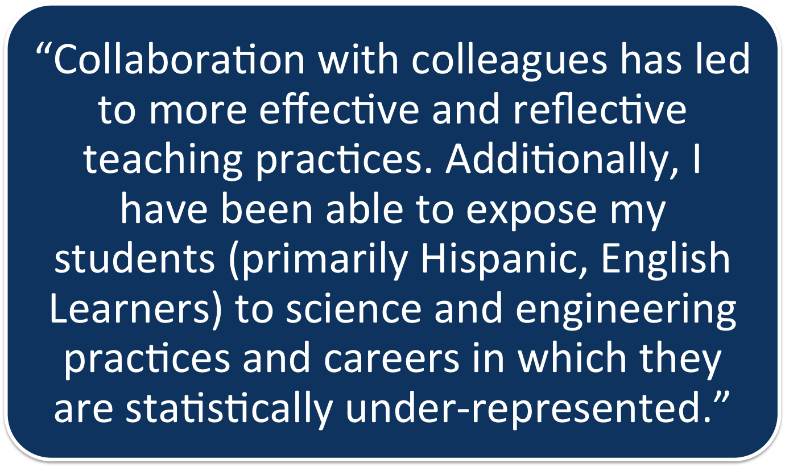
iTEAMS TEACHER REFLECTION

Slide 21
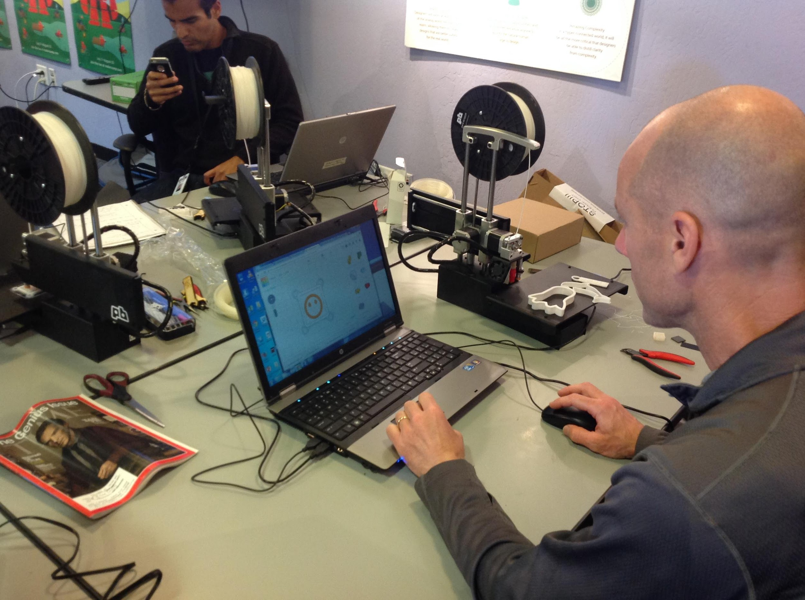
iTEAMS CELEBRATION

Slide 22
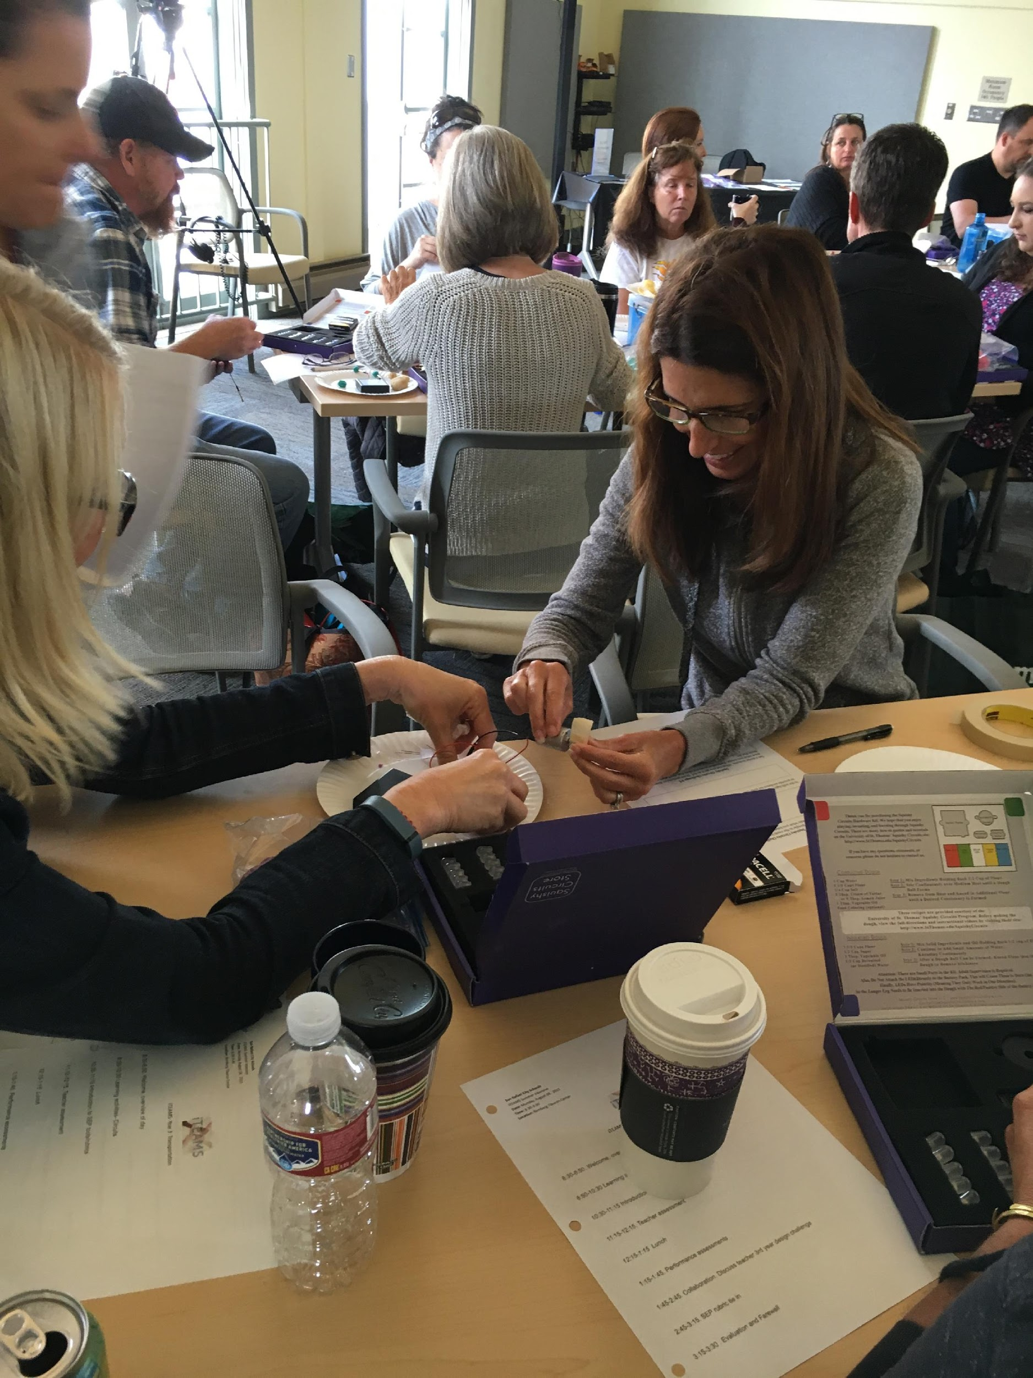
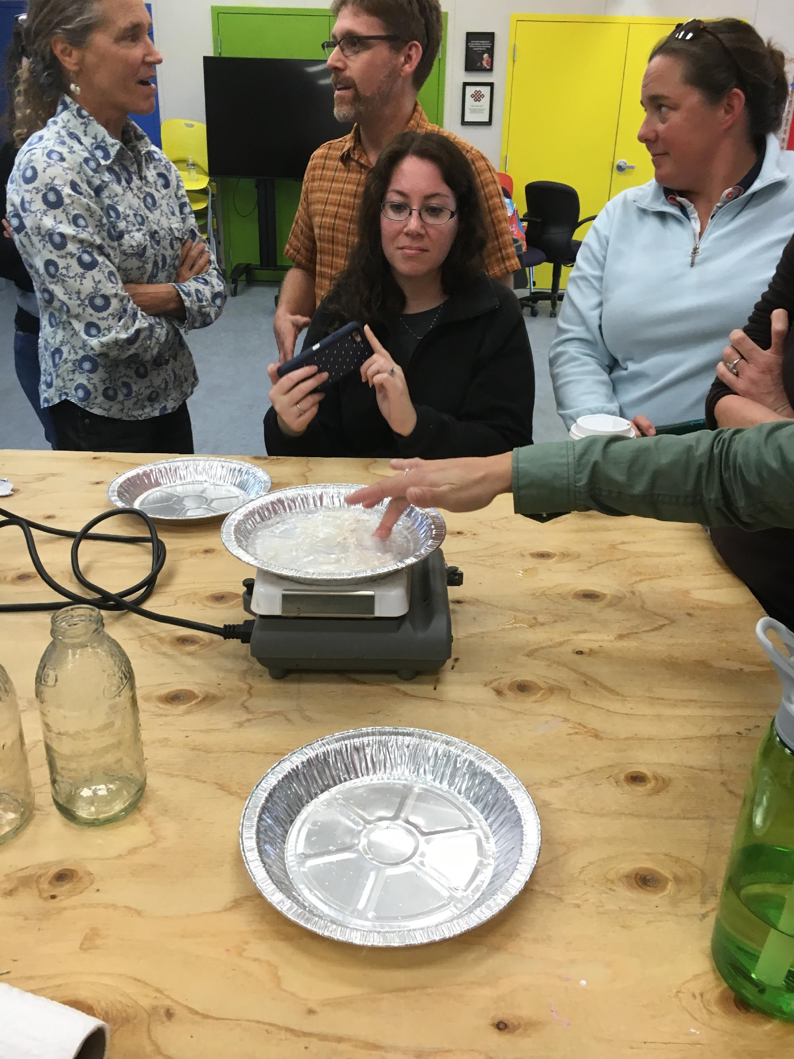
iTEAMS CELEBRATION

Slide 23
iTEAMS TEACHER REFLECTION

Slide 24
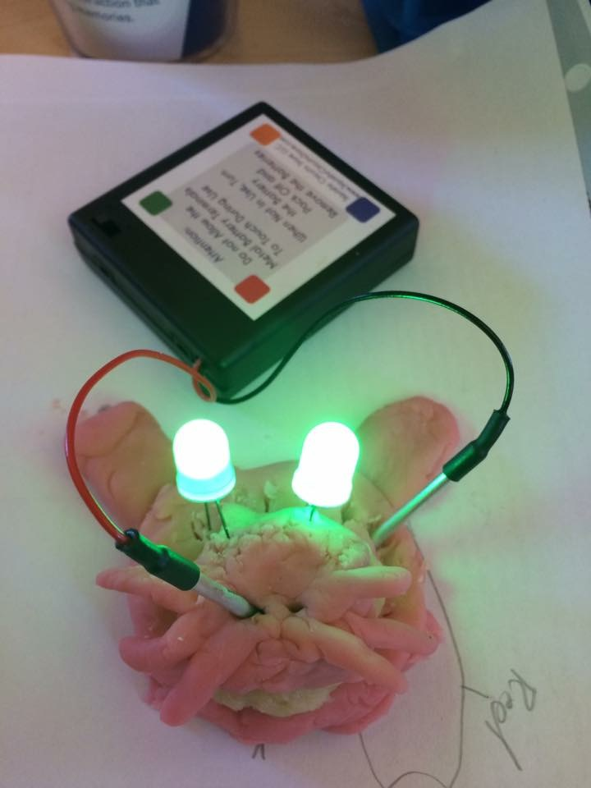
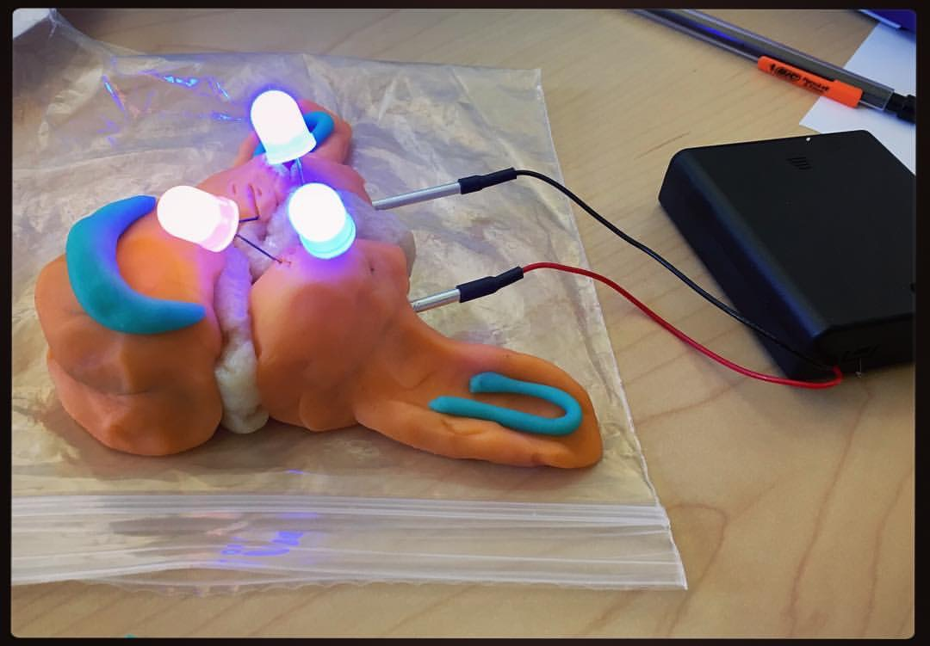
iTEAMS CELEBRATION

Slide 25
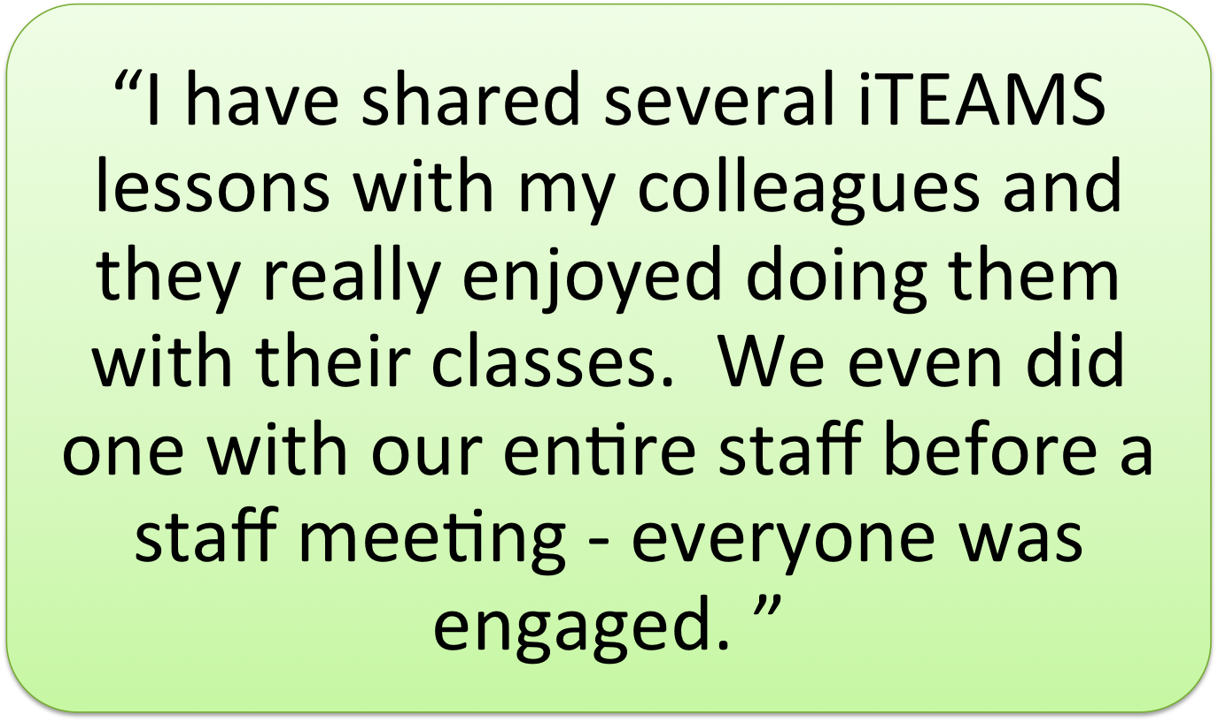
iTEAMS TEACHER REFLECTION

Slide 26
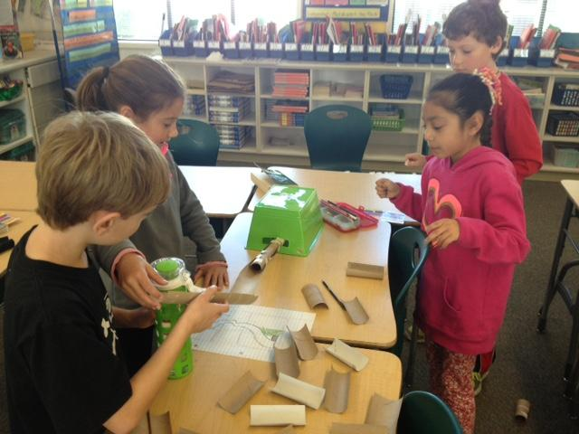
iTEAMS CELEBRATION

Slide 27
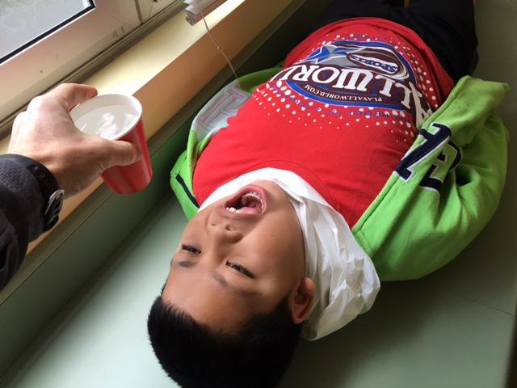
iTEAMS CELEBRATION

Slide 28
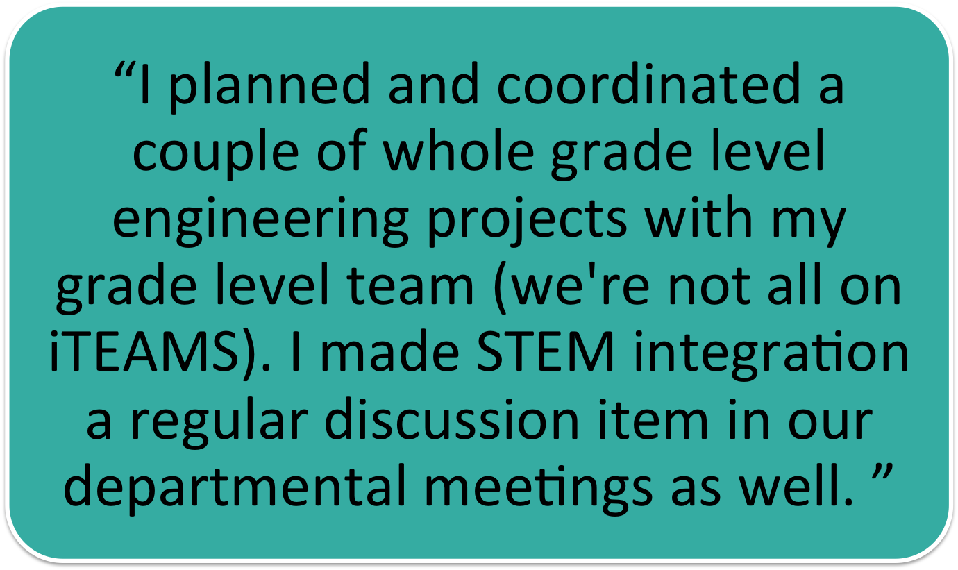
iTEAMS TEACHER REFLECTION

Slide 29
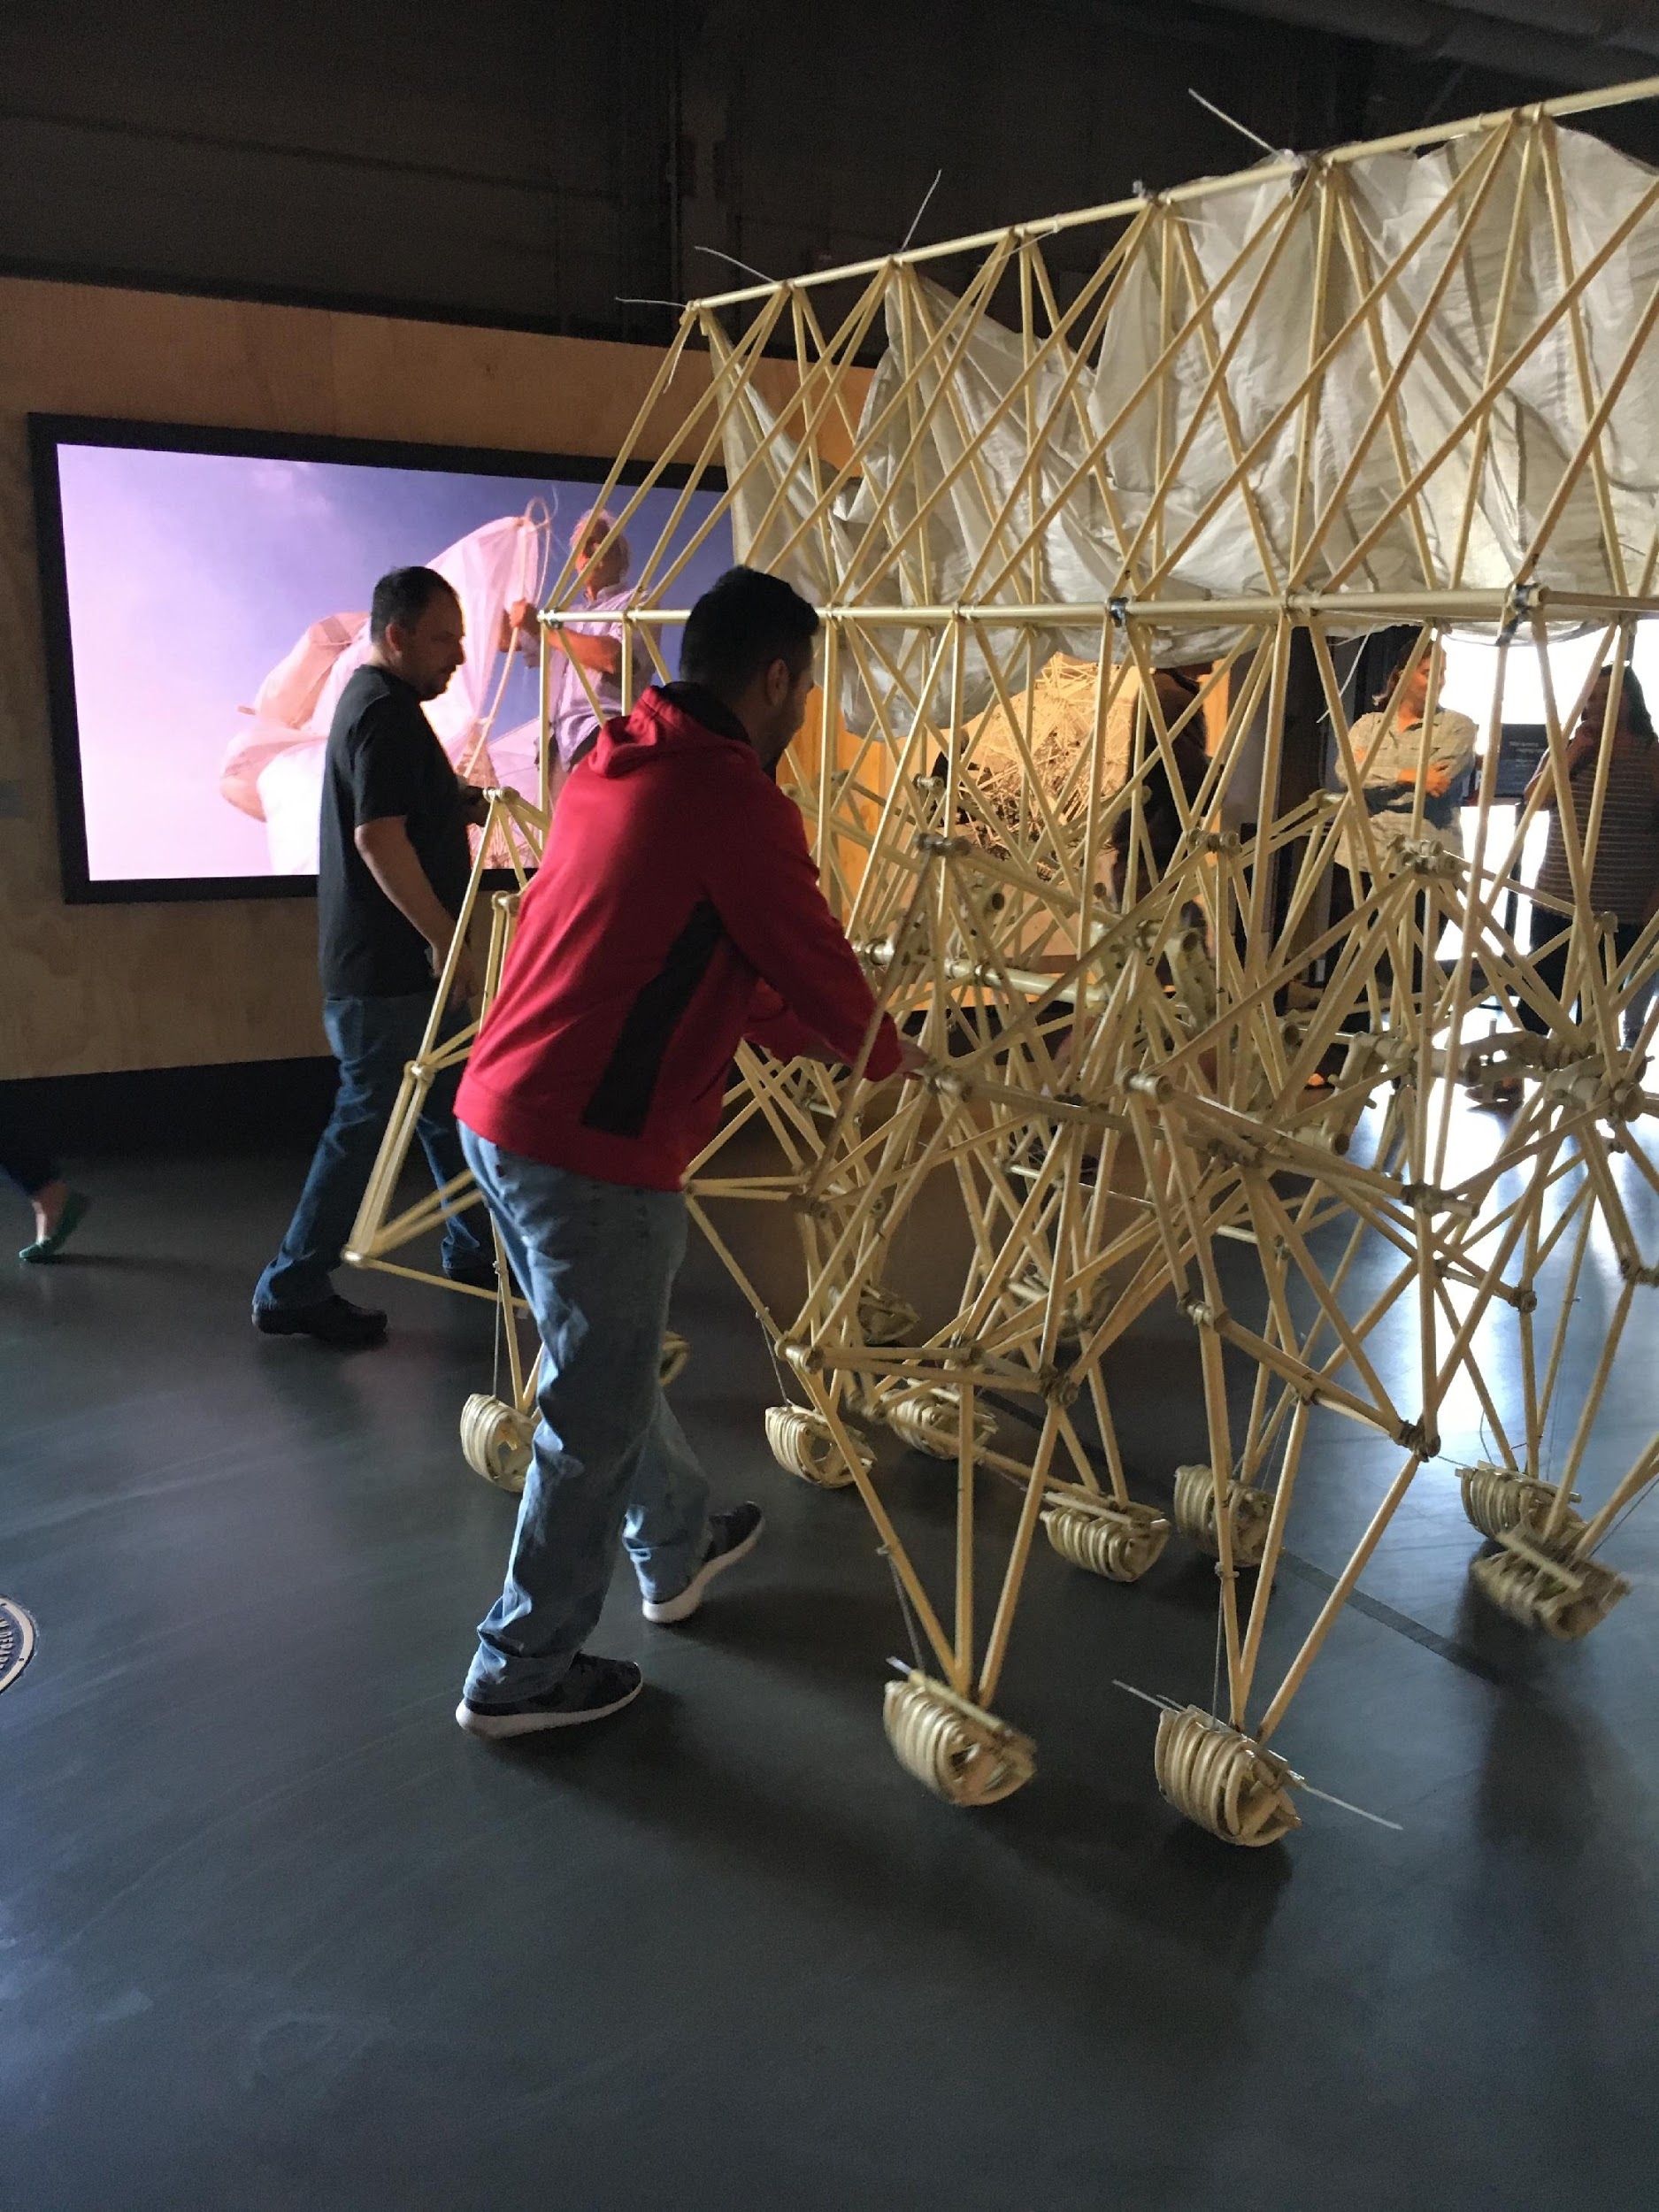
iTEAMS CELEBRATION

Slide 30
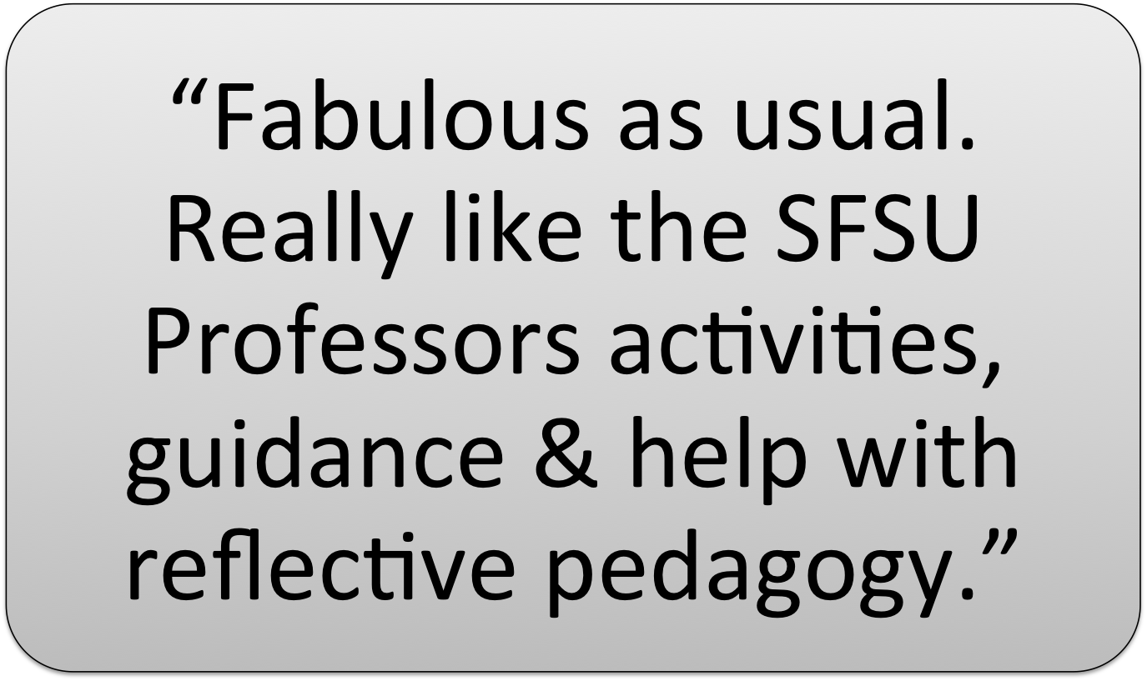
iTEAMS TEACHER REFLECTION

Slide 31
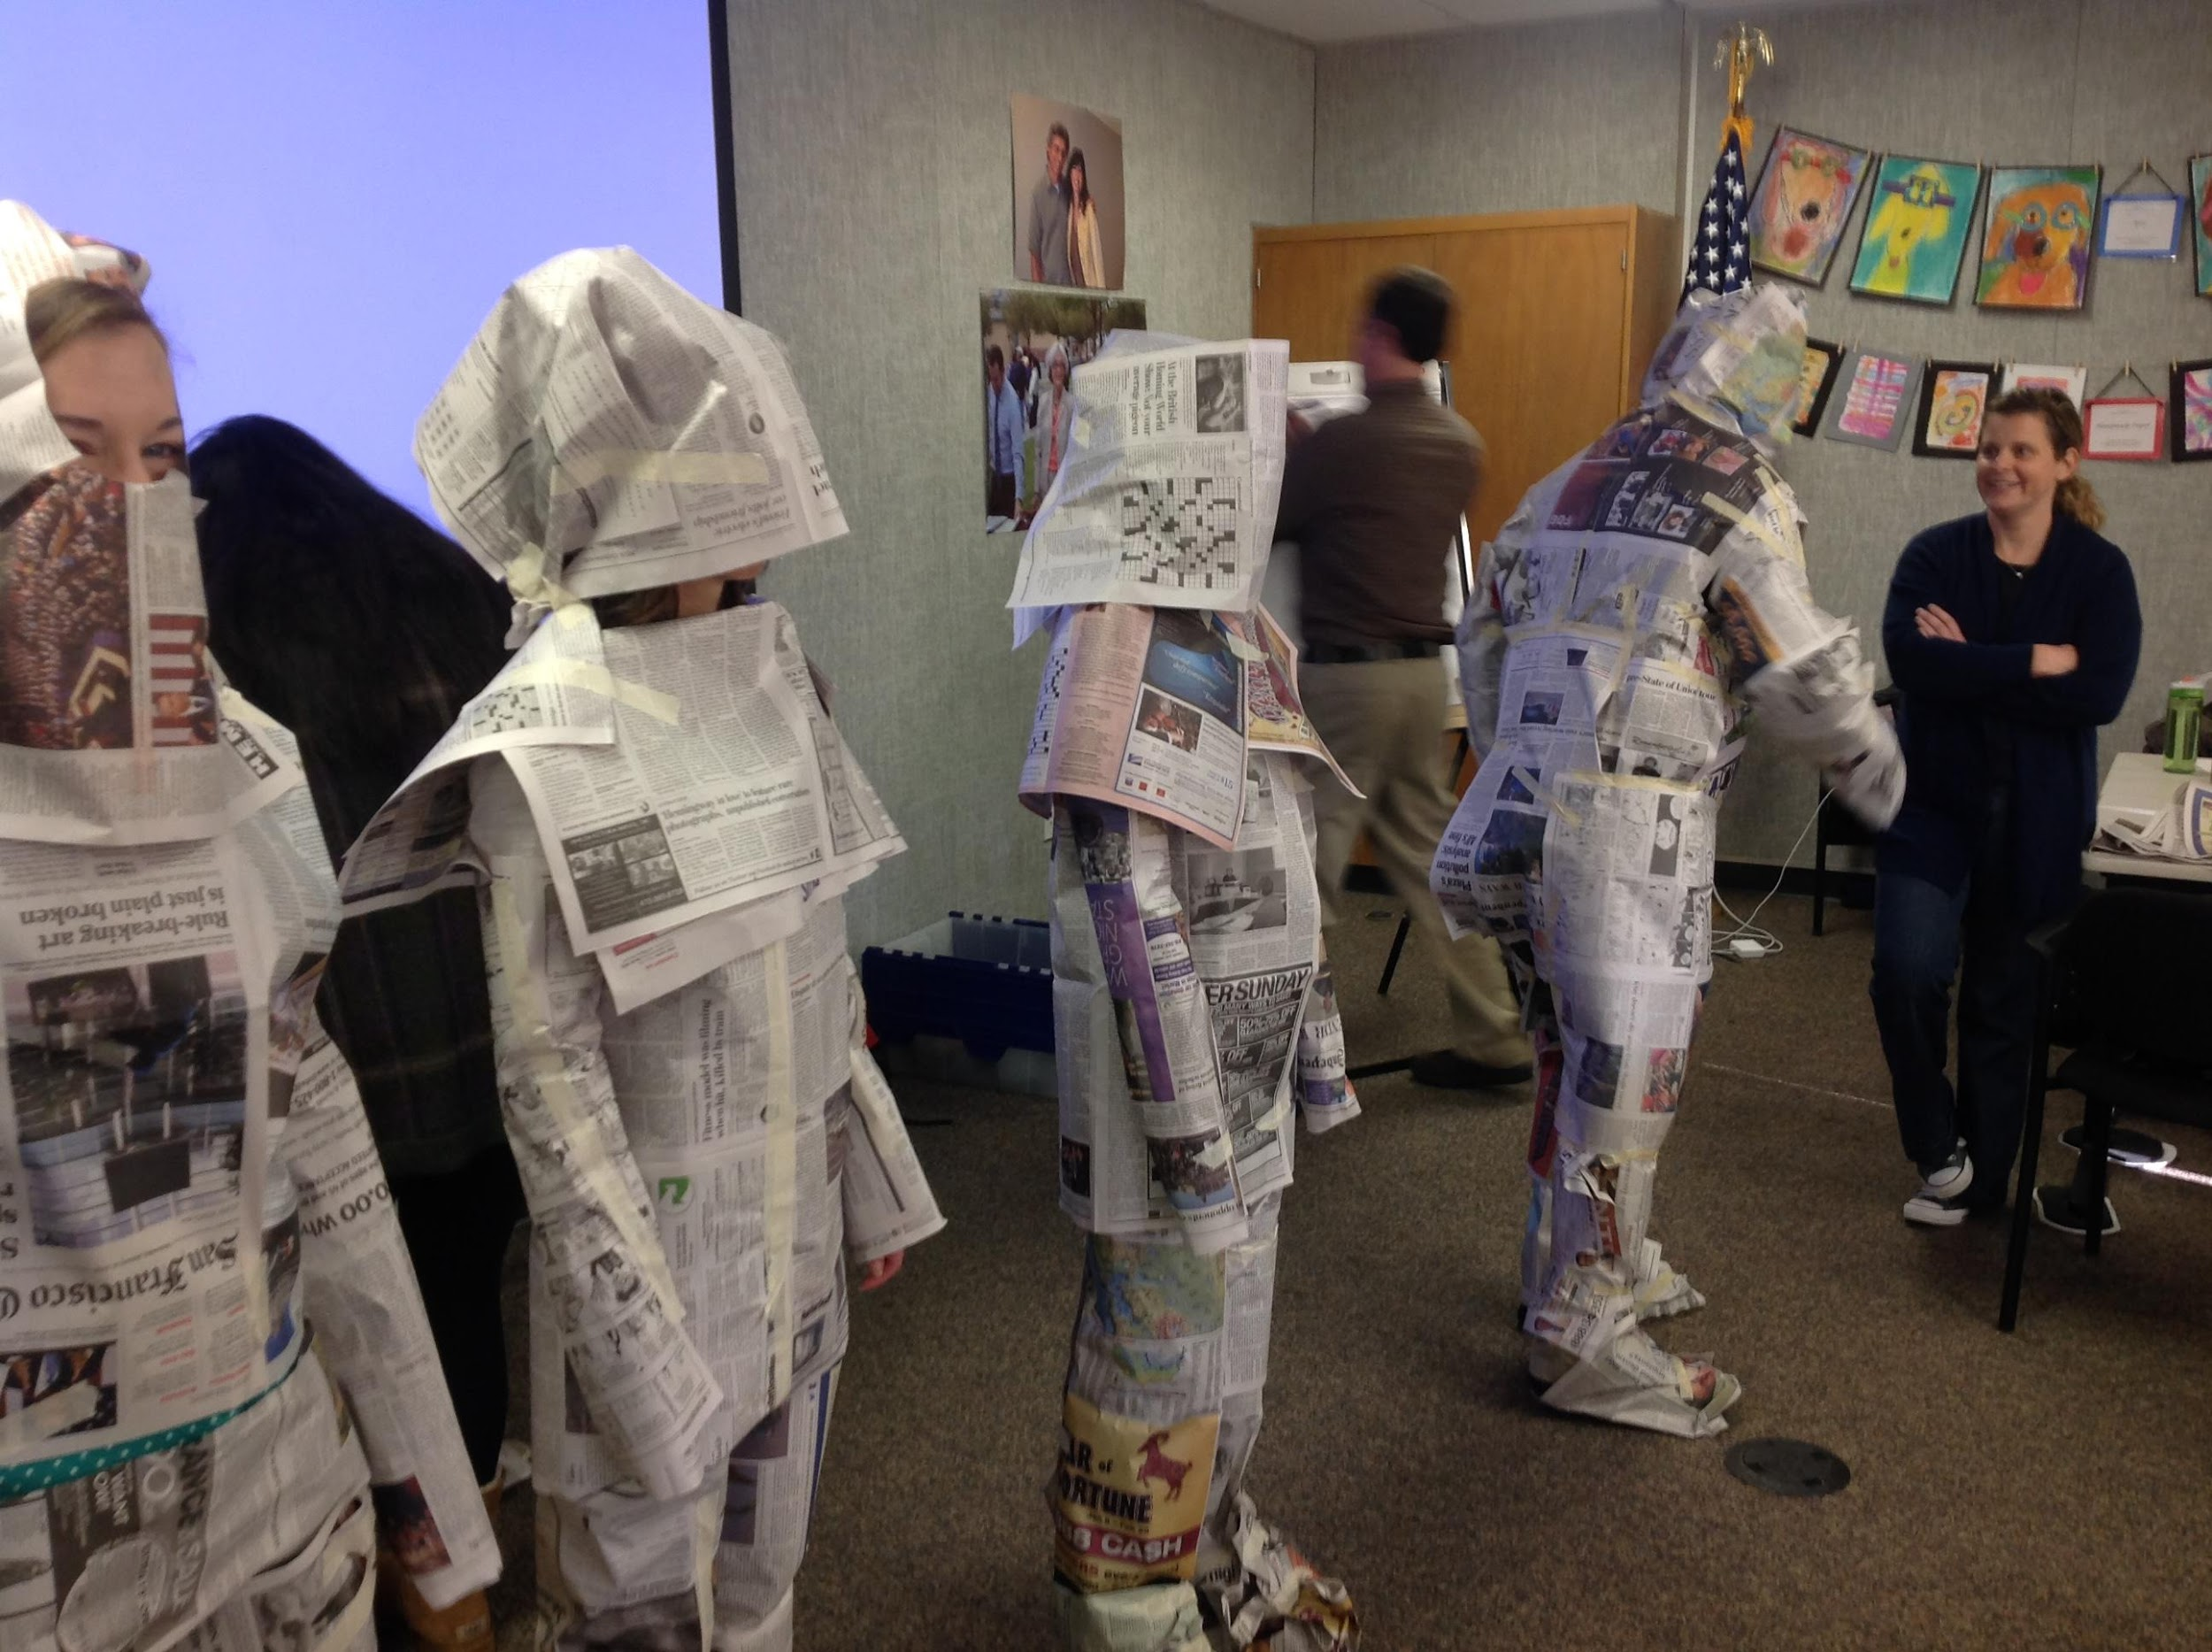
iTEAMS CELEBRATION

Slide 32
iTEAMS TEACHER REFLECTION

Slide 33
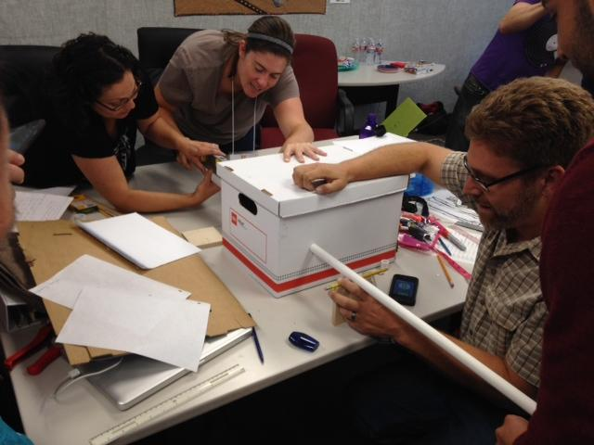
iTEAMS CELEBRATION

Slide 34
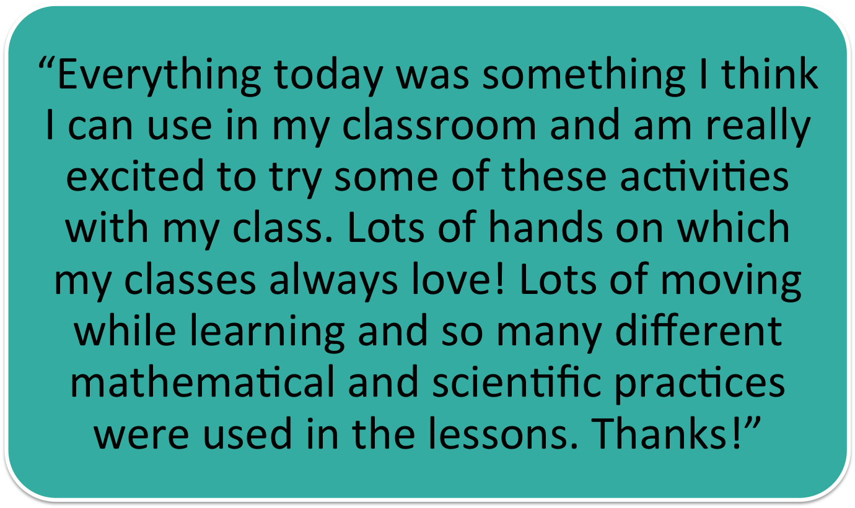
iTEAMS TEACHER REFLECTION

Slide 35
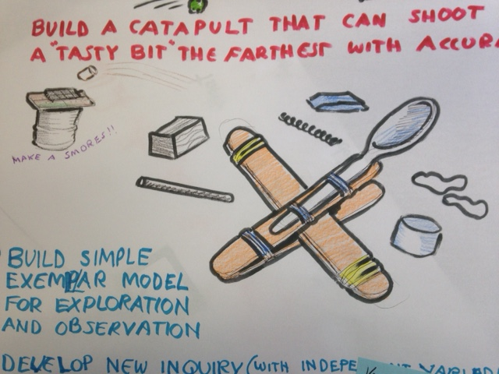
iTEAMS CELEBRATION

Slide 36
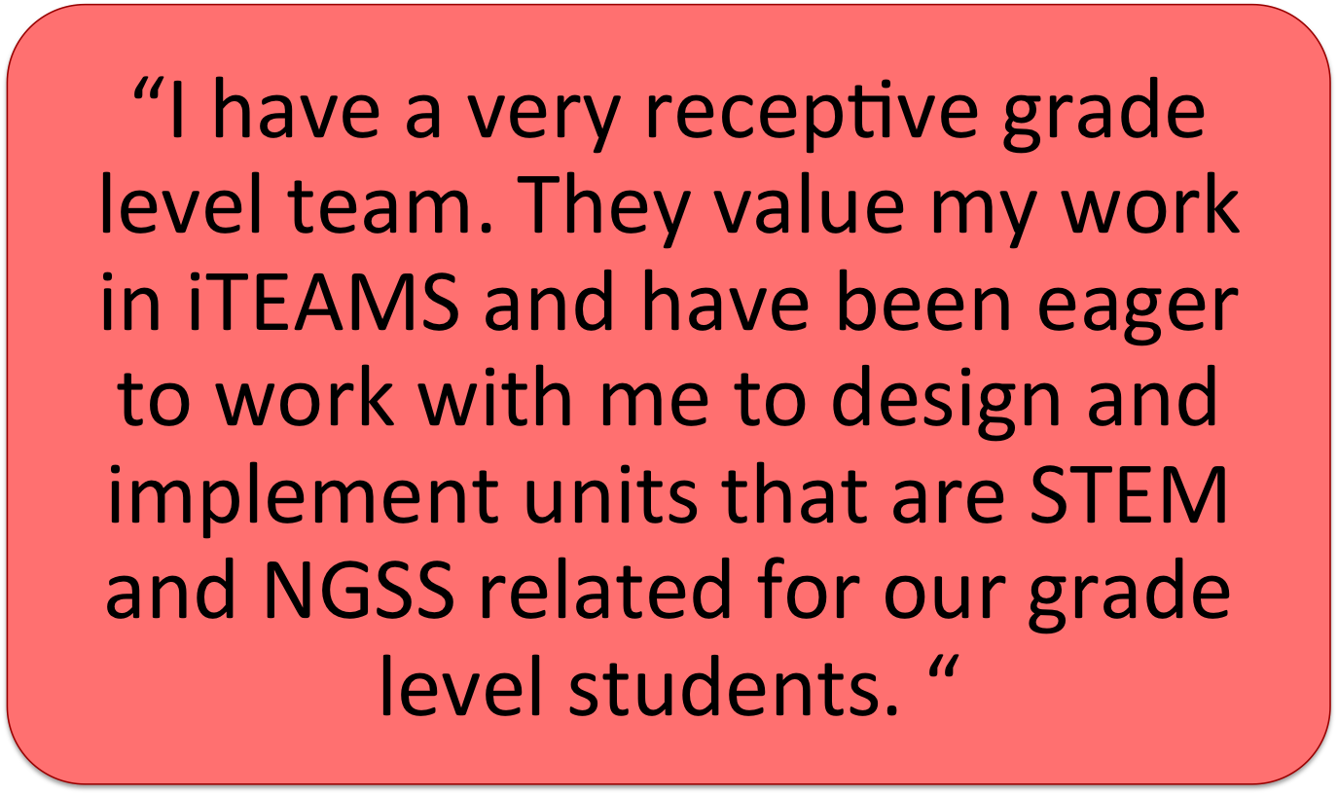
iTEAMS TEACHER REFLECTION

Slide 37
iTEAMS CELEBRATION

Slide 38
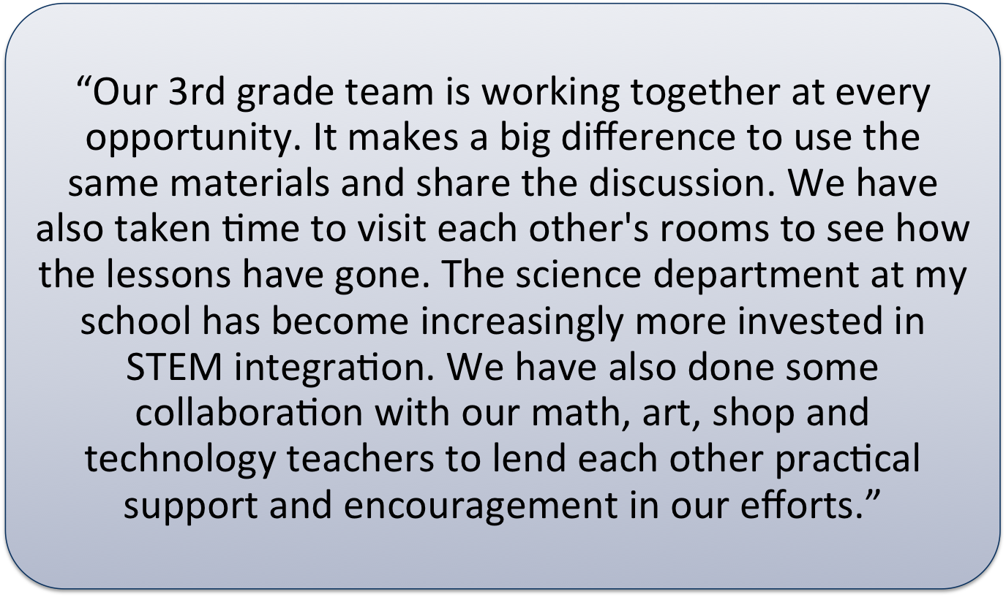
iTEAMS TEACHER REFLECTION

Slide 39
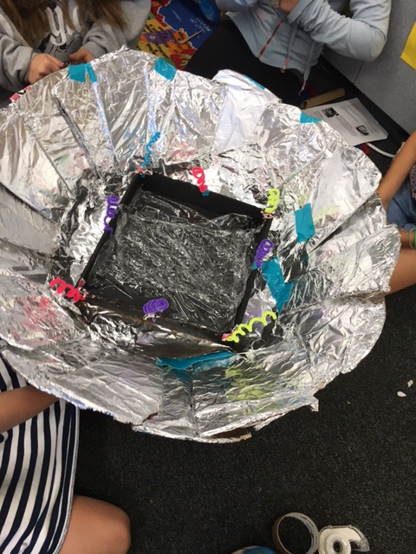
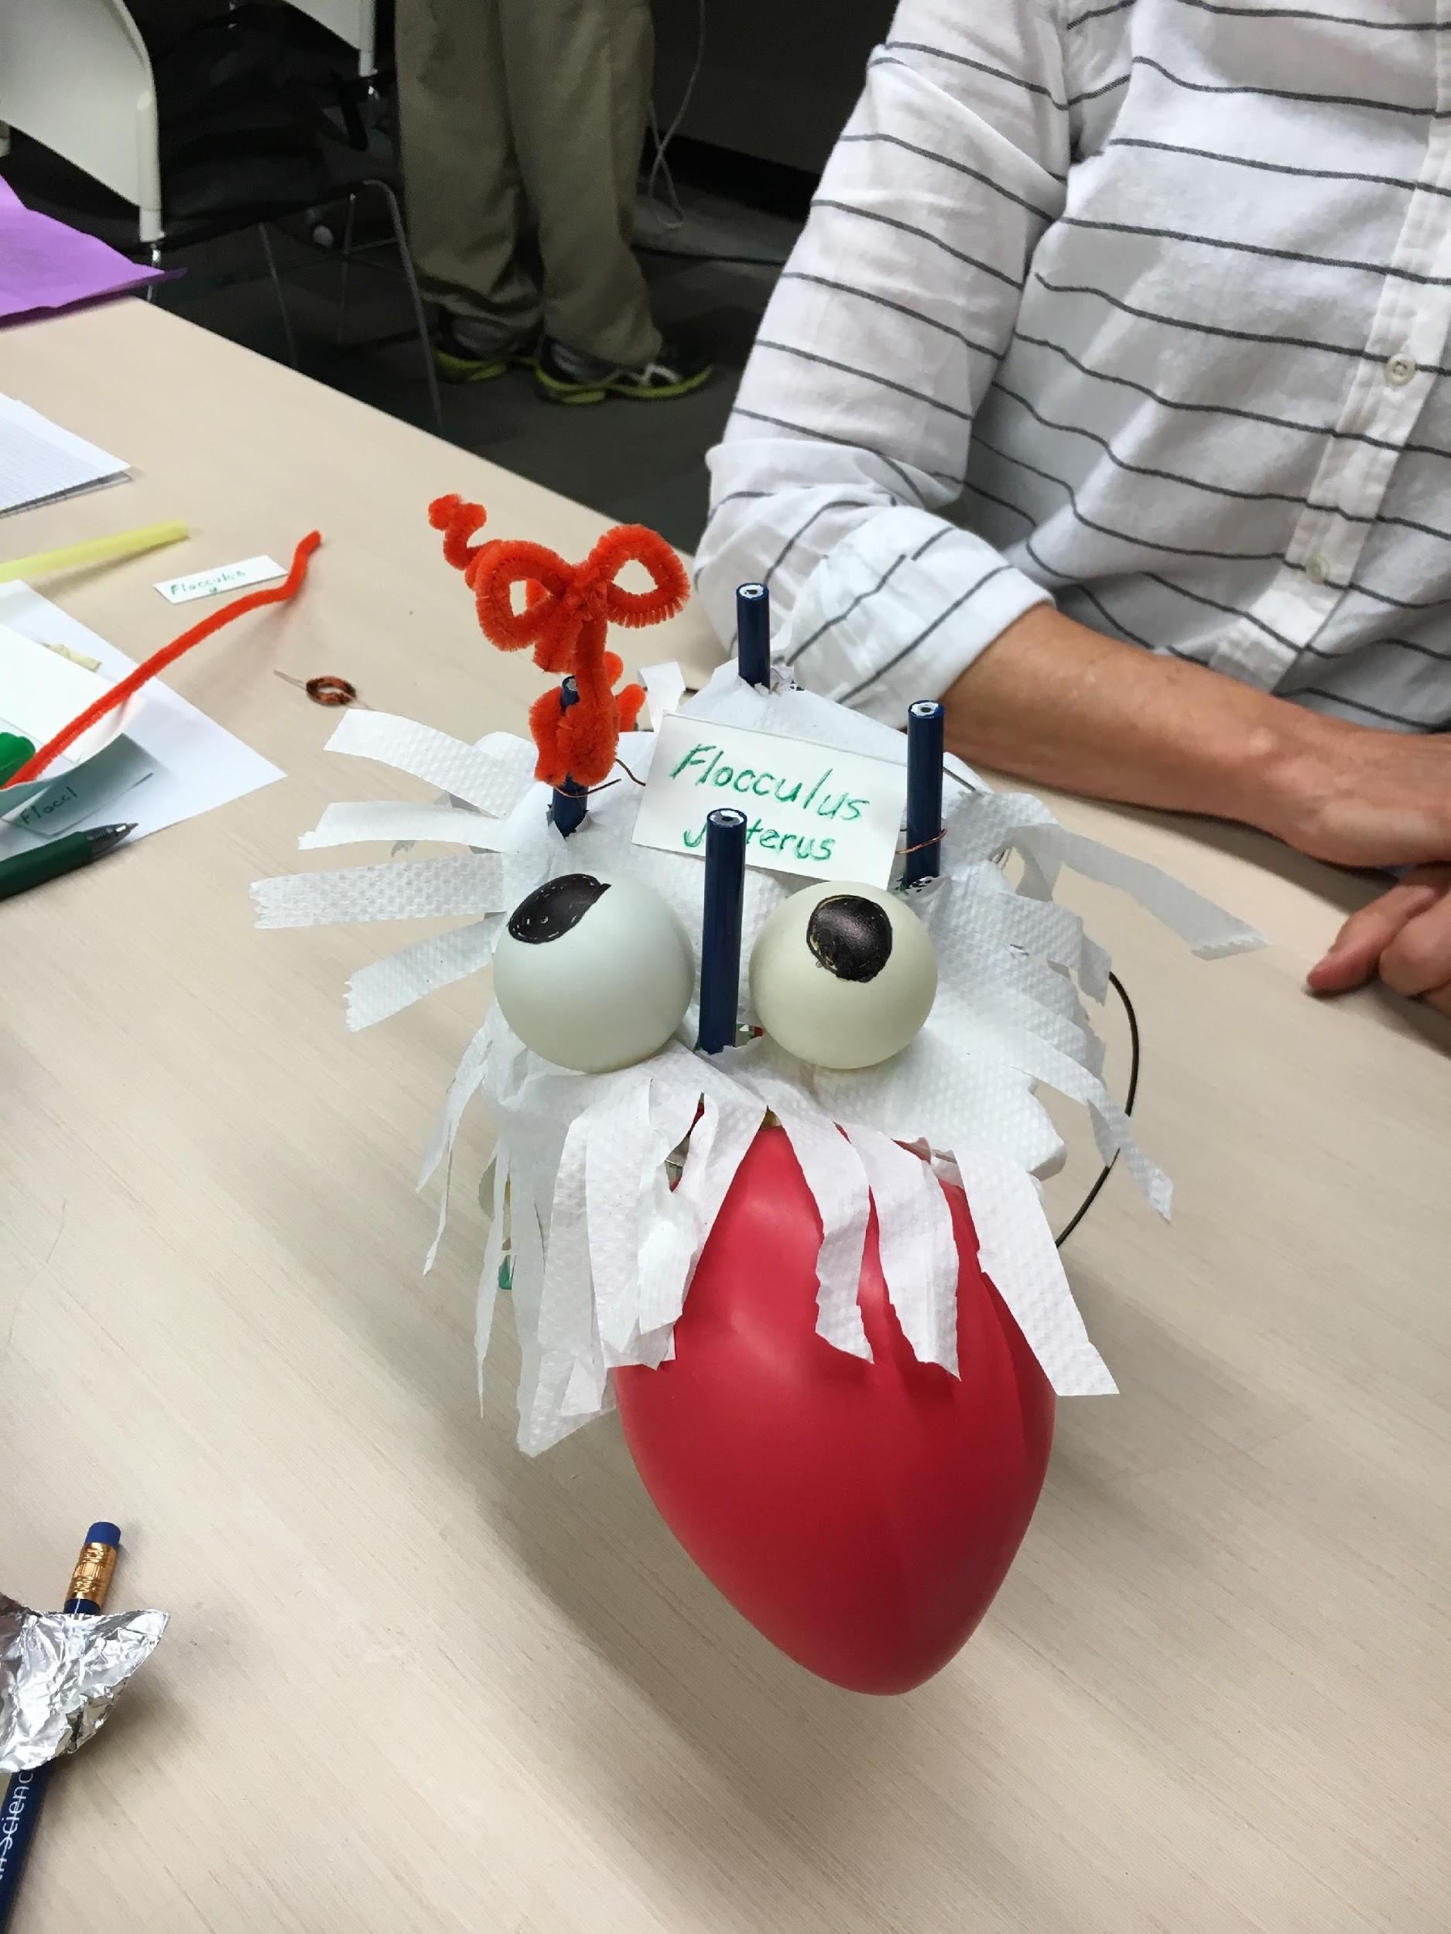
iTEAMS CELEBRATION

Slide 40
iTEAMS TEACHER REFLECTION

Slide 41
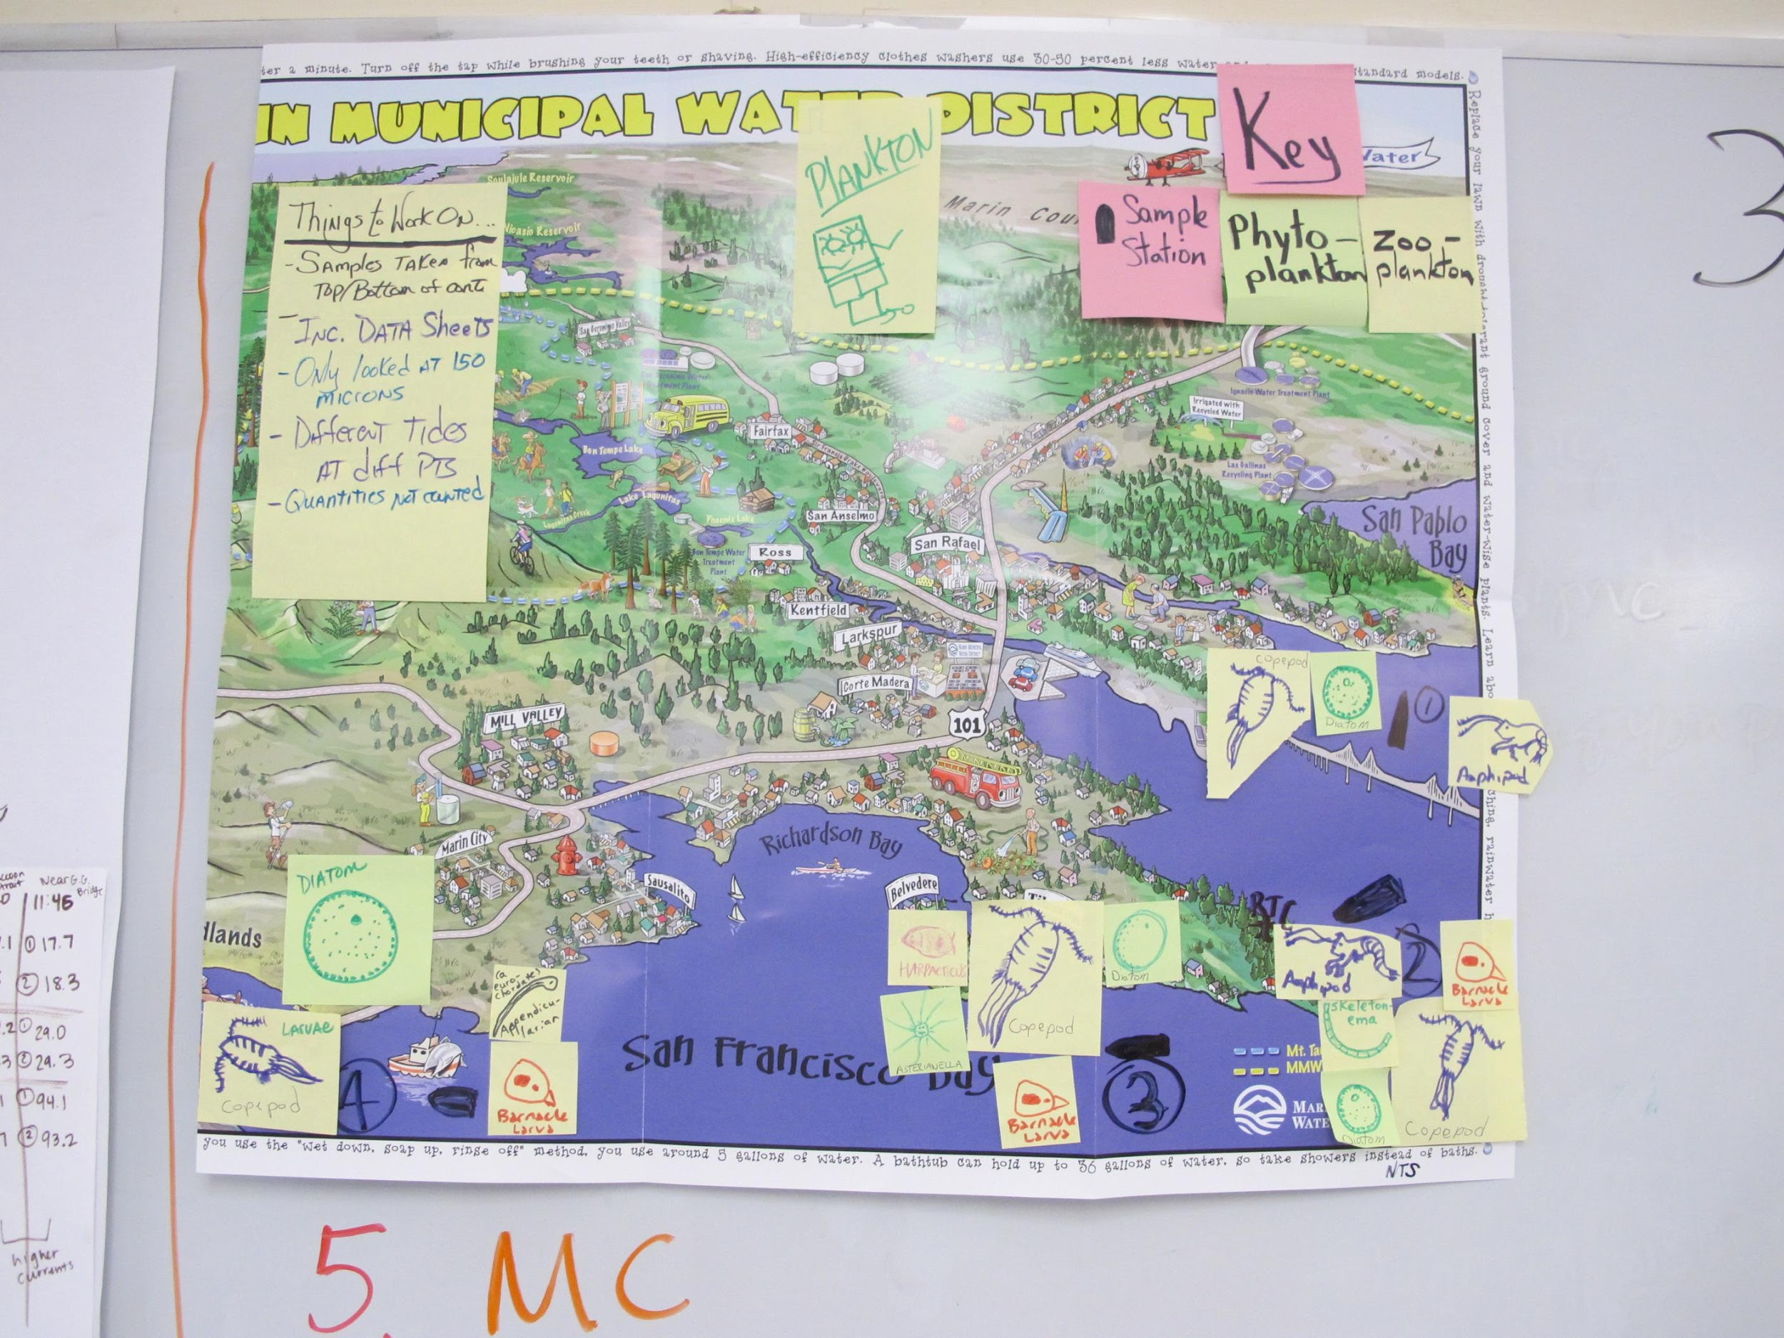
iTEAMS CELEBRATION

Slide 42
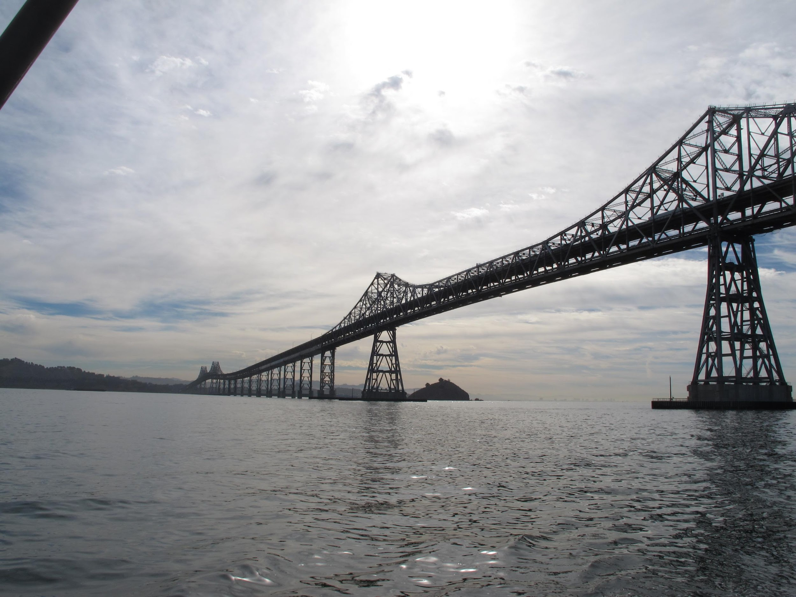
iTEAMS CELEBRATION

Slide 43
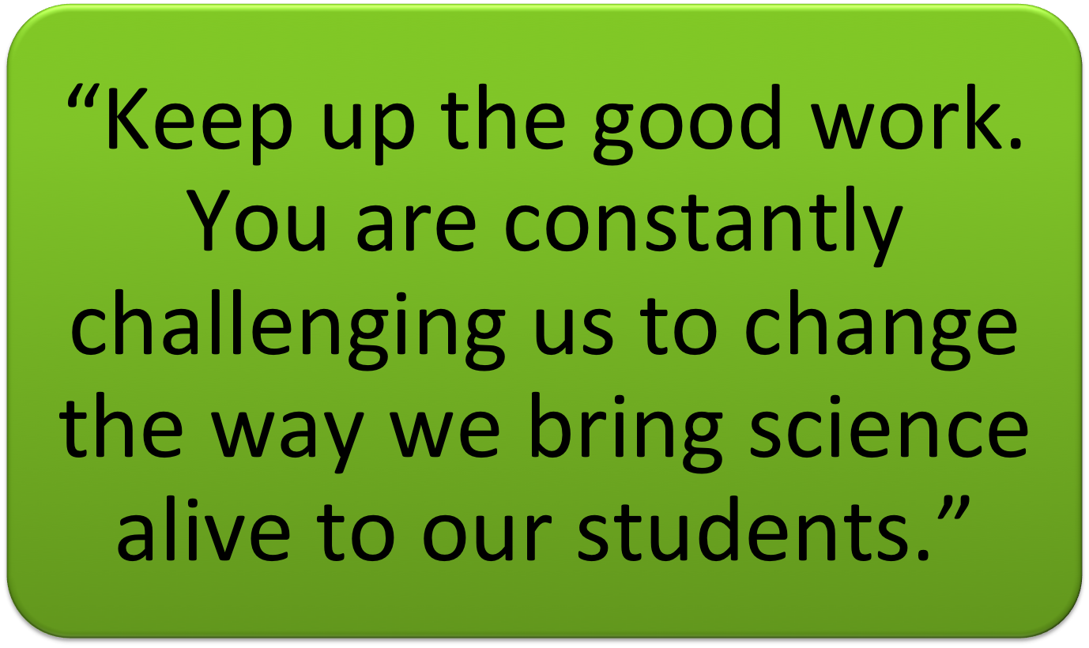
iTEAMS TEACHER REFLECTION

Slide 44
iTEAMS WEBSITE
Please visit our website:
www.iteamsmarin.weebly.com
You can also follow us on Facebook:
www.facebook.com/iteamsmarin

