Slide 1
Please get ready for your next
(more fun) assessment…
Each person needs:
1 piece of blank paper
1 pen or pencil
Battery pack
2 bulbs
1 bag of conducting dough
½ bag of insulating dough

Slide 2
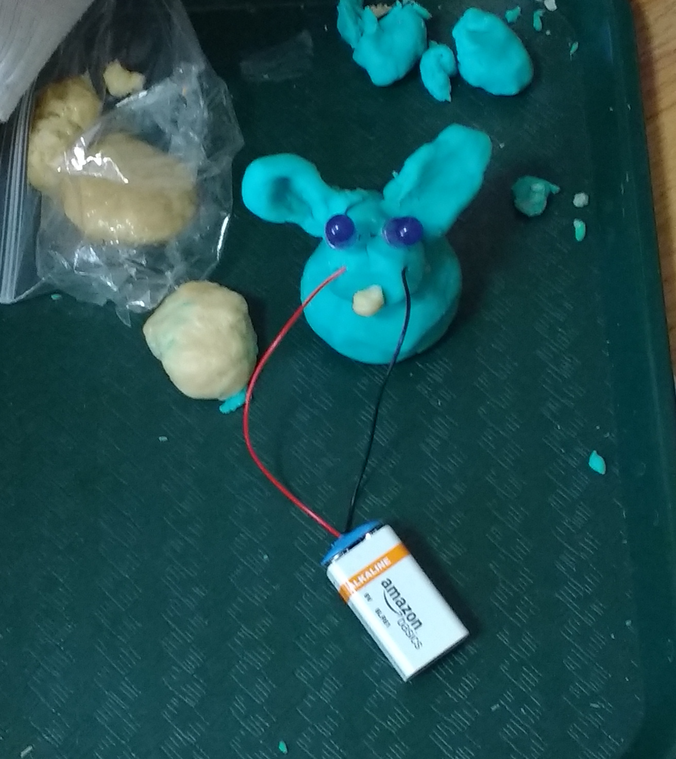
Circuit Performance Assessment
Why won’t Juliet’s rabbit eyes light up? Explain in words and a diagram.
Build a rabbit with working light up eyes.
Explain why your model works. Use words and a diagram.
(word bank suggested for use with children, not included for grown folk)

