Slide 1
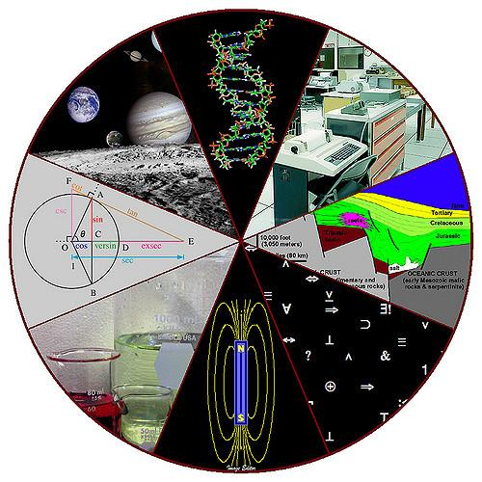
Getting Started with ELD Science
John Flanagan, San Rafael, California March 2017 (based on collaborative work done with Kathleen Morrison, the Davidson Middle School Science Department & iTeams)
Here are a few of the challenges we faced, guidelines we tried to follow, ideas we came up with, experiences we had and tools/resources that we thought worth sharing. The purpose of this slideshow is to let you know how we started our ELD Science Program at Davidson and to support our friends & colleagues in their efforts to engage, inspire & educate all students!
Take what you need, and leave the rest.

Slide 2
A Few Quotable Quotes to Start with…
“All the world is a laboratory
to the inquiring mind.” - Martin H. Fischer
“The art of teaching is the art
of assisting discovery.” - Mark Van Doren
“Who dares to teach must
never cease to learn.” - John Cotton Dana
Tell me and I'll forget. Show me, and I may not remember. Involve me, and I'll understand. - Native American Proverb
“The aim of education should be to teach us rather how to think, than what to think—rather to improve our minds, so as to enable us to think for ourselves, than to load the memory with the thoughts of other men.” - Bill Beattie
“It is a miracle that curiosity survives a formal education.” - Albert Einstein

Slide 3
Program Structure:
Our ELD Science Program consists of one Level 1 Newcomer section, two Level 2 ELD/Newcomer Sections & one 3rd Level ELD/Transitional Section. All four sections are held at the same time of the day so that students may be transferred between levels based on their language growth or ELD level redesignation. To minimize disruption to the students, we try to move those who are transferring to a new class at the end of 3 week learning units.
Program Population & Challenges:
Each section has students in 6th-8th grades.
The majority of these students have four classes per day together (2 classes with their homeroom ELD Language Arts teacher, this ELD science section and a math section), so they are very social with each other and relational issues occasionally carry over between classes.
The newcomer population is somewhat fluid, so students enter and leave at various times throughout the year. It is hard to predict student numbers with any degree of accuracy. Sometimes students have to be passed from section to another in order to maintain manageable class sizes.
Students arrive with a wide range of previous educational backgrounds. Some are very literate in their primary language and have learned some of basic scientific concepts. Other students arrive with limited literacy, no formal science knowledge and seem unaccustomed to standard classroom expectations (like not constantly talking at will and handling classroom materials appropriately).
Some students entering the 3rd Level ELD/Transitional class have a decent amount of social English, while other students are barely out of “the Silent Period” in their English Language Development.

Slide 4
Curriculum:
The ELD Science Program is based on the major concepts covered by the 3rd through 6th grade Next Generation Science Standards.
Why?
The overarching goal of our program is to prepare these students to participate successfully in regular science classrooms as early as one year after they have started in our ELD Science program (in 7th, 8th or 9th grade, that is). Few of the students in our program have had a cohesive elementary school science education prior to their arrival at DMS. None of them have mastered the basic science standards that the NGSS assumes as entry level knowledge into middle school science, and all of these students are learning the content vocabulary necessary to succeed in upper grade science courses.
We also have an interest in creating scientific thinkers, scientifically literate citizens and students who are more likely to want to continue in their education after 8th grade because they have built both skills and self confidence through engagement and success with comprehensible curriculum. We are helping the students to build their academic vocabularies, improve their level of literacy in English and develop their capacity to speak & understand English. The 3rd - 6th grade NGS Standards offer an abundance of opportunities for developing critical thinking skills and include more than enough abstract content to challenge our students!

Slide 5
ELD Science Year 1 Topic Outline
Semester 1
● Startup - What are Scientists? - Observation & Categorization vocabulary, Using basic scientific tools, Recording observations -Class/Lab safety
● Intro to Ecosystems -Living and nonliving elements- Local ecosystem observations & nature drawings - habitats & Biomes
● Plants and animals- Structure and functions-Adaptations for Survival (structural & behavioral), Interdependence of organisms (ie.respiration and photosynthesis)- {ELD Level 3 may add: Ecosystems in depth(food web/chain, consumers-producers, populations…)}
● ELD Levels 1 & 2: The Human Body - Skeletal-Muscular Systems, Cardio-Respiratory System, Digestive System
● {ELD Level 3 option:Levels of Organization-Organism-Organ Systems- Tissues and Cells}
Semester 2
● Physical Science- Basic particle Theory, States of matter, Physical Changes, Measuring matter (Metric System - Mass, Length, Volume, Density,Temperature), Heat Transfer (Conduction, Convection, Radiation)
● Weather and Climate- Water Cycle- Atmosphere & Air Pressure, What causes wind & weather changes, Types of Seasons (reasons for seasons)- Charting weather(climographs)- { ELD 3 may add: Global warming- Human sustainability}
● Earth’s Changing Surface - Landforms, Weathering, Erosion, Design Solutions for Erosion, {Level 3 may add: Earth’s Interior, Plate Tectonics}
● Astronomy- Earth, Sun, Moon, Phases of moon, Eclipses, Solar System, Planets, Stars life cycle
● Physics/Engineering- Forces in motion- Newton’s Laws, simple machines (planes, levers, pulleys)-design challenge with mix & match parts for Rube Goldberg Machines
● (If time) Chemical Reactions - exothermic, endothermic, physical vs chemical change, intro to some key elements & basic chemical formulas
>>>Note: 7th & 8th graders will participate in 7th grade sex education unit, with additional translation support. May be split by gender.<<<

Slide 6
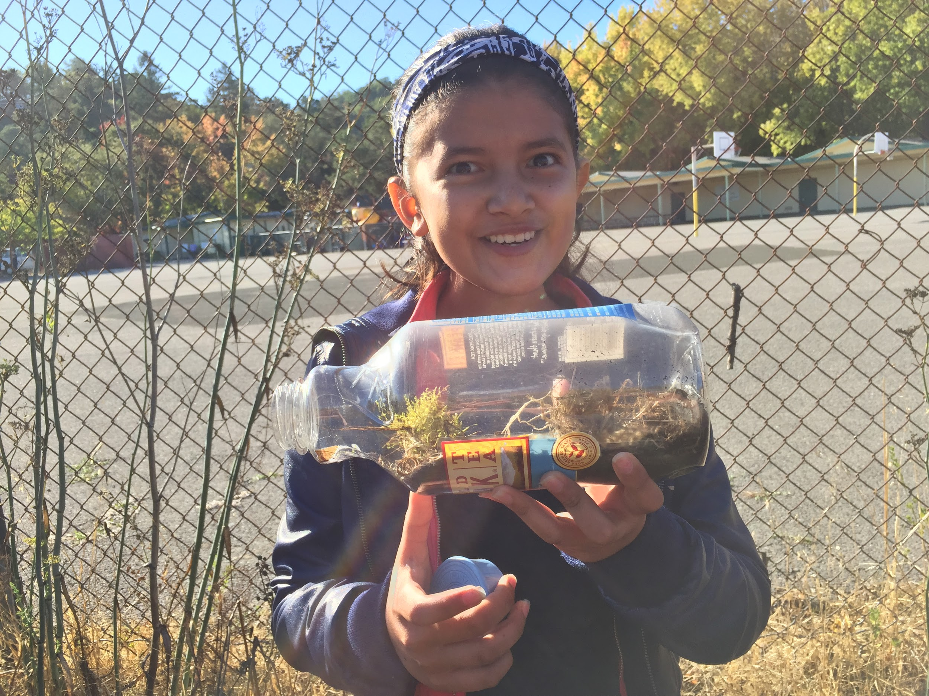
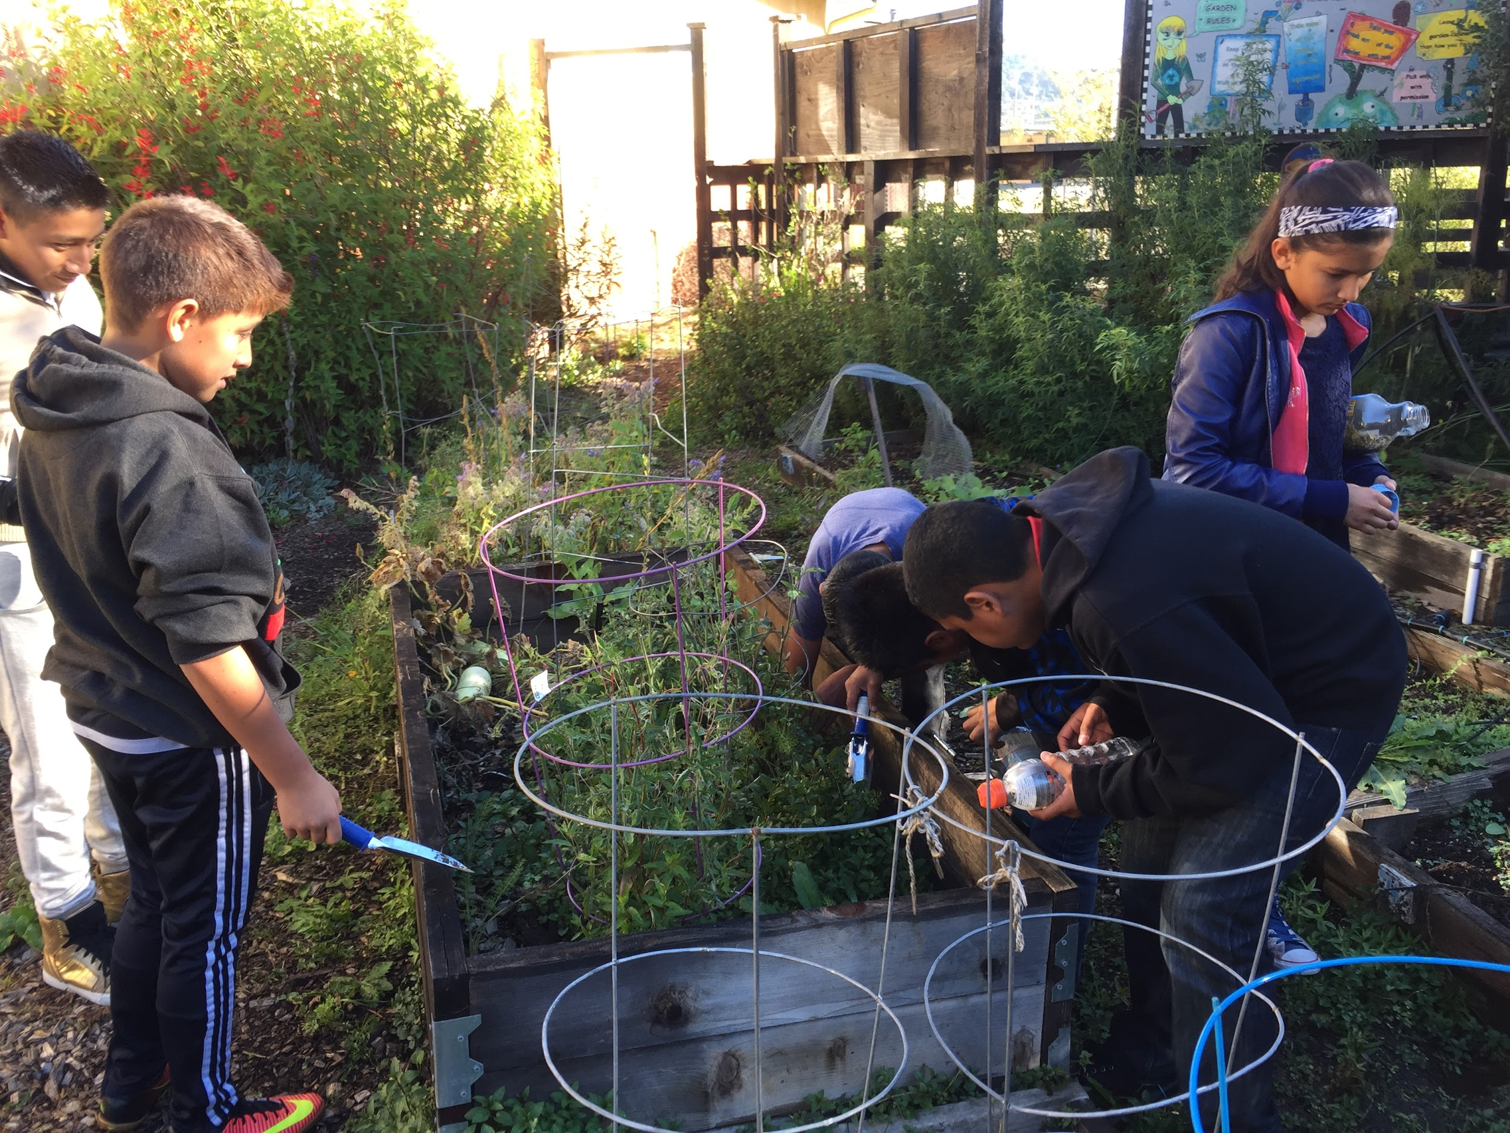
Sample activities:
#1 Constructing a Vivarium
While learning about ecosystems and species interdependence, we all took an onsite field trip to Davidson’s creek and garden to gather mosses, small plants, soil and bugs to make vivariums. When we observed them later, we were excited to find evidence of photosynthesis in the condensation forming on the sides of the bottles!

Slide 7
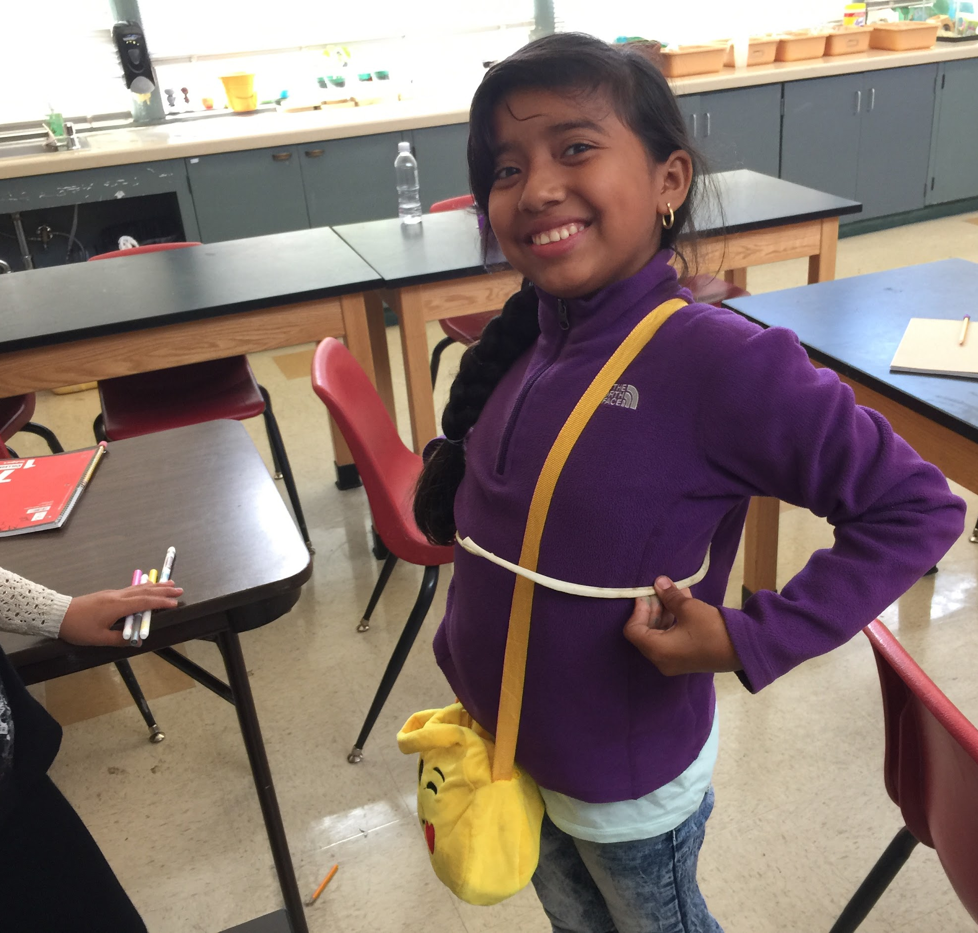
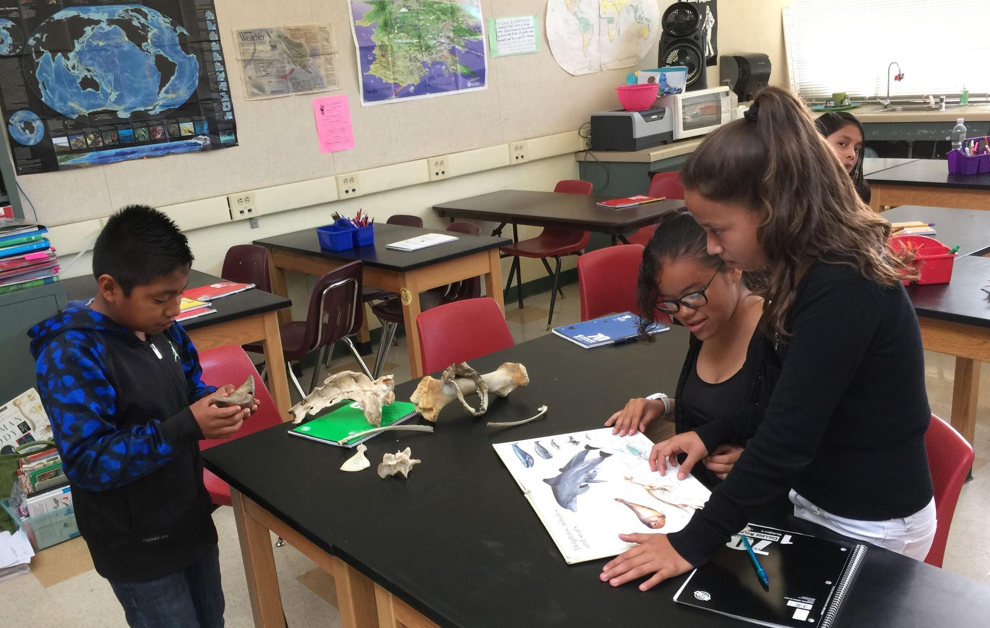
Sample Activity #2:
Comparative Anatomy
Comparing
Animal & Human
Skeletal Structures
The Science Department’s extensive animal bone collection came in handy as we transitioned from studying animal adaptations to human anatomy. The students discovered that vertebrates share many similar structures!

Slide 8
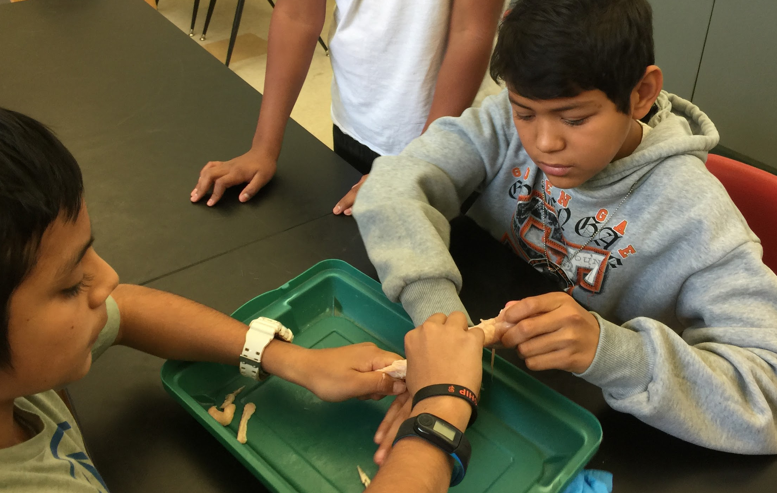
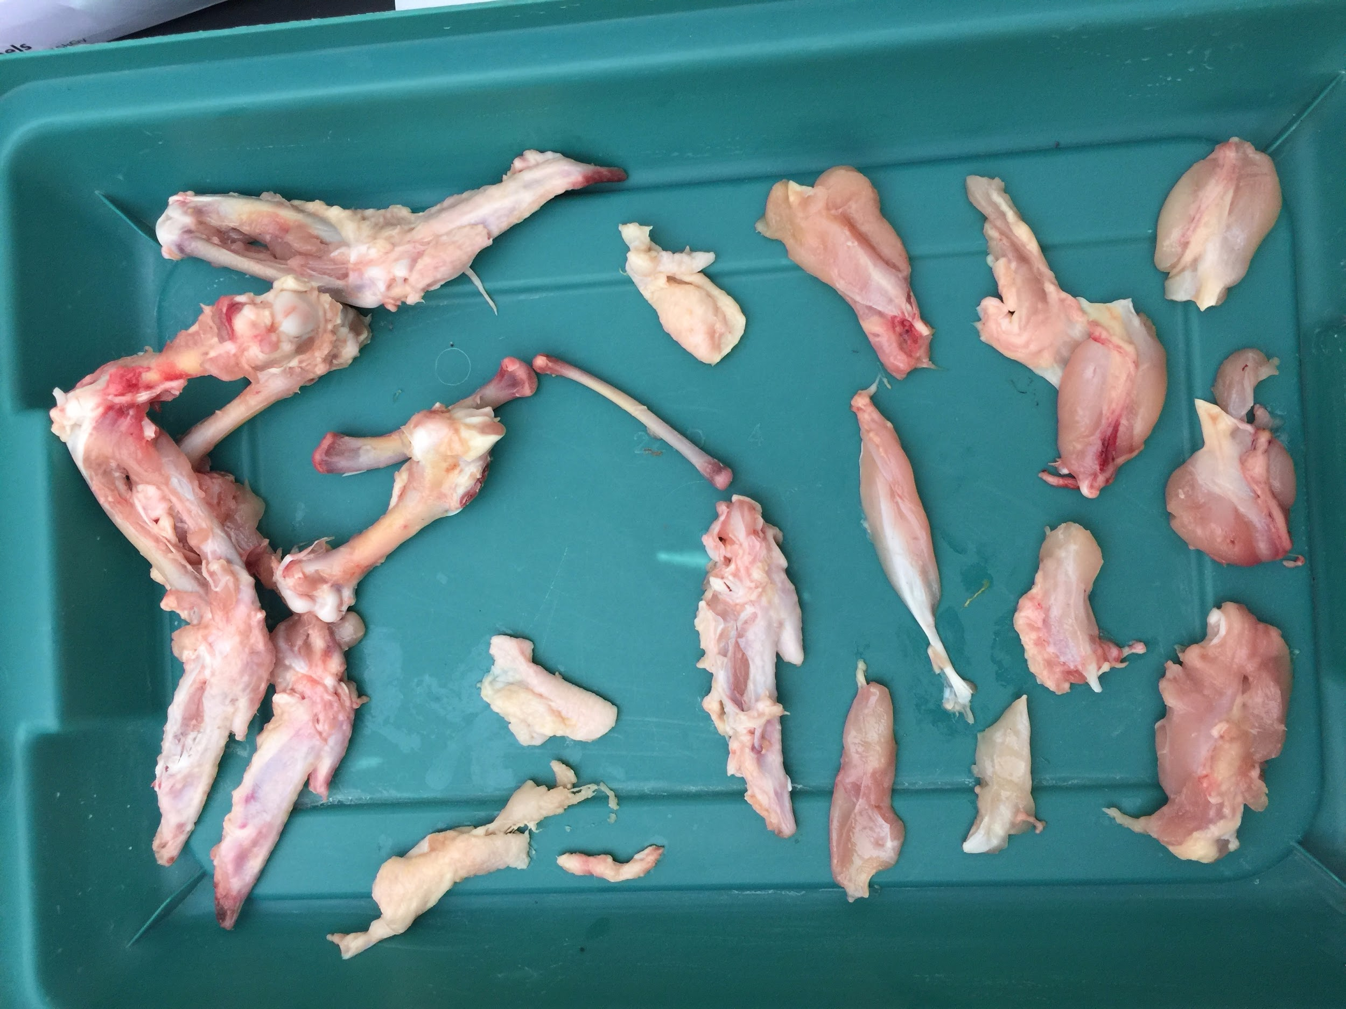
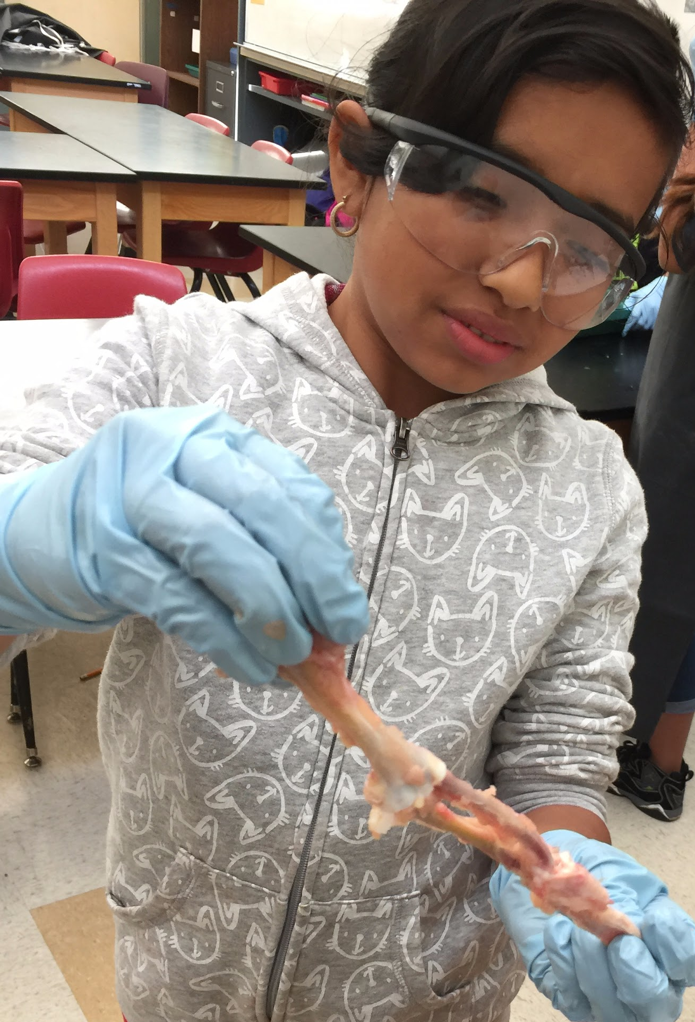
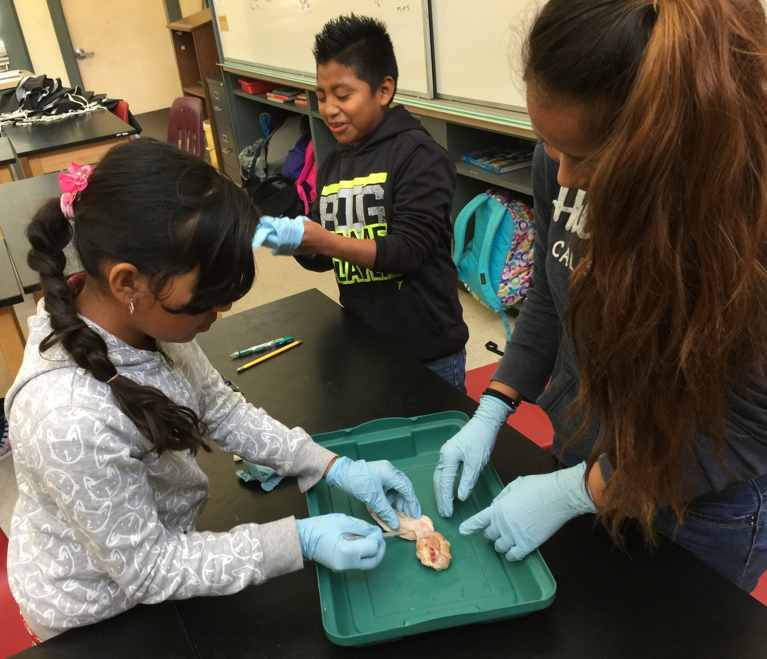
Sample Activity #3:
Chicken Bone Dissection!
Who can resist getting familiar with their dinner and dissecting a few chicken legs? The students saw firsthand how muscles are attached to bones and how the muscular and skeletal systems work together to make vertebrates move. This also made a nice tie in to our other work with comparative skeletal structures.

Slide 9
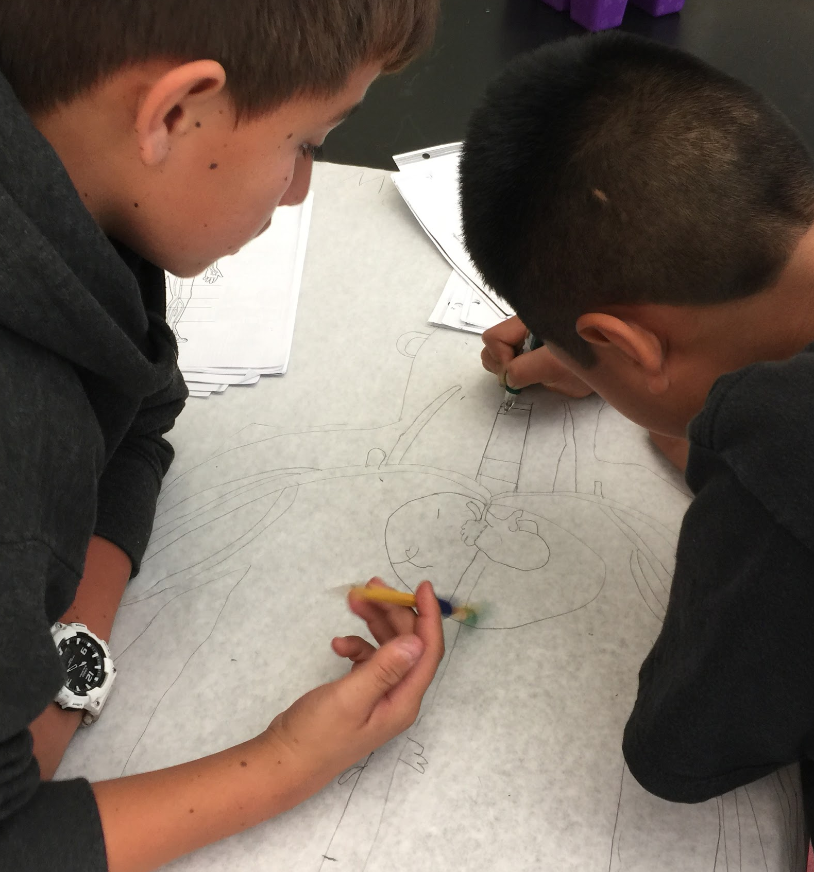
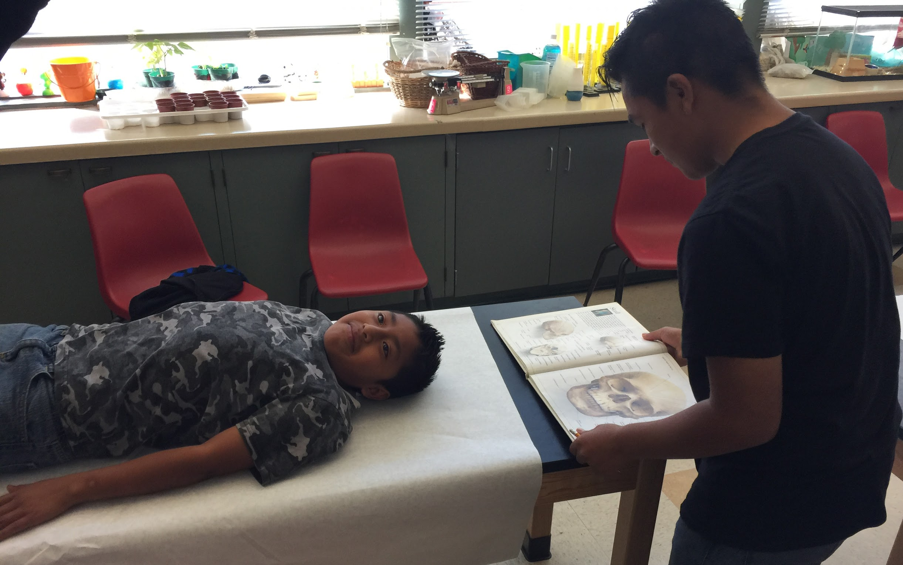
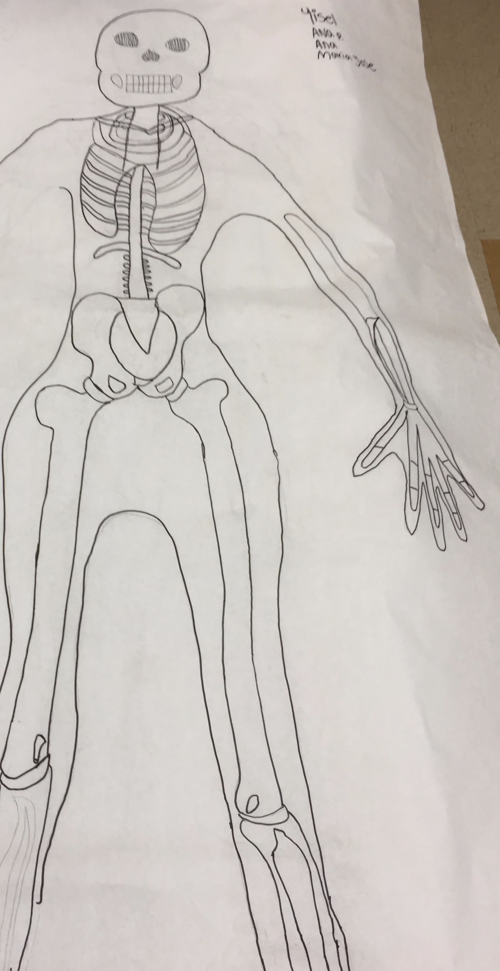
Sample Activity #4:
Butcher Paper Bodies
The tried and true technique of having students trace their peers on butcher paper and then fill in their guts in detail never gets old. We were able to use this as our introduction to the skeleton and as a way to really see the interface between the respiratory and circulatory systems. This gave the students the background that they needed to understand the faster paced video simulations that followed each activity.

Slide 10
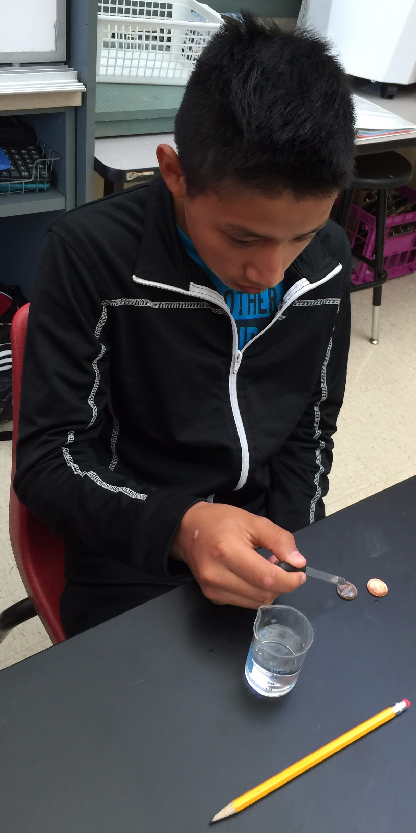
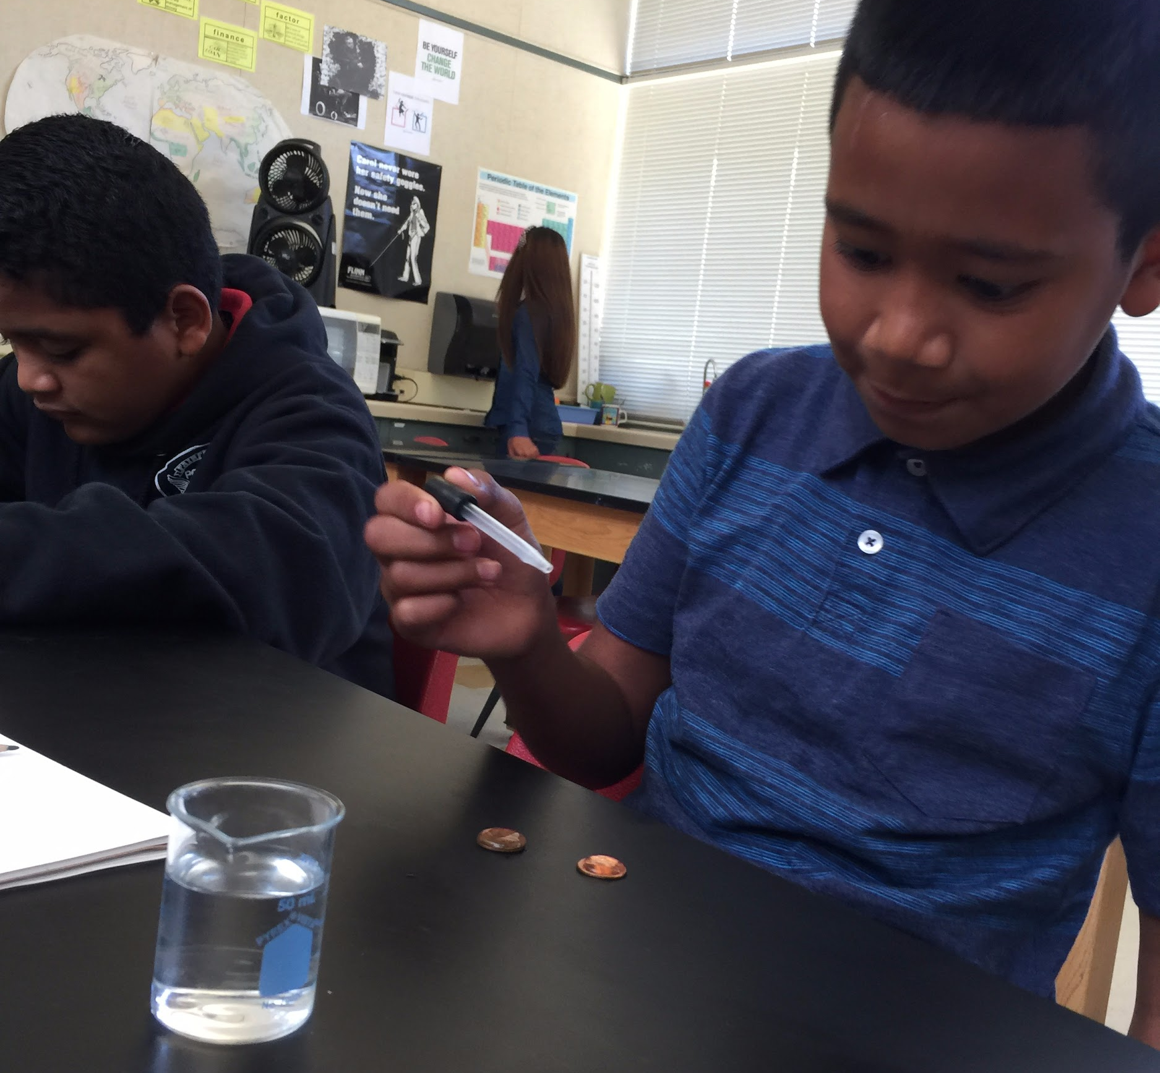
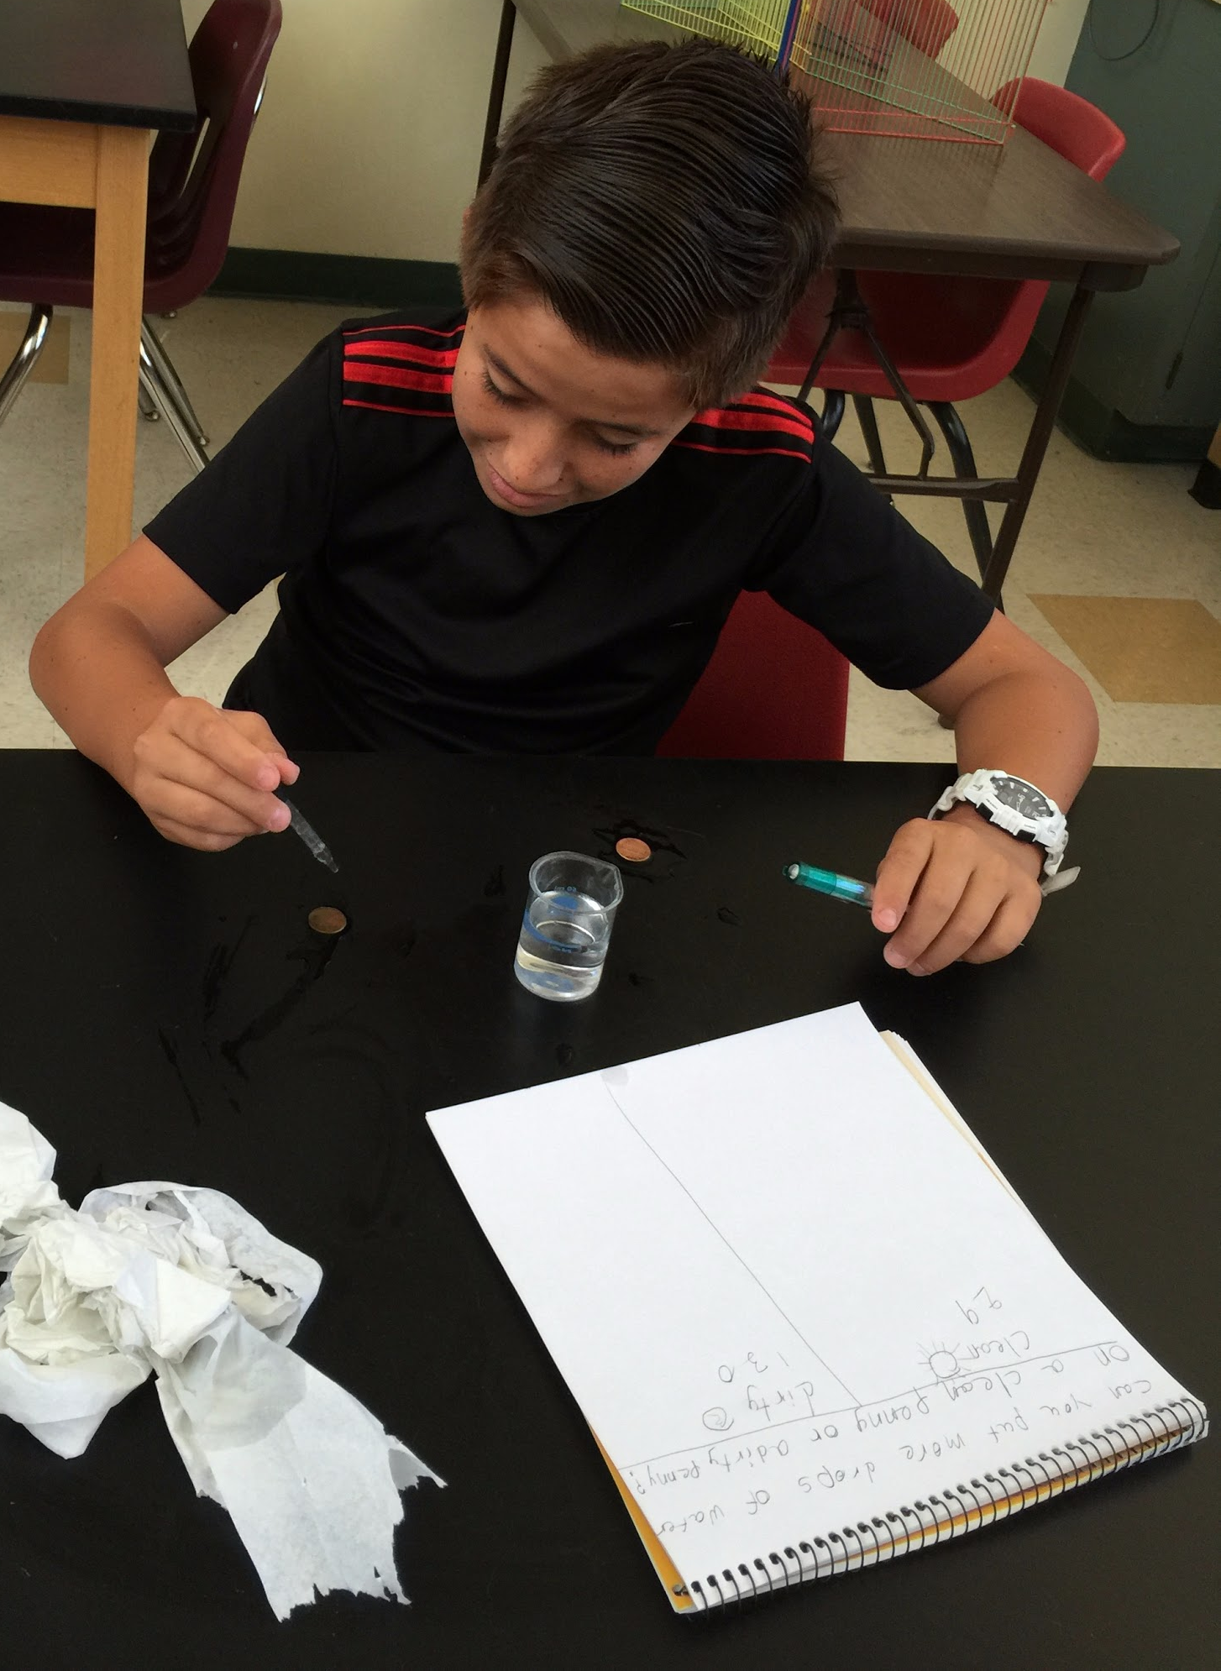
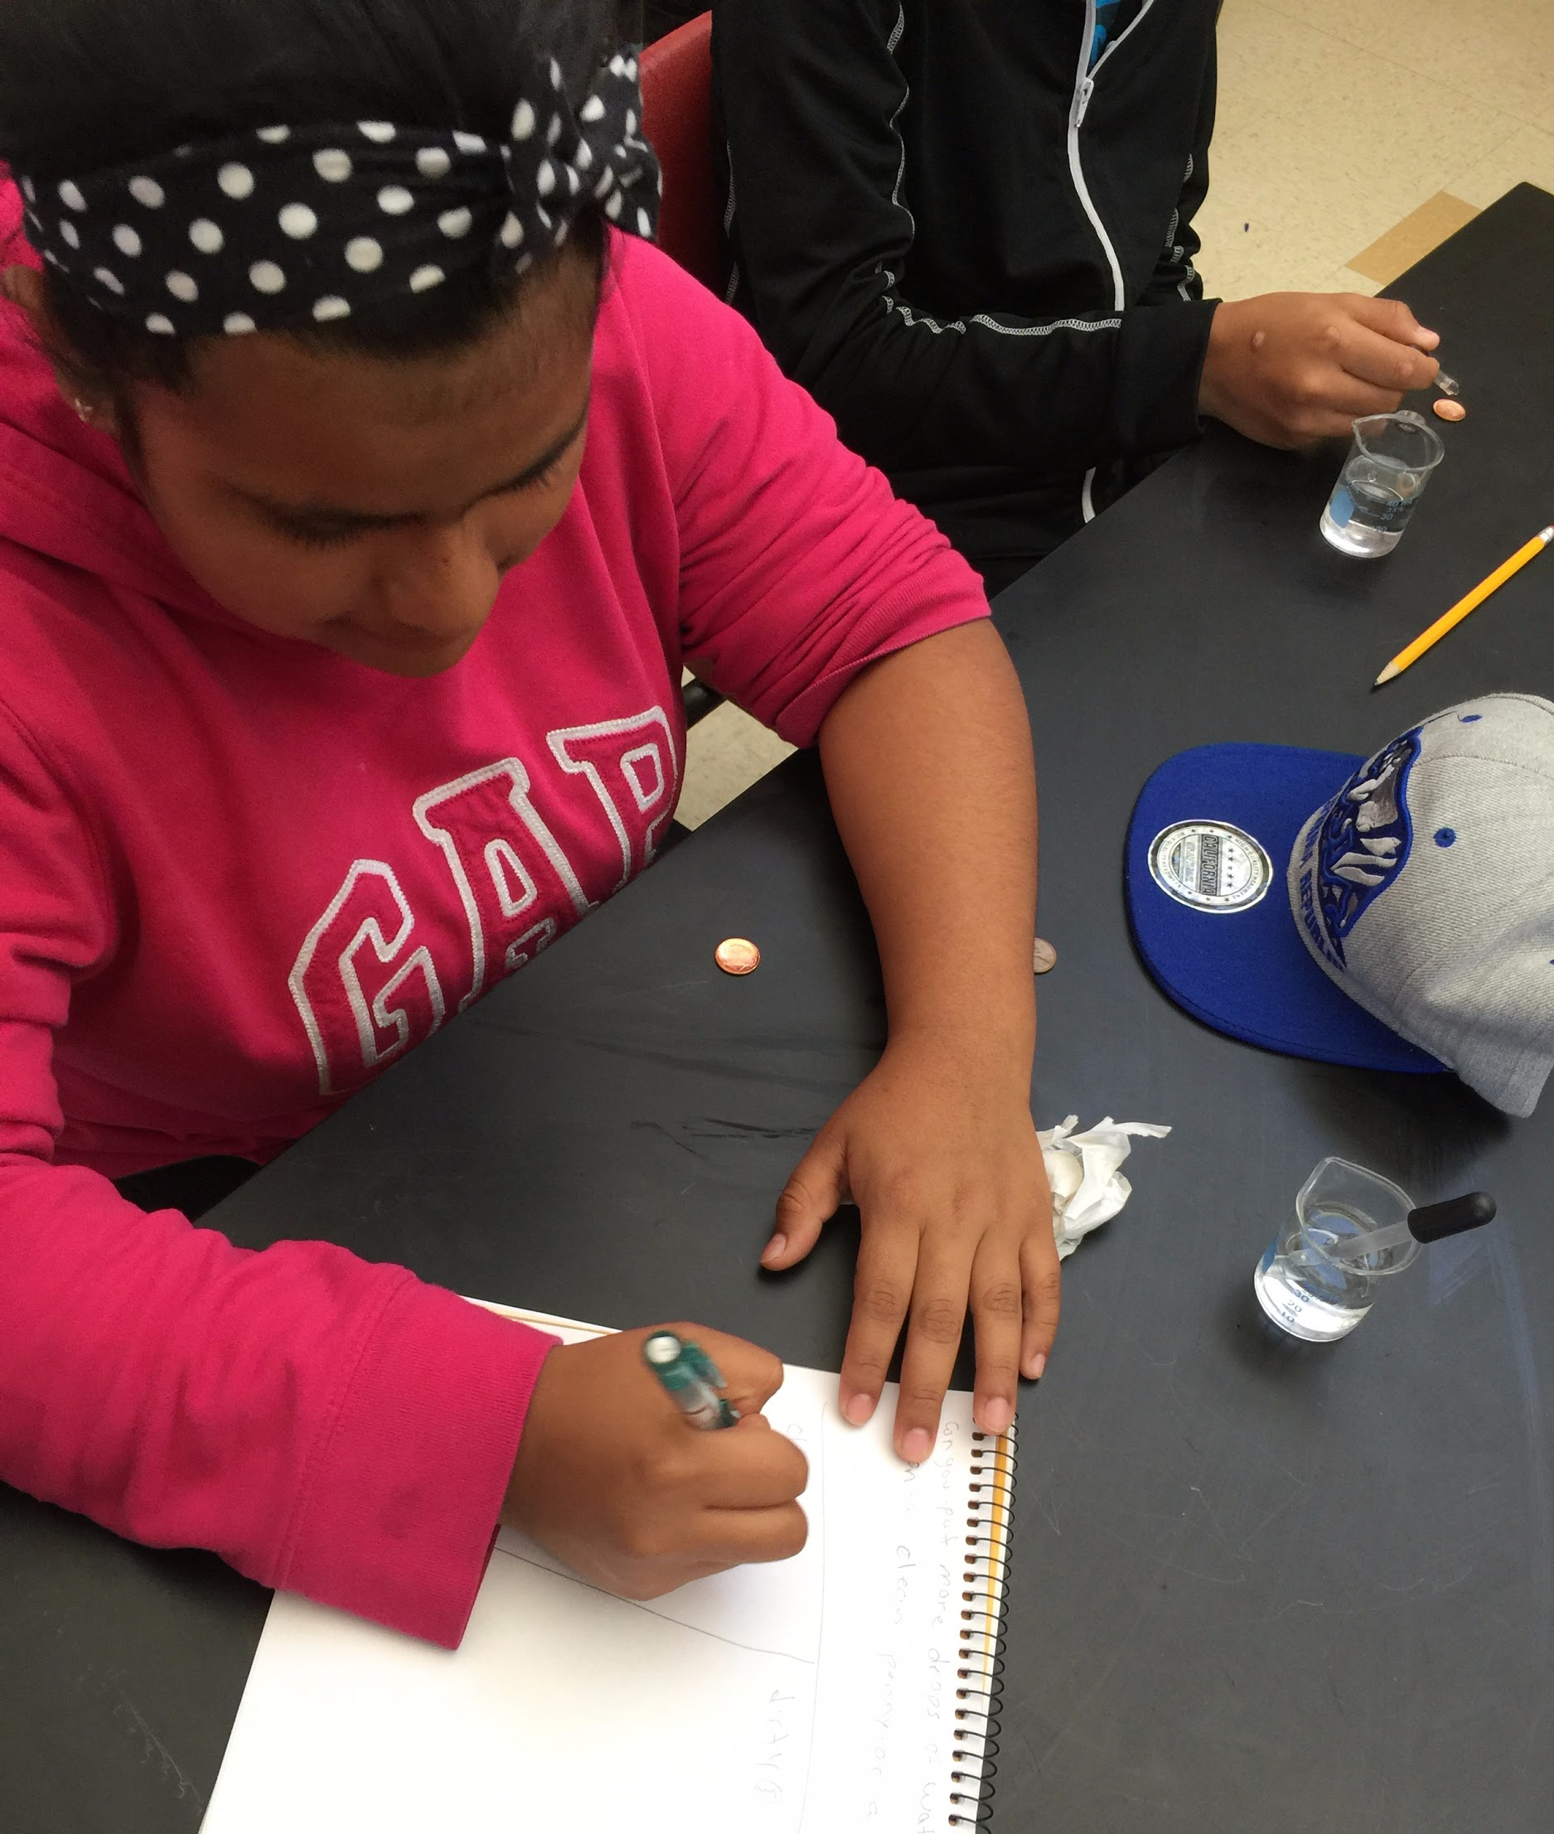
Sample Activity #5:
The Penny Experiment
Our ELD Science Team was able to piggyback off of work that we had done previously with other science PLCs. This Level 2 ELD class is doing an experiment traditionally used by the 6th grade team to introduce the formal scientific method. When there’s no threat of “stealing the thunder” from another grade level team’s activity (by ruining the novelty for students who might attend their class in the future), ELD subject matter teachers will find their peers more than willing to share the wealth of great ideas that they’ve developed!

Slide 11
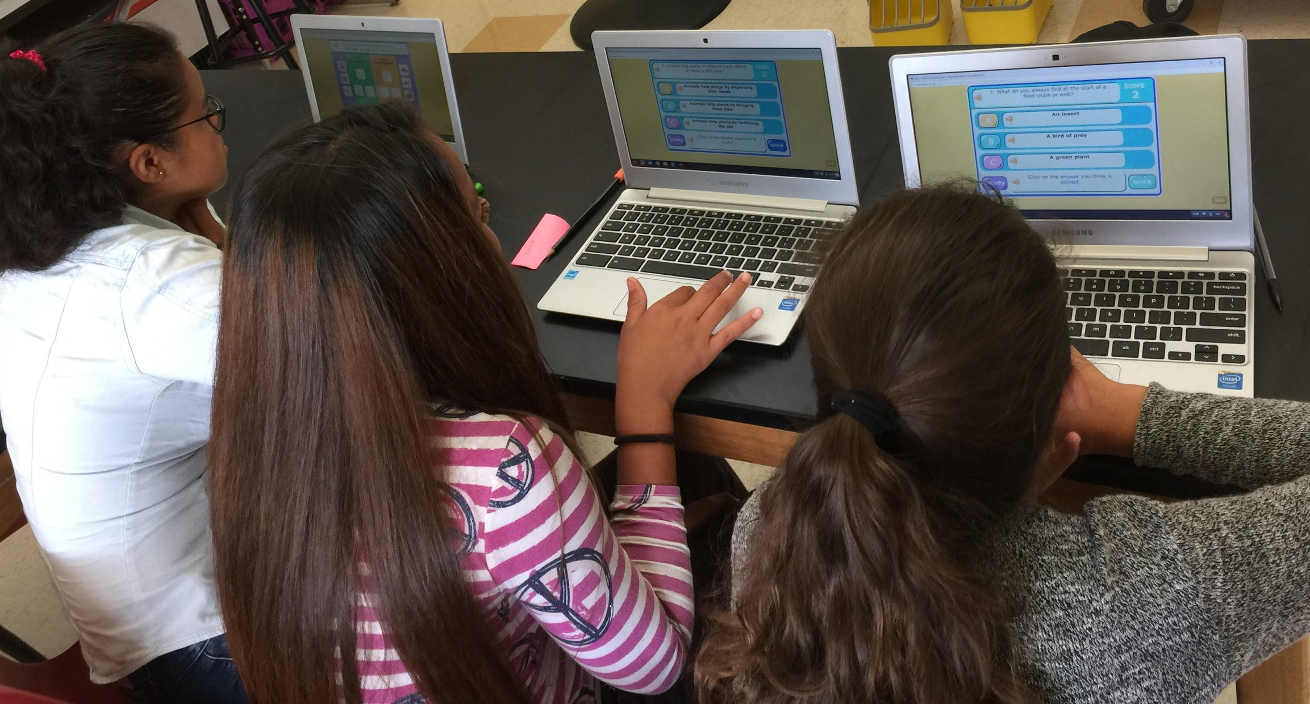
Sample
Activity #6:
Taking
Advantage of
Technology
Technology has made it significantly easier to come up with primary language text/explanations, visual aids and other online tools to share with ELL students - even at the last minute or during a “teachable moment”. These are great alternatives to resorting to “busy work” on a day when your prep time has been lost due to an unexpected student issue or a site emergency. The low grade image on the left was projected in the classroom during an on the fly Google image search based on the search words “vertebrates spanish”. Below, the students are exploring some old BBC science simulations that illustrate a variety of concepts. They were easily accessed through one of the elementary site’s student links on a day when a Chromebook cart happened to be available in the classroom.

Slide 12
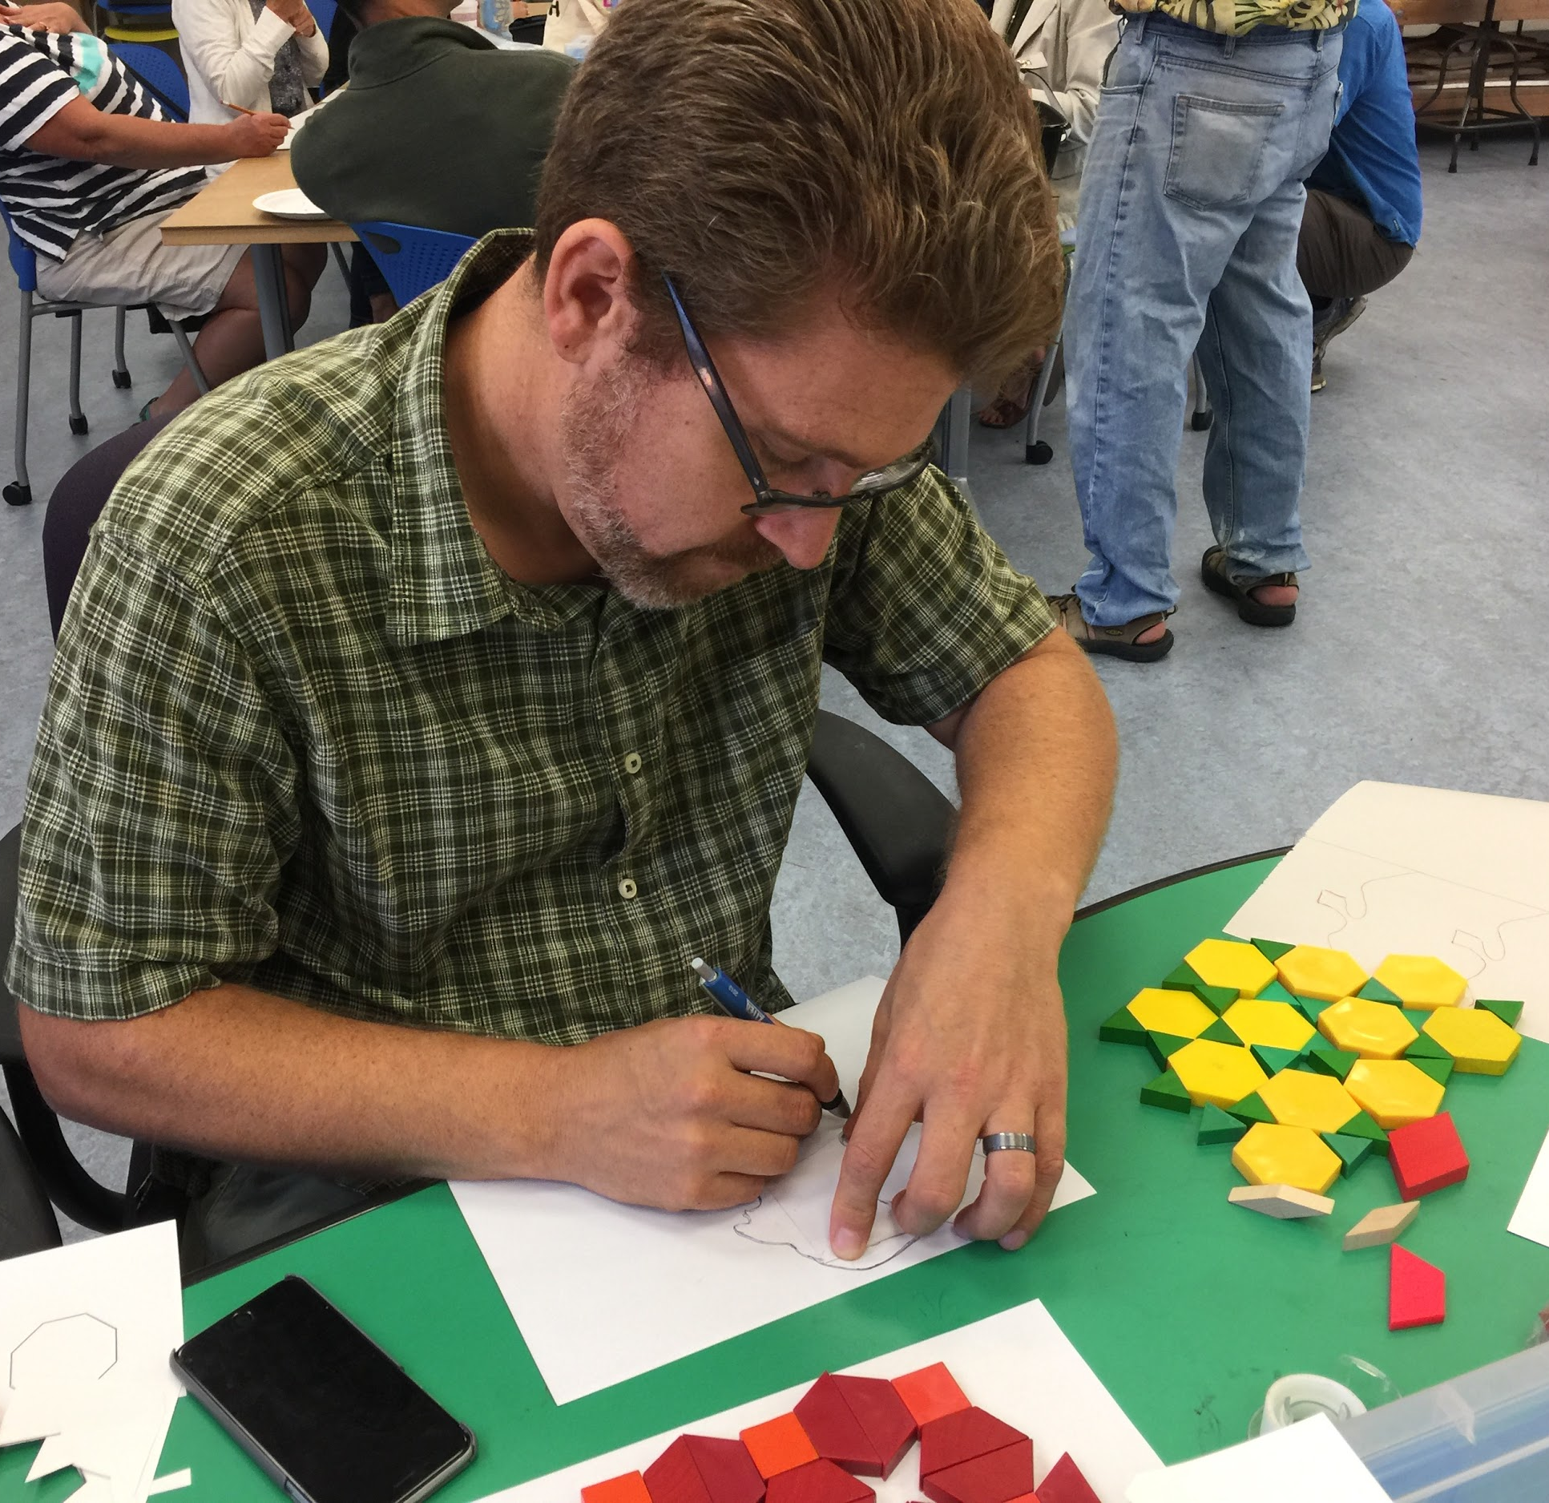
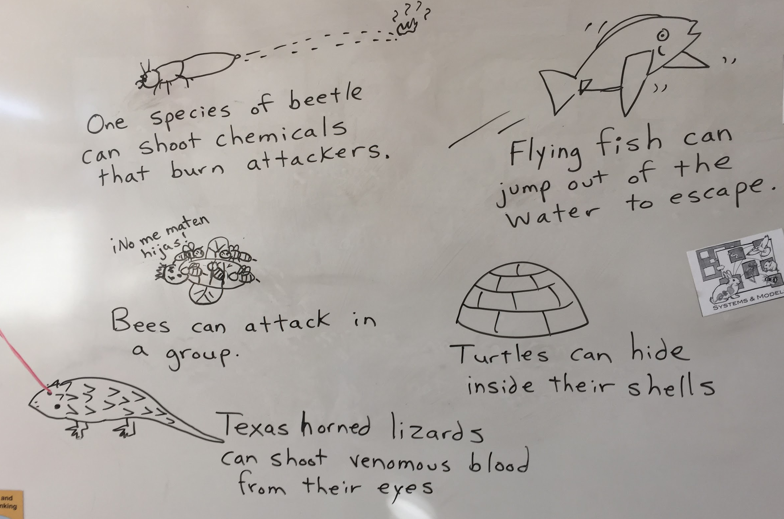
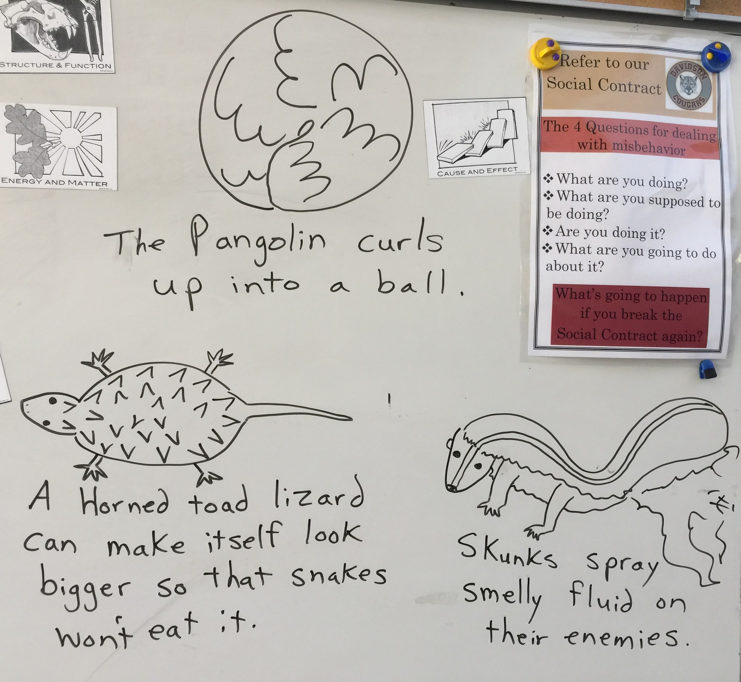
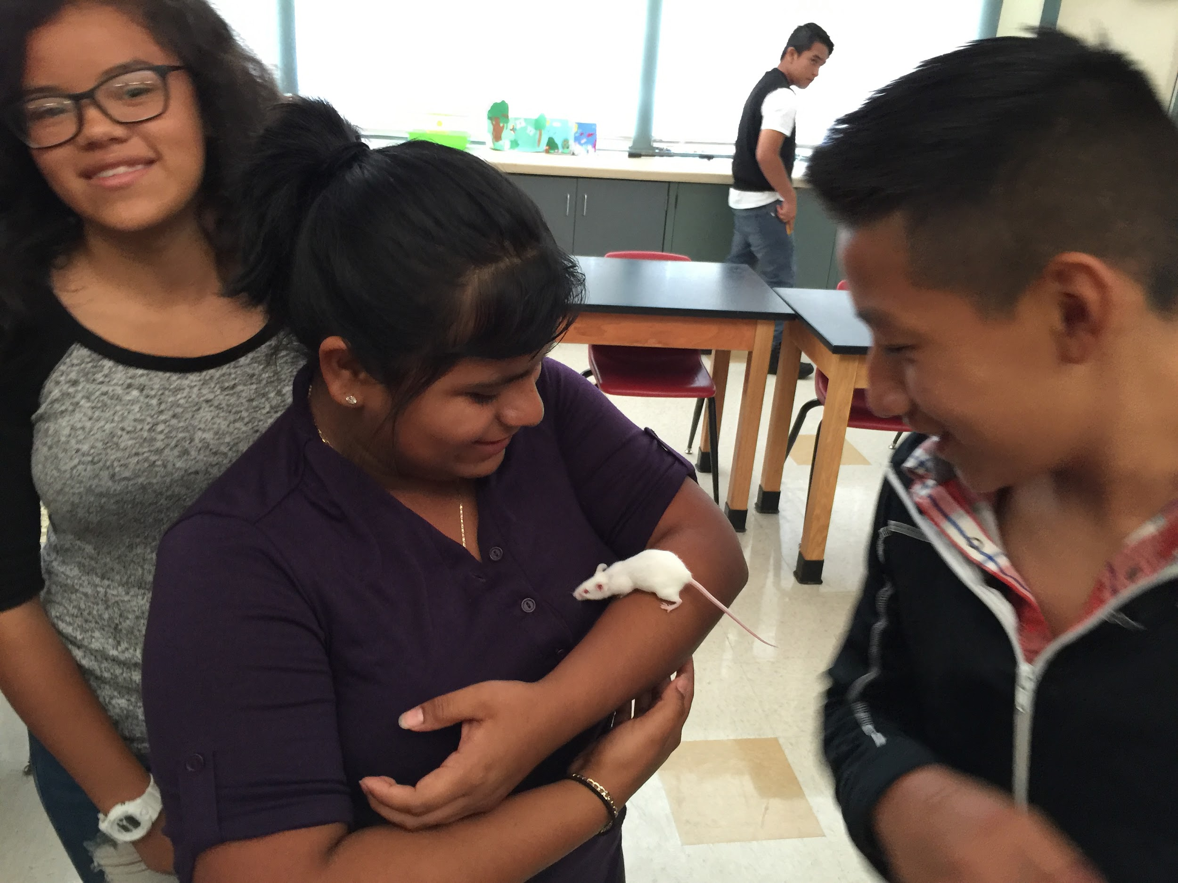
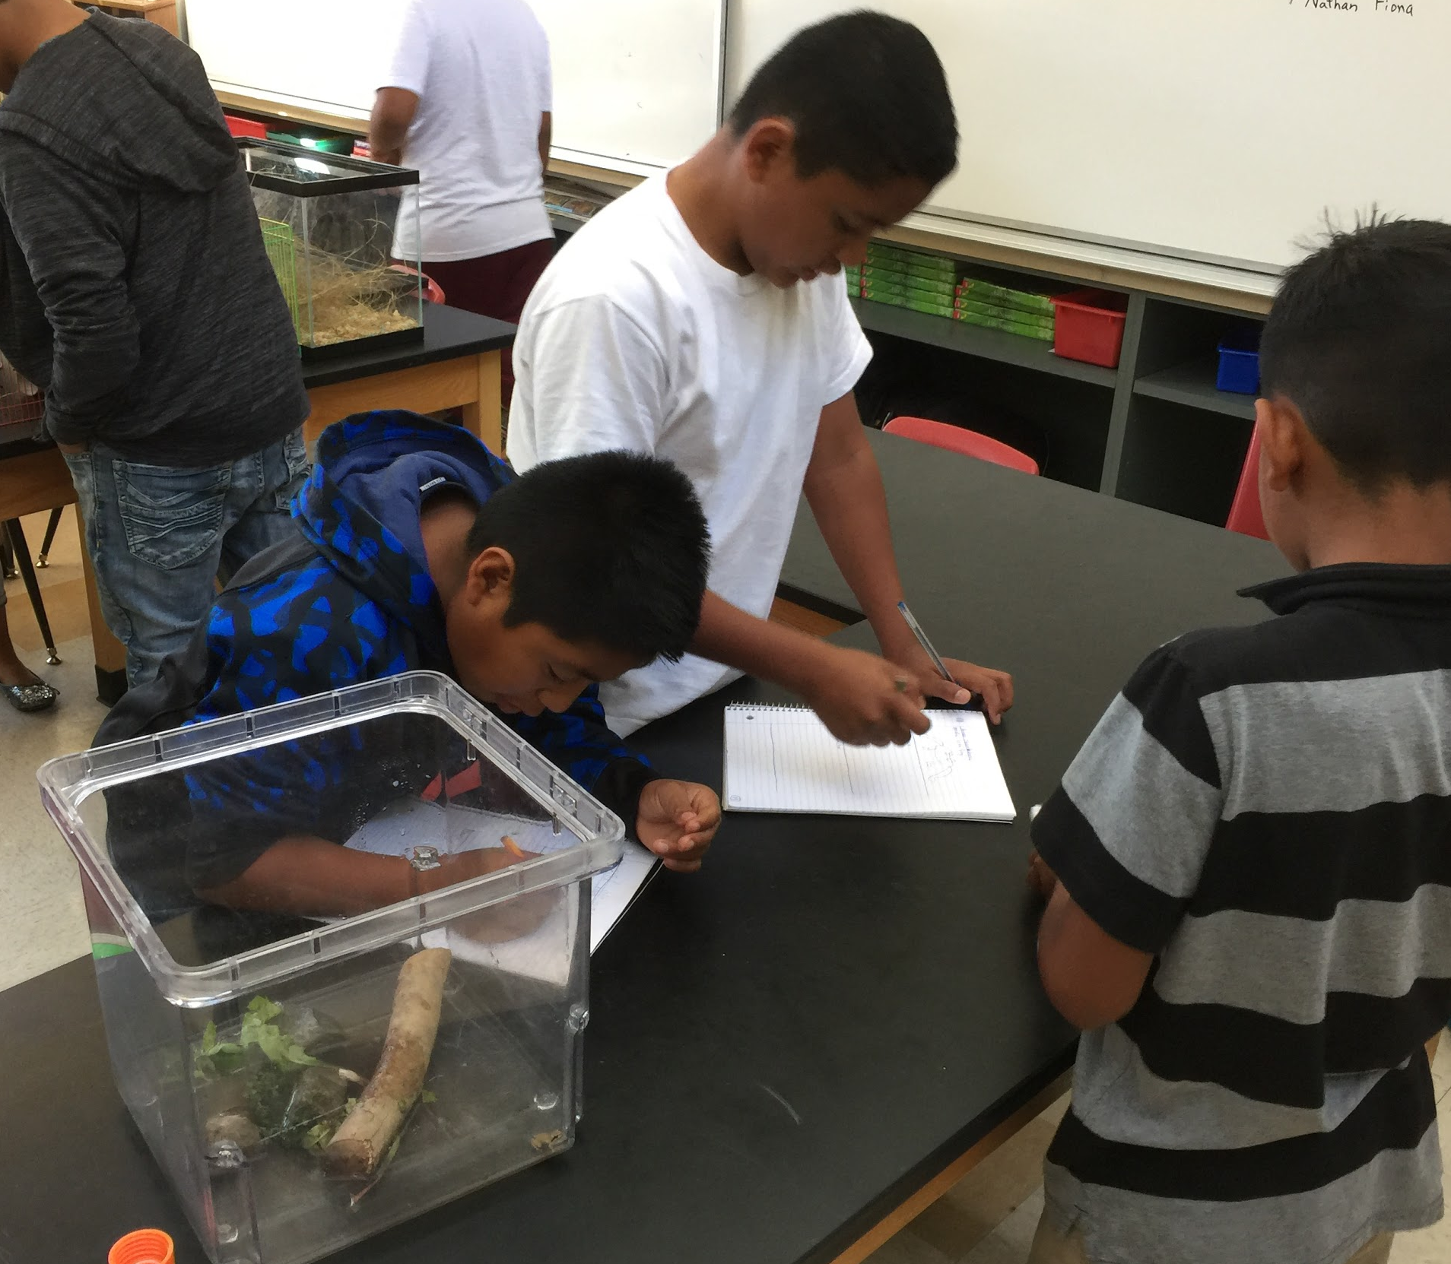
Sample
activity #7:
Integrating
Art
The students in ELD Level 1 started the year with a drawing book in which they created diagrams, visual dictionary pages and a myriad of other formats for adding meaning to their writing with images. In ELD 2, the students routinely incorporated drawings with their observations (as in the live animal observation activity below). They also did a number of guided drawings to illustrate examples and bring concepts to life. (Any teacher with a student who can draw well in his/her class or who knows how to surf the Internet has all the guided drawing help s/he needs!).
(As Mr. Singer can tell you, the iTeams STEM training included a great deal of integrated art & design!)

Slide 13
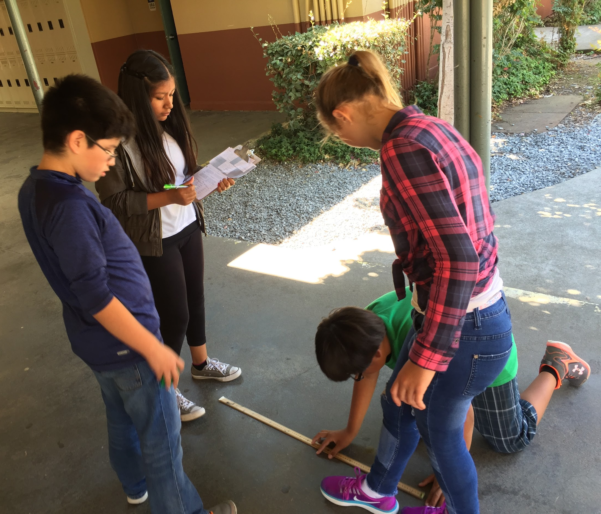
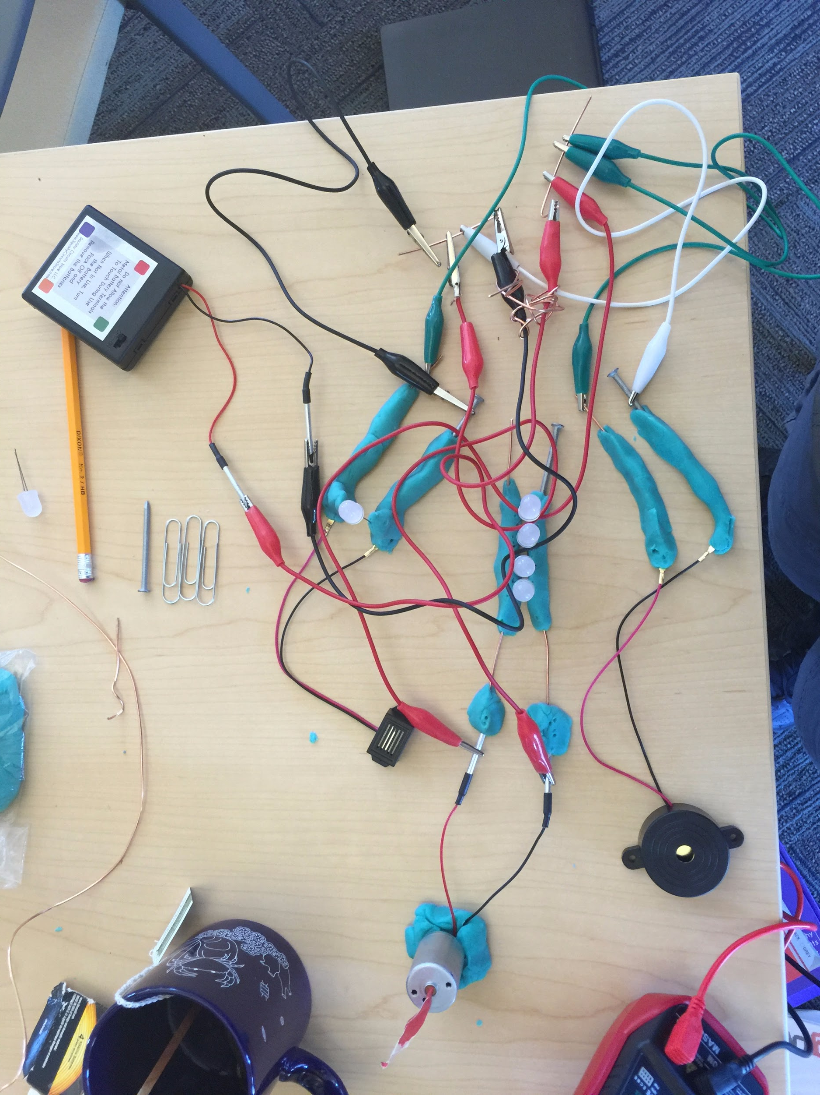
Sample Activity #8:
Using STEM Activities
(or whatever other
engaging,rich,
innovative & challenging
techniques you are
using with other students!)
The “regular” science students pictured above are doing the exact same STEM activity that was used with students in ELD Science at our site. When she heard about this, SRCS Board Trustee Maika Llorens Gulati thought it was more than appropriate. “Just because you speak with an accent, doesn’t mean that you think with an accent,” she commented. This is the expectation in our District. Just as we want the elementary students to arrive at Davidson Middle School with similar preparation in math (for example), the high school teachers want students who are prepared to take on tasks that require critical thinking, intellectual rigor and an understanding of how to work effectively with a team to solve problems and meet challenges. Not every student will have the same command of the English language or even the same level of mastery of subskills or tertiary concepts. We want them all to have some handle on the main concepts in each subject area, however, as well as the ability to use the human and technological resources around them to mitigate any academic or interpersonal weaknesses that they possess. This is part of the shared mission which the passionate, hardworking staff at our school clearly shares.

Slide 14
So what would you like to try in order to improve the education of the ELLs in your classes (whether they’re newcomers or those students seemingly “stuck” in the Long term ELL classification)?
… and how can the rest of us support you in your efforts?
We’ve put together a few tools, resources and reminders that have helped us in our work in starting up the ELD Science Program at our site this year. For even great expertise, please consult the dedicated ELD teachers at our site. (PS: They are not responsible for this slide show content, so don’t blame them for any editorial comments that you may find along the way!)
((PPS:
If you know any of these concepts so well that you never get too tired, busy, distracted or frustrated to forget them, then feel free to click through the following slides at will.
They are not meant to be condescending, boringly obvious or a waste of your time.
These are simply reminders that came in handy for us on a fairly regular basis.))

Slide 15
A few basic reminders & guidelines:
#1: BICS ≭ CALP - J. Cummins pointed out that problems arise when educators think that a child is proficient in a language simply because they demonstrate good social English.
Basic Interpersonal Communication Skills (BICS) are language skills needed in social situations. It is the day-to-day language needed to interact socially with other people. Social interactions are usually context embedded. They occur in a meaningful social context. They are not very demanding cognitively. The language required is not specialized. These language skills usually develop within six months to two years after arrival in the U.S.
Cognitive Academic Language Proficiency (CALP) refers to formal academic learning. This includes listening, speaking, reading, and writing about subject area content material. This level of language learning is essential for students to succeed in school. This usually takes from five to seven years. Some research has shown that if a child has no prior schooling or has no support in native language development, it may take seven to ten years for ELLs to catch up to their peers (Thomas & Collier,’95).
#2:Prior Education & Parental Educational Level Make a Huge Difference - This is not an excuse to give up or write off certain students of course. This is just a reminder to temper our frustration or the tendency to unfairly blame some of our students’ poor performance on apathy or lack of effort. As we’ve all seen with all of our students, not all our newcomers & ELL’s come in with the same advantages that other newcomers & ELL’s have. Being aware of students’ backgrounds is useful in providing both appropriate supports and appropriate challenges to each student.

Slide 16
#3:Mental Exhaustion & the Affective Filter Must be Taken into Account
Most people think abstractly in their native language. Some students lack abstract vocabulary in both their home language and in the literate English used at school; therefore, a lot of the work that we do can feel like a bit of a stretch to them.
Constant immersion in a second language environment is mentally exhausting. When social or cultural differences are added, the situation is compounded.
Mental exhaustion & cognitive dissonance can have a huge impact on information processing, work efficiency, and organization. They’re also routinely associated with depression, irritability and anxiety. Add the ongoing adjustments of maturation (especially adolescence) and any economic, familial or other stresses at home, and you can see what our ELLs and other linguistically disadvantaged students are up against.
#4: Assigning Work Isn’t Teaching
If the students cannot decode and comprehend at least 80% of the reading material that is being assigned to them, then they are not at an independent working level. They are at what is referred to in academic research as the “frustration level”. This leads to disengagement and reduces the possibility that a student will choose to read on his/her own, further widening the performance level between students.
If students haven’t had enough guidance in gathering relevant evidence,supporting/refuting a claim, structuring a cohesive argument, or proofreading/editing for grammar/spelling, then simply assigning thesis writing to students is not an appropriate educational practice, no matter what your subject is.

Slide 17
#5:One Size Doesn’t Fit All; Be Wary of Easy or “Mandated” Solutions
Both the “sink or swim” Full Immersion un-scaffolded Academic English approach and the segregated alternative of allowing students to “hide out” in Native-Language-only or “strategic”, leveled work groups fail too many of our students. Students drop out psychologically and then academically, or they muddle through the educational system with limited understanding and are passed on with sub-par skills.
Teaching only to the academic/linguistic or intellectual “middle” ignores the needs of the students both at the top & the bottom of the group. It can be just as harmful to put a disproportionate amount of available of the resources & effort toward the needs of our most underperforming students while neglecting our public duty to train a large productive workforce and to challenge tomorrow’s innovators, entrepreneurs & Nobel Prize winners. Full inclusion works best when it addresses the needs of all of our students yet is as pragmatic & efficient as possible with our available resources so that we can effectively educate the greatest number of students.
As we innovate, seasoned educators are always careful not to “throw out the baby with the bathwater” or to repeat the same old mistakes. Lasting programmatic change involves learning from the past, while being open to new tools, approaches & ideas.
#6: Differentiation, Scaffolding & Thoughtful, Intentional Curriculum Design are the Keys to Successful Integration
We all know this. It’s one of the big challenges that we face as professionals. Sometimes all of the work that we have to do to try to reach each student is an exhausting, inconvenient truth. And sometimes we simply don’t have time to do as much planning, scaffolding or diversified resource acquisition as we’d like to. Other things like e-mail, paperwork, grading, meetings, adjunct duties or life get in our way. That doesn’t mean that good teachers will ever stop trying. It’s just who we are.

Slide 18
Take Advantage of the Latin Roots of Academic Vocabulary
Many scientific words (and academic words) are Spanish cognates. (For example: absorbent -absorbente, activity - actividad, adaptation - adaptación, adult - adulto) Students who have had a strong education in a Spanish speaking country can transfer a lot of this language.
Links to three middle school Spanish-English glossaries from NYU are below
http://steinhardt.nyu.edu/scmsAdmin/media/users/xr1/glossaries/Science/ScienceIntermediate/ms6to8sciencespanish.pdf - Science Glossary
http://steinhardt.nyu.edu/scmsAdmin/media/users/xr1/glossaries/Math/Grades6to8/ms_6_8_math_spanish.pdf - Math Glossary
http://steinhardt.nyu.edu/scmsAdmin/media/users/xr1/glossaries/SocialStudies/Intermediate/msSocialStudies6_8Spanish.pdf - Social Studies Glossary

Slide 19
Websites & Video Resources Abound!
YouTube is one of the easiest “go-to’s”. The fastest method for a decent YouTube search is to find your search terms using an online Spanish dictionary.
One resource with various Science website links for Spanish resources is - http://www.crscience.org/educators/SpanishResources
A couple of other popular resources are:
BrainPop Español- Esp.brainpop.com - SUBSCRIPTION ONLY - Cool animated movies, quizzes, lesson plans, and facts about science and technology K-12
Comunidad Educativa de Castilla y Leon http://www.educa.jcyl.es/en Click through explanations, experiments, worksheets covering many topics, such as: Kingdoms of Living Things - 5th, Planets - 3rd, Volcanoes, Water Cycle, …
And NASA’s Spanish website - https://ciencia.nasa.gov/

Slide 20
STRATEGIES TO MODIFY CONTENT
Adapt, adjust, and simplify the content in your curriculum. Ask: What do I really want my ELLs to know? By definition, these students cannot learn all of the details of all of the content or they would not be classified as LEP. If we try to teach them everything, they may well end up learning nothing.
Therefore, focus on the principle of “learn more about less.”
• Select Priority Topics—one that recurs at various grade levels or is a concept upon which others are built, e.g., magnetism in science, freedom in social studies, and place value in math
• Select Topics of Interest—topics that relate to students’ personal experiences or prior learning
• Select Practical Topics—topics that are easiest to make comprehensible to ELLs, the ones that best lend themselves to the modifications described here
• Select Challenging Topics—and go for depth not breadth. Have ELLs become “experts” in a narrow section of content, rather than trying to have them master everything in a unit. For example, in a science lesson on the Solar System, the ELL can focus on a single planet; in a Social Studies unit on the Civil War, they can concentrate on a single battle or figure.

Slide 21
STRATEGIES TO MODIFY ORAL INSTRUCTION
ELLs are often working to translate what they hear (English) into what they understand (their primary language). Complicating this “double duty” is the fact that while working on the meaning of one sentence, they then completely miss the next thing the teacher says. For ELLs, then, how the teacher speaks is as important as what the teacher says.
• Change the Pace of Your Speech - Slow Down - Speak at a slightly slower, but not unnatural pace; pause for an extra second or two to give students a chance to process the oral language and catch up.
o Enunciate - Try to speak as clearly as possible, vary the pitch of your speech, and emphasize key words, as if underlining them in a text. Do not raise your voice.
• Simplify Your Speech - Avoid contractions - Use Fewer Pronouns - Use Simpler Words - Simplify Your Sentence Structure
o Teach the Meanings of Words or phrases that are Used in Different Ways- Explain and Limit Idioms

Slide 22
More Strategies to Use with ELLs
• Enhance Your Words - Use Gestures Make oral language a visual experience by using hand gestures and facial expressions (but try to make it part of your usual style so that you do not appear to be singling out the ELLs for this “special” visual enhancement).
o Use Visuals and Graphics Whenever possible - write on the board, use pictures, real objects, maps, graphs or anything else that would visually enhance your words. This will help contextualize your speech.
o Use Repetition and Paraphrase; Emphasize key points by summarizing or repeating them several times during class and not just at the end. Ask: “So, why was _______ important?” “Who can explain the process we just saw?”
• Check for Comprehension - Avoid asking, “Do you have any questions?” This can make those who do have questions avoid looking “stupid” by simply keeping their mouths shut. Instead, expect questions by saying, “OK, question time. What questions do you have for me?” Reinforce by answering, “Great question. Thanks for asking that!”
• Give Clear and Consistent Directions - State what you want students to do in a simple, step-by-step manner - Support your words with written directions and keep these in view during the lesson. - Model the process and the product so they can see exactly what to do and what the result should look like.- Check for comprehension by asking students to repeat what they are expected to do.
• Develop and Maintain Routines - All of your students will benefit from knowing what happens each day, but especially the English Language Learners.

Slide 23
STRATEGIES TO MODIFY THE LANGUAGE OF TEXT
• Explicitly Teach how to access info in Textbooks & Online Articles - chapter titles, section headings, text boxes, highlighted or bolded terms, diagrams, outlines, summaries, discussion questions, glossaries, bilingual resource/dictionary links etc.
• Pre-teach Select Vocabulary - select vocabulary that may be difficult or technical, as well as key concepts, and teach these to the whole group . You can also have students create their own personal dictionaries of new and important terms.
• Highlight Important Concepts - Make an outlines, Cornell Notes or Powerpoints for important chapters/articles. Offer buddy students extra credit if they will work with ELL students in making partner notes of articles/chapters that you don’t have the time to do with the whole class. A bilingual peer may be asked to translate concepts and information from the text for newcomers and other non-fluent ELLs.
• Group Students to Discuss the Text, Lab Questions, Introductory/“Do Now” Questions, etc, - Many students learn more from small group discussions, where the language demands are less and the social/embarrassment stakes are lower, than they do in a more formalized, whole group question-and-answer exchange with the teacher.
• Have your class use Subject Notebooks, Learning Logs, Interactive Notebooks, and/or Established Note sections in Multiple Subject binders - Option a) Have students record their notes, key diagrams, “Do Now”/ Exploratory questions, reactions to the text, etc. in a daily journal. Option b) Have students set up established areas in notebooks/binders for “Cornell/Text Notes”, “Diagrams/Flowcharts/Test Review Summaries”, “Key Vocabulary” and a “Questions I Want to Know/Test Corrections/Help me with this!” area. If you don’t routinely have time to look at student logs/notebooks yourself, allow students time at intervals to meet in groups to discuss their entries (and seek teacher support as necessary). Students can also be required to bring their learning logs/ notebooks/ binders to teacher tutoring sessions. The logs/notebooks can clearly serve quite well as notes for test reviews.

Slide 24
STRATEGIES TO MODIFY WRITTEN ASSIGNMENTS
Goal: To create challenging assignments that teach content but keep the language as simple as possible.
Strategies to use with regular, Whole Class Assignments:
o Provide a Word Bank (of key content words, descriptors & important transitional phrases)
o Assign Fewer Questions to ELLs - Select the ones that seem most central to the topic
o Evaluate for Content Only (Read ELL student work for content, not for grammar.)
o Provide Models and Outlines, such as pre-formatted sheets so that ELLs can concentrate on the content and not on creating language to convey the content. (ie. In science, a pre-formatted form might look like this cloze/fill-in-the-blank example:
“We wanted to show that __________” and “The first thing we did was ___________________.”

Slide 25
Developing Alternative Assignments
o Diagrams, Maps, and Charts - In place of descriptive writing, ELLs can complete a map, chart or diagram. Requiring the addition of some words or short phrases may also be appropriate. Writing may be required in English or a student’s primary language, depending on the ELLs level of proficiency.
o Sequenced Pictures - These work well in science and history classes, where, instead of writing up the results of an experiment or a sequence of historical events, ELLs can draw sequenced pictures that illustrate several stages, steps, events, or causes & effects.
o Graphic Organizers - Word webs have the widest application, allowing students to depict complex relationships among elements with minimal language. In social studies they can be used to show the causes of a war or in science to classify, categorize and describe substances and structures. Venn diagrams and timelines are also effective for ELLs.
o Hands-on Assignments - In addition to practicums or live assessment of activities by the instructor, you can have newcomer/beginning ELLs show mastery of content by creating dioramas or models. As they acquire more language, ELLs may present an experiment, exhibit, or demonstration.

Slide 26
STRATEGIES TO MODIFY INSTRUCTIONAL TECHNIQUES
• Activate Background Knowledge - make learning meaningful by building upon students’ prior knowledge
o Brainstorming o Think-Pair-Share. o K-W-L Chart on the board/notebooks/hand-out/”Do Now” to find out what students already know (K), what they want to learn (W), & afterward, what they have learned (L).
o Personalize Lessons - invite students to share first-hand knowledge or experiences related to the lesson. To introduce the Civil War (or any war, for that matter), you might talk about the concept that differences among people can lead to conflict. (Sadly, many ELL students may be able to share first-hand knowledge of conflicts from their own countries.)
• Increase Teacher-Student Interaction - a) Monitor Your Interaction Patterns - Many of us realize from time to time that we are not interacting with all the students in a class. Use a checklist, popsicle sticks,... if necessary to make sure you call on every student., b) Build Participation Skills - The challenge with ELLs & many other students is to avoid putting them “on the spot”. Build student skills/confidence with basic recall questions & then move them up to higher order questions. Give students wait-time to think before you call on one of them.
• Enhance Teaching Techniques - Write key points & questions on the board, Illustrate Your Words (pictures, maps, charts, realia), Demonstrate Your Words (model step-by-step how to solve a problem), Dramatize Your Words (ham it up, emote, pantomime)

Slide 27
STRATEGIES TO MODIFY ASSESSMENT
Short answer and extended response questions can be extremely difficult for English Language Learners. Even “simple” multiple-choice questions can be hard for them (because of the high reading skill required). Grading these tests raises a fairness issue. Compared to native English speakers, ELLs often “earn” a failing grade on standardized tests. If you give the grade they earned, that can seem unfair, given the student’s lack of English. However, to give a higher grade can seem arbitrary or unfair to those who actually earned those grades. The answer is to use alternative or modified tests for ELLs.
• Modifying Test Techniques: 1. Replace multiple-choice questions (or even short answer and essay questions) with completion questions, which require a much lower reading demand, e.g.,“The Battle of Antietam was important because ___________________.” 2. For essay questions, allow students to use visuals and graphics (ie., sequenced pictures, T-lists, labeled diagrams, flow charts or maps. 3. For essay questions, use the cloze technique, omitting key words from a paragraph that students then have to replace. 4.Allow the use of a bilingual dictionary. 5. Allow extended time for test completion or divide the test into several sections and give each one separately. 6. Shorten the test (by selecting only the concepts of primary importance). 7.Limit choices on multiple-choice tests (ie., from four to three or two). 8. Divide word banks into smaller groups (ie., one word bank for every 4-5 questions). 9. Change all or part of the test to an oral exam 10. Allow students to use their notes or the textbook.

Slide 28
As a final note, keep in mind that a Little Peer Cheerleading Goes a long Way. This is an article from Education Week that ELD Teacher Tom Kernan sent us to laud our efforts:
With More Exposure to Science, English-Learners' Achievement Soared By Corey Mitchell , Education Week January 19, 2017
Integrating innovative science courses and English-language instruction can dramatically boost student achievement and test scores in the sciences, along with reading, and writing, according to a new study from the Oakland, Calif.-based Education Trust West. The curriculum in each district was aligned to the Next Generation Science Standards, a set of common science standards adopted by states that emphasize scientific inquiry along with engineering and design, and prioritize experimentation over memorization. The study notes that conducting experiments in teams forces ELL students to communicate, allowing them to practice their problem-solving and English-language skills at the same time. To better prepare teachers to serve as science teachers for ELLs, the districts teamed up with science education institutions, including the Lawrence Hall of Science at the University of California, Berkeley and the Exploratorium museum in San Francisco, to access in-person and virtual training sessions. As a result of the revamped curricula, many ELLs performed just as well, and sometimes better than, their native-English speaking peers on standardized science exams. They also outperformed English-learners at schools that offered few or no science classes for ELLs, sometimes scoring two to three times higher on tests than high-achieving peers who didn't have access to the new courses. [For the full article, see the link below.]
http://blogs.edweek.org/edweek/learning-the-language/2017/01/integrating_science_and_englis.html?cmp=eml-enl-eu-news2

Slide 29
Postscript / Publication Disclaimer :
This slideshow was created for the sole purpose of sharing educational practices with San Rafael City Schools staff, the Marin iTeams participants, and our educational colleagues. It was not commissioned by the SRCS Administration, and it has not been made for profit.
Some of the material on slides 20 - 27 was paraphrased from an anonymously posted USC educational research project which referenced the work of G. Giblin & J. Reiss. Slide 28 contains an excerpt from an Education Week article by Corey Mitchell. These were accessed solely for educational use.
This amateur, educational use only slideshow should not be sold or posted on for-profit or non-educational websites without the express permission of all of the contributors and students pictured herein. That would not be cool, and - really - it’s not good enough to be worth the trouble. OK?!!
If you want some other resources to peruse and potentially post, check out these websites:
http://www.cal.org/what-we-do/projects/project-excell/the-go-to-strategies
http://www.colorincolorado.org/content-instruction-ells
https://www.weareteachers.com/collection/ell-success/
https://www.csun.edu/science/ref/language/teaching-ell.html

