Slide 1
TOPOGRAPHIC MAPS

Slide 2
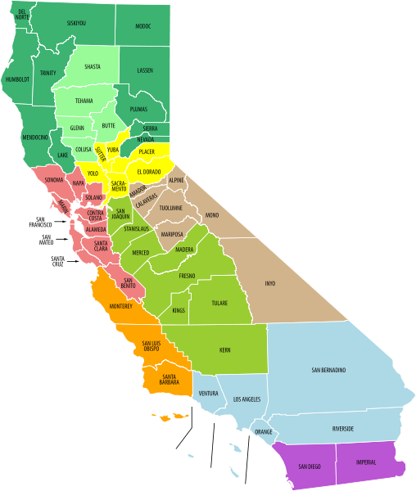
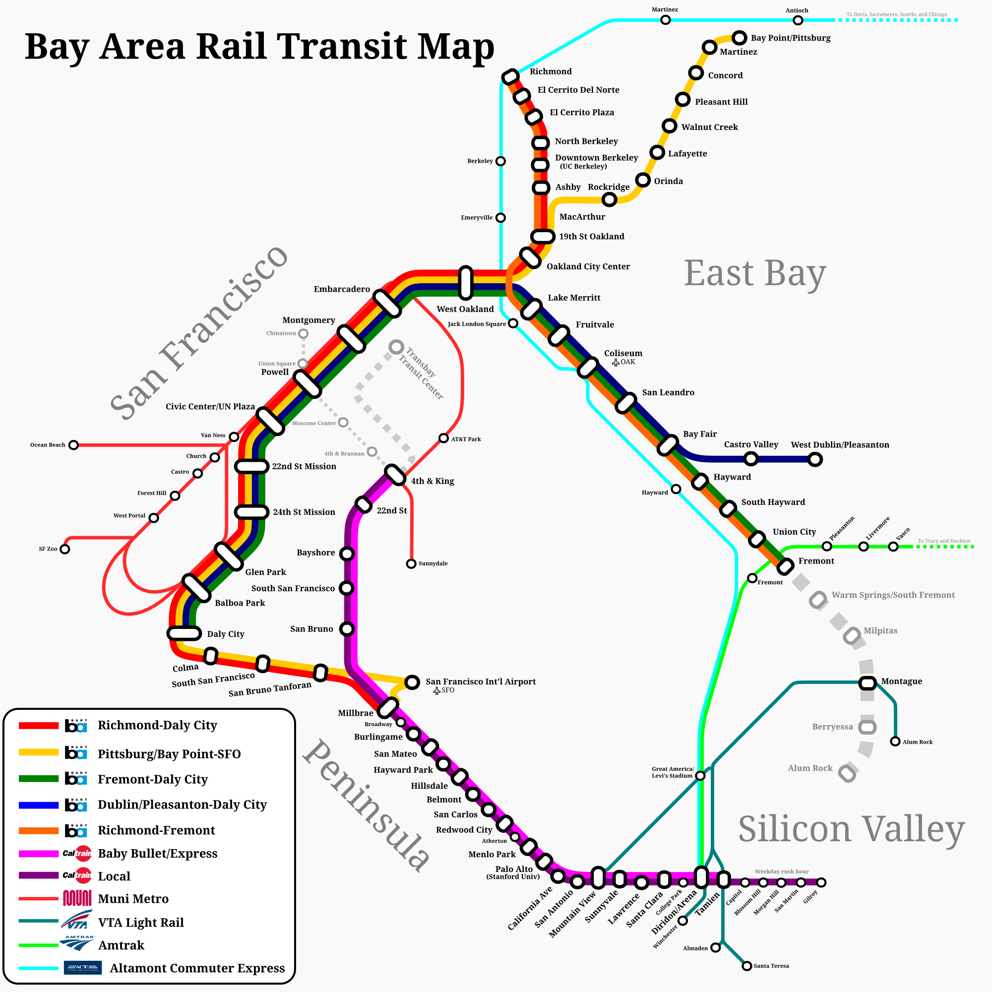
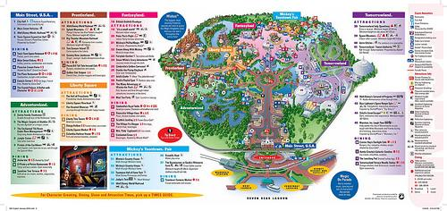
What do we already know about maps?

Slide 3
Why is it important to know the elevation of landforms?

Slide 4
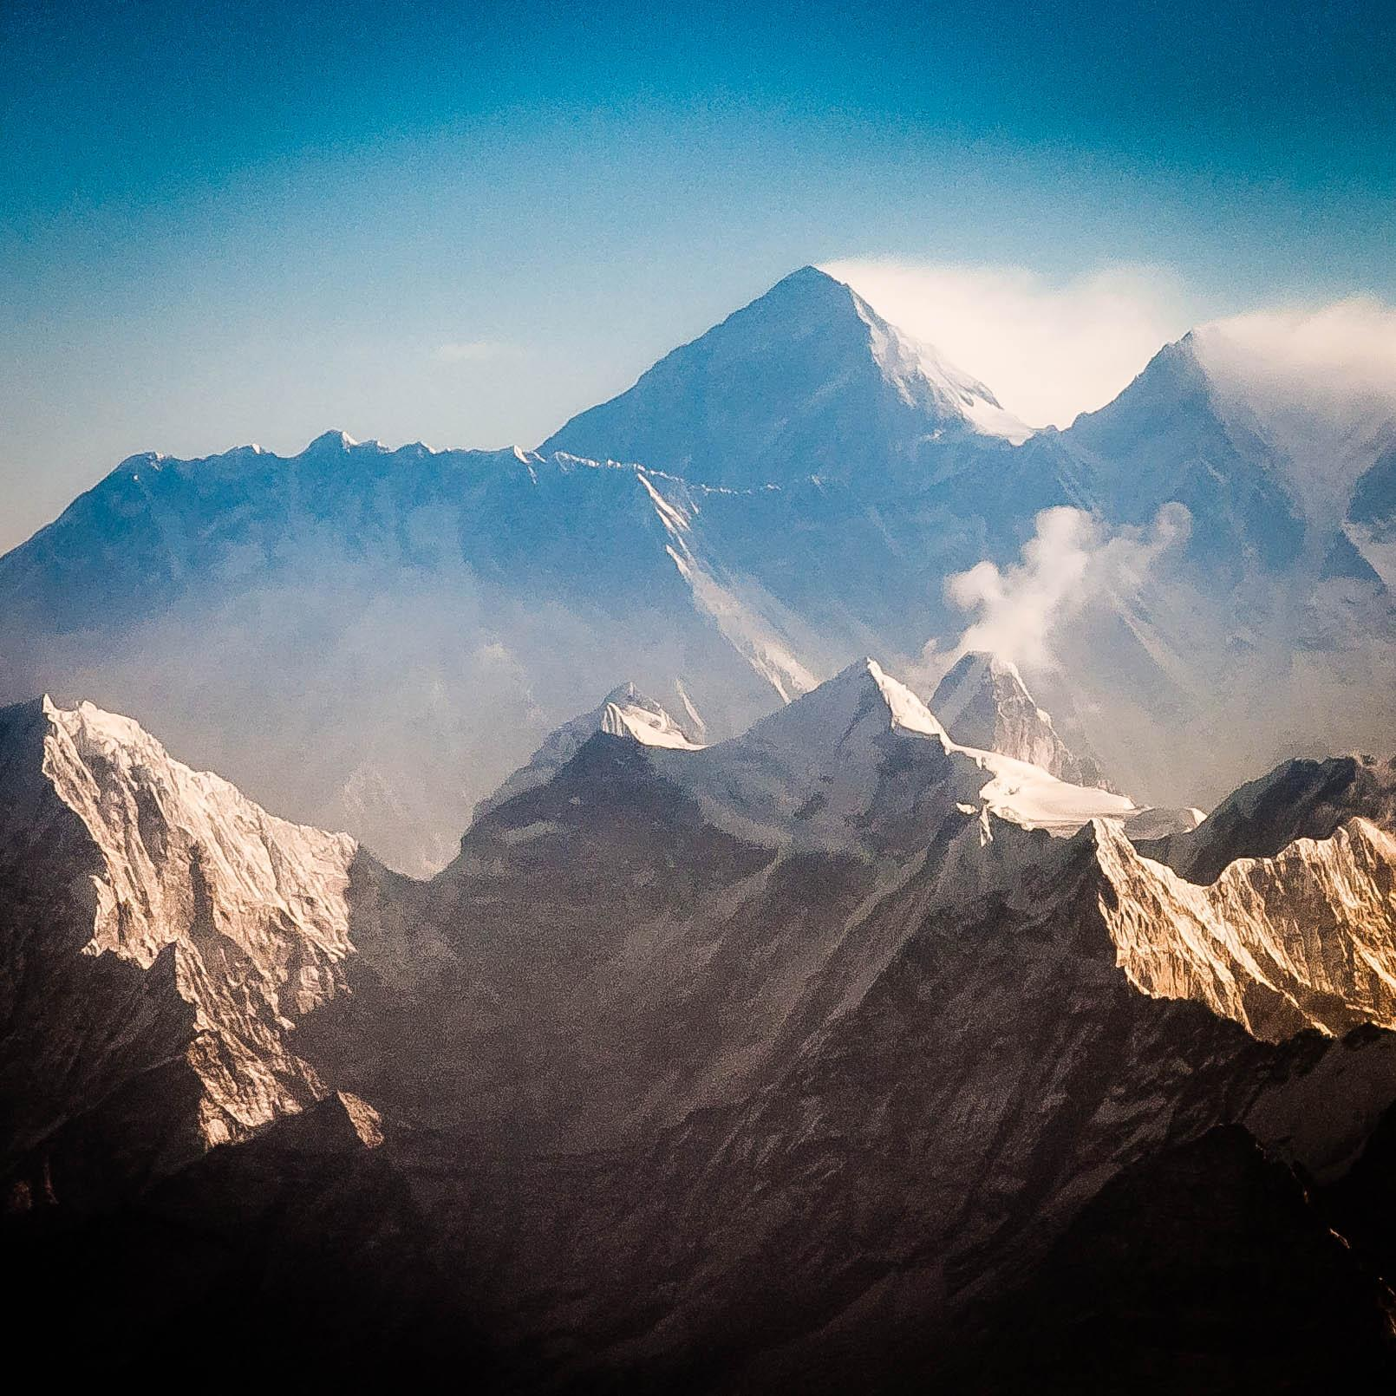
If you’re really tired, would you rather hike here...

Slide 5
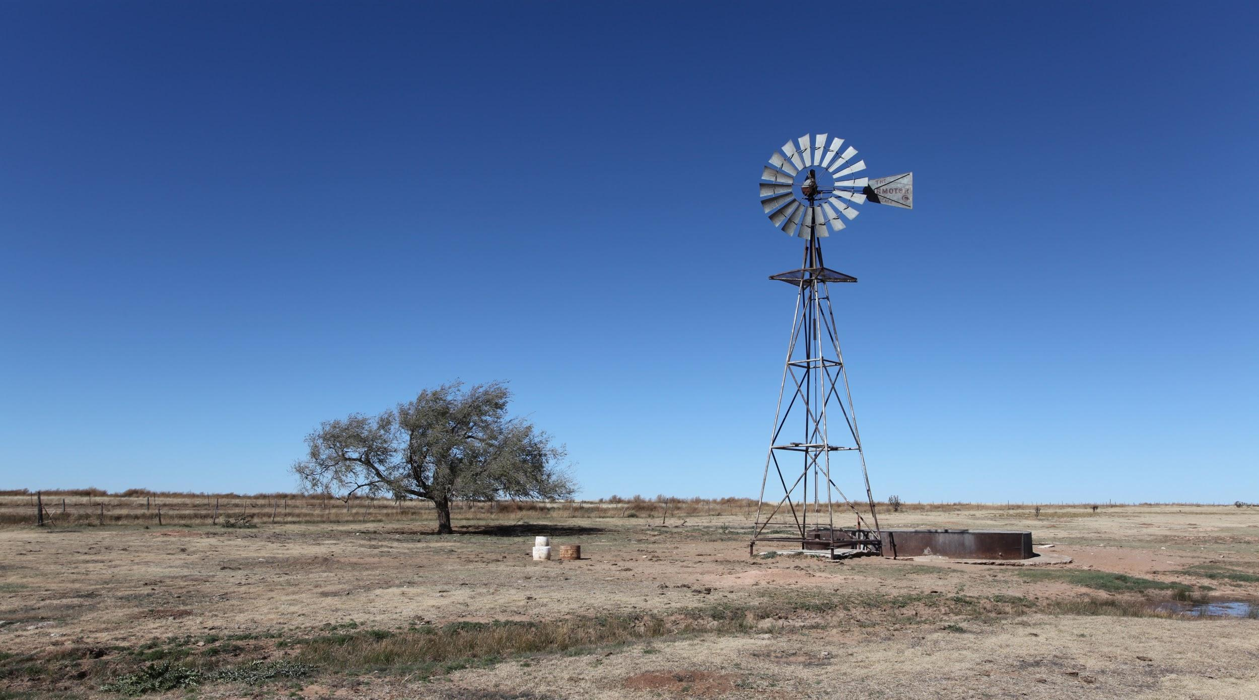
Or here...

Slide 6
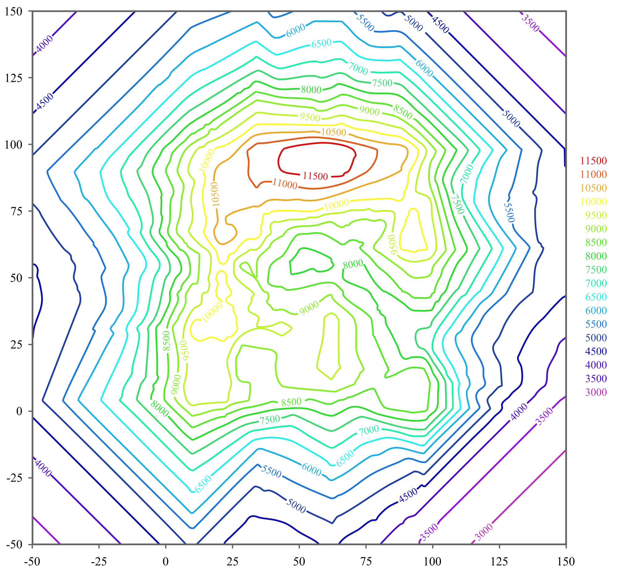
Key Term - Topographic Map
Topographic Map - a map showing the elevated features of Earth’s surface

Slide 7
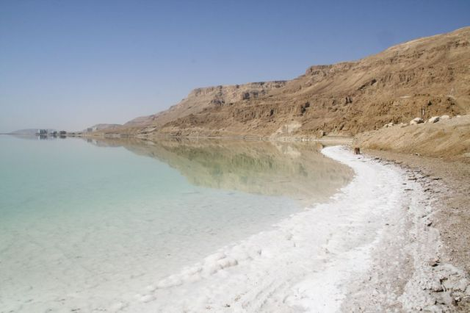
Key Term - Elevation
Elevation - height of land above sea level

Slide 8
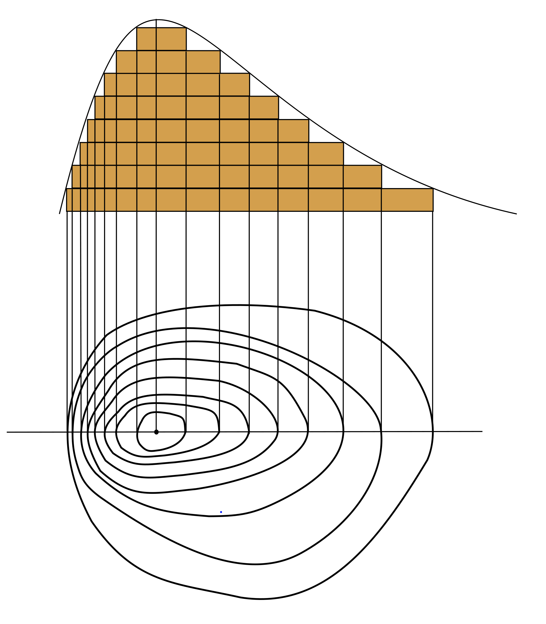
Key Terms - Contour Lines & Contour Interval
Contour Line -
A line on a map joining points of equal elevation above a given sea level.
Contour Interval -
The change in elevation between one contour line and the next is the contour interval.

Slide 9
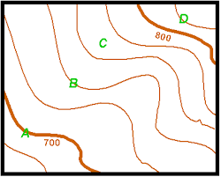

Slide 10
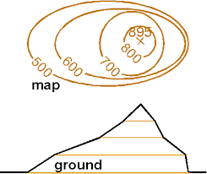

Slide 11
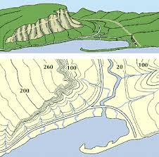

Slide 12
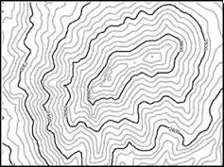

Slide 13
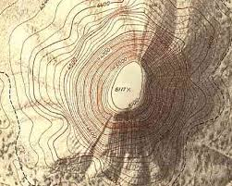

Slide 14
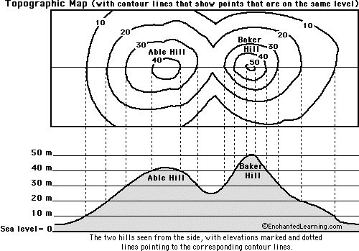
Now you try it!

Slide 15
Share what we know!
What unit of measurement is used?
METERS
What is the contour interval?
10 METERS
Able Hill is
more than 40 METERS, and is less than 50 METERS.
The approximate height above sea level of Able Hill is
42 METERS
Baker Hill is
more than 50 METERS, and is less than 60 METERS.
The approximate height above sea level of Baker Hill is
51 METERS.
Which hill is taller and how do you know?
BAKER HILL
What does a greater distance between contour lines tell us about the slope of the land?
THE GREATER THE DISTANCE BETWEEN CONTOUR LINES, THE MORE GRADUAL THE SLOPE.
What does a closer distance between contour lines tell us about the slope of the land?
THE CLOSER THE LINES, THE SHARPER THE SLOPE.

Slide 16
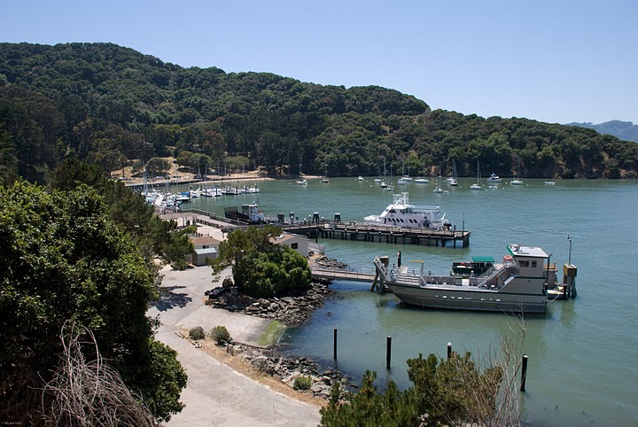
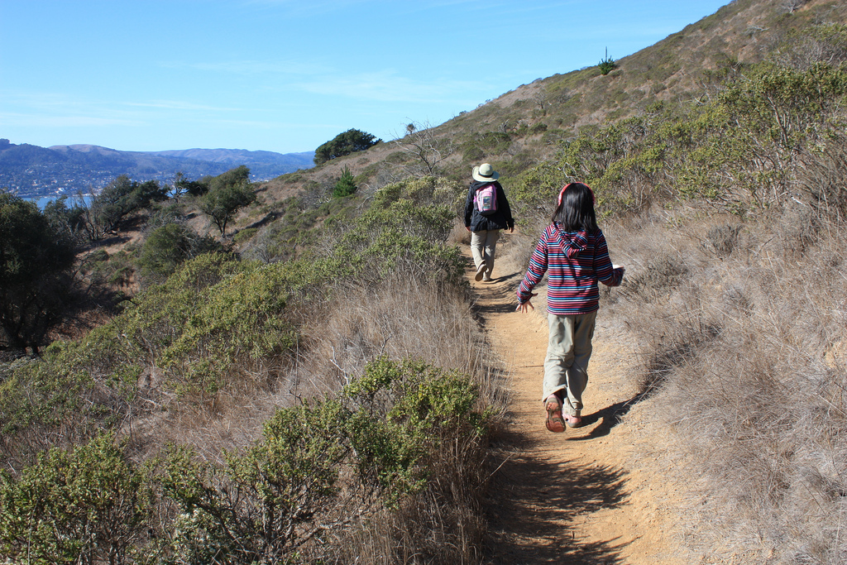
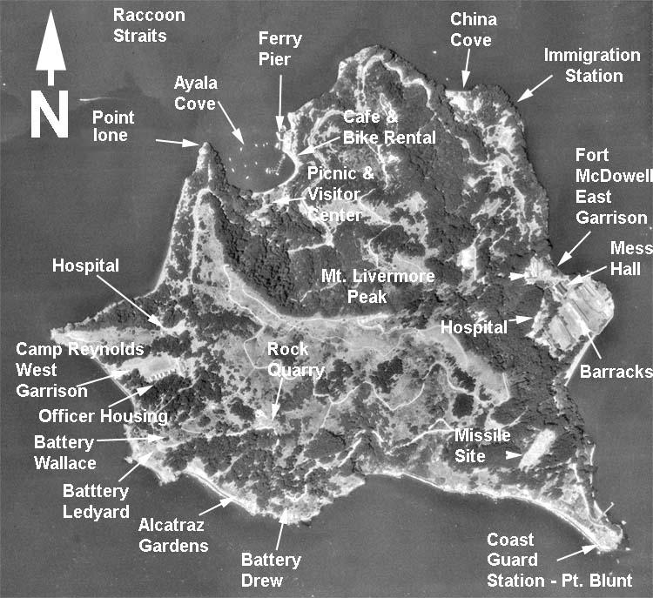
Angel Island
Angel Island is an interesting island. It is the largest natural island in the San Francisco Bay. The island has a rich history. It was a seasonal hunting and gathering location for the Coast Miwok Indians. Later, an immigration station was established on the island where many Chinese immigrants were processed. During World War II, both Japanese and German prisoners of war were detained on the island before being sent elsewhere. Many US Troops were processed on the island either leaving for or returning from service. At one time, Angel Island was even a cattle ranch. In 1954, the process for the island to become a California State Park began. One side of the island was open to visitors. By the early 1960s, the entire island was a California State Park. Today, you can visit Angel Island to enjoy many activities like riding your bike, going on a hike, or enjoying a picnic with your family.

Slide 17
Directions:
Cut out map.
Tape the map to the inside of 1 plastic lid. Turn the lid over so the edges of the container are touching the table like an upside down bowl. You should be able to see the map.
Organize the 8 lids. Place the lid with the map on it on the table. Stack the next lid on top after you rotate it one time. Stack the next lid in the same position as the first. Continue stacking and rotating the direction. It is important to do this, so there will be some distance between lids, otherwise they’ll stack flat.
Set the organized stack aside, except for the first one with the map.
Use a sharpie marker and label the elevation at sea level - 0ft. on the first lid. Write 0ft. in the upper left corner. Then, trace the contour line at sea level. This is the outermost line around the island.
Stack the next lid on top - Be sure it does not lay flat against the first lid. Then, write the elevation in the left corner, slightly below the 0ft. Write 100ft. Trace the 100ft. contour line around the island.
Remove the 100ft. lid and set aside.
Continue stacking the next lid on top and continue writing the elevation on the left side a little bit below the previous elevation. Continue tracing the contour lines for each elevation until 700ft. One unit of elevation for each lid. Use the bottom lid with the map as your guide for each elevation.
Tip: You may need to stack and restack as you work to be sure your lines and elevation marks are where they should be
On the last lid, elevation 700ft., write ANGEL ISLAND at the top. Draw a compass rose and a key. Write your name and number wherever you think it should be.

Slide 18
Write in your Science Notebook:
What did you learn during this lesson?
Think about: Topographic maps, elevation, contour lines and intervals, Angel Island, compass rose, map key, units of measurement, etc.
What else do you wonder about these topics?

